Slide 1
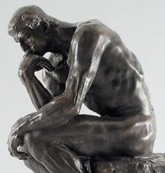
Week 4: Modern Philosophies
EDUC 300/ CORE 310
Knight Chapter 4
Dr. S. Holtrop

Slide 2
Learning Objectives for This Week
The philosophies this week are Pragmatism and Existentialism.
The student will …
Understand basic concepts about the two philosophies.
Be able to apply useful components of the two philosophies to his/her intended educational situation.
Compare and contrast the two philosophies and critique them from a Christian perspective.

Slide 3
Some basics on the 2 philosophies see analytical chart (on Canvas)
 | Pragmatism | Existentialism
In a nutshell | Practical-ness (American) | Revolt against trad. philos.
Who? | Dewey, Wm James, | Kierkegaard, Nietzsche, Sartre
Main emphases or essential concepts | People can know what their senses experience. | Existence before essence. Individualism.
View of truth (What is real?) | The cave is all we have. Truth is what works. Truth is relative. | Truth as choice. You are what you choose to be. Sartre: Man is nothing else but what he makes of himself.
View of values | Beliefs are private. Ethically good is what works. Six of the Ten Commandments work for all. | All about individual choice. Knight: Frightful task of producing values out of nothing. Sartre: condemned to be free.
View of aesthetics | Concepts of beauty depend on how people feel about something. | Revolt against public standard. What is beautiful to me is beautiful, and who can contradict me?
See analytical chart (handout)
7:00

Slide 4
Some basics on the 2 philosophies see analytical chart (on Canvas)
 | Pragmatism | Existentialism
View of the student | Students have experiences, solve problems, adapt to changing world. Felt needs. | Students are free agents and shouldn’t be forced to be cogs in the machine. Unique individuality.
View of the teacher | Teachers are more experienced fellow travelers | Facilitator.
View of the curriculum (Best subjects? Why?) | Students at the center. Problem solving. Thematic units. Field trips. Project method. Process. | Student choice. Many options. Literature and the arts. Avoid uniformity.
Purpose of education | Learn process. Participate in the democracy of learning. Learn how to change society. | Foster creativity in the individual. Find ways to provide choices to students. Help them explore great ideas esp. in lit. & art.
View of work/ calling | Do something to help society. | Be yourself. Just for yourself.
See analytical chart (handout)
7:00

Slide 5
Review and Extension 3-minute Group Conference Use the filled out analytical charts to help you find similarities between the traditional and the modern philosophies:
 | Pragmatism | Existentialism
Idealism
Realism
Neo-Scholasticism
7:05

Slide 6
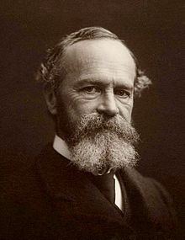
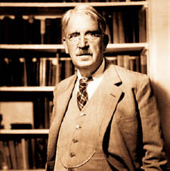
Pragmatism
How is vocational education (tech, career ed.) an example of pragmatism?
What would a pragmatist say about standardized testing?
What would a pragmatist say about arming teachers with guns?
Who is the authority in a pragmatist classroom?
John Dewey
William James
Philosopher, psychologist, physician. Taught first psych course in America.

Slide 7
Discussion Forum Questions -- Pragmatism
I'm slightly confused about if pragmatism is based on wanting absolute truths or if it is the opposite.
How do pragmatists view emotions? For example, does it consider emotions or intuition valid tests of truth or moral values?
What is the best way to approach the idea of learning from experiences in a Christian setting, is it something that can be discussed in a Christian setting without eyes rolling?
Dewey
7:15

Slide 8
Discussion Forum Questions -- Pragmatism
Although focusing on students’ needs (instead of the system’s needs) sound like an ideal educational system, is it really possible to meet every student’s needs and interests in a school setting?
Knight states, “For the pragmatist, the school experience is a part of life, rather than a preparation for life” (71). In that vein, why would the pragmatist want “school” at all? Why not just let children live life without bringing them to a school building for 8 hours a day, five days a week? Is the purpose of school purely to house kids so their parents can work in this view?
Dewey
7:15

Slide 9
Think-Pair-Share
Come up with an example of pragmatism in your own schooling.
E.g., an example of pragmatism could be student choice of reading materials in middle school.
Do you think your teacher realized the influence of this –ism at the time?
7:20

Slide 10
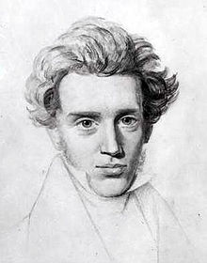
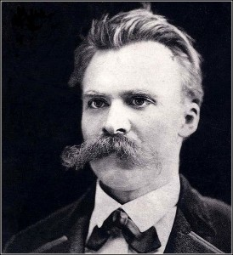
Existentialism
Søren Aabye Kierkegaard was a Danish Christian philosopher, theologian, poet, social critic and religious author who is widely considered to be the first existentialist philosopher.
Born: May 5, 1813, Denmark–Norway
Died: November 11, 1855, Copenhagen, Denmark
Influenced: Jacques Derrida, Paul Tillich, Karl Barth
Friedrich Wilhelm Nietzsche was a German philosopher, cultural critic, poet, philologist, and Latin and Greek scholar whose work has exerted a profound influence on Western philosophy and modern intellectual history. Wikipedia
Born: October 15, 1844, Röcken, Germany
Died: August 25, 1900, Weimar, Germany
Influenced: André Gide, Maurice Barrès, Oscar Levy

Slide 11
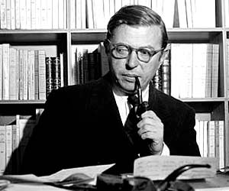
Existentialism
Sartre
Jean Paul Sartre
(1905-1980)
Listen to Jean-Paul Sartre - In Our Time BBC Radio 4 (1 min.)
https://www.youtube.com/watch?v=CJm31WIYTOs
And Sartre in Ten Minutes (1 min 30 sec):
https://www.youtube.com/watch?v=_ba3kvofvyg

Slide 12
Existentialism
Explain: “Existence precedes essence.”
How is school choice an existential concept?
Would an existential feminist say that most college-educated women should try to be managers and bosses or that educated women are free to choose to be at-home moms if they want?

Slide 13
Discussion Forum Questions -- Existentialism
Since the existentialist believe each person is in need of a different education what would they propose?
How do we find a balance in teaching our students absolute truth (which aligns with our Biblical view of truth), but also letting our students discover multiple answers or more than one truth?
In our search for how to teach biblically, can we and do we err too heavily on the side of existentialism (and not enough of a universal standard)?
What is the most important take-away for Christian educators from the philosophy of existentialism?
Are philosophies like existentialism as popular/ prevalent in other countries and cultures?
Sartre
7:25

Slide 14
Think-Pair-Share
Come up with an example of existentialism in your own schooling.
Do you think your teacher realized the influence of this –ism at the time?
7:30

Slide 15
Phone Poll
If you had to do a field experience in one of the following, which would you choose?
A school focusing on pragmatism
A school focusing on existentialism
7:45

Slide 16
7:45
Notes:
If you had to do a field experience in one of the following, which would you choose? https://www.polleverywhere.com/multiple_choice_polls/OWBBOYADU8MZcWe

Slide 17
Fall 2014 Results…
7:45

Slide 18
Fall 2015 Results

Slide 19
Fall 2016 Results…

Slide 20
Jigsaw: In small groups, evaluate each philosophy’s compatibility with Christianity
 | Pragmatism | Existentialism
Pros (useful for teachers?)
Cons
Compatibility w/ Chr. worldview
Incompatibility w/ Chr. worldview
Implications for: curriculum design methods of instruction assessment classroom management
8:00

