Slide 1
Week 10 Knight Chapter 10 Personal PoE & Christian Approach
Dr. S. Holtrop
Spring 2017
6:54

Slide 2
Building a Christian philosophy of education
What is your biblically-based view of…
What is real (metaphysics)
Truth, what is knowable (epistemology)
Values - ethical and aesthetic (axiology)
The student (image of God, calling)
The teacher (calling, image of God)
The curriculum (truth or exploration?)
Purpose of education
Work (calling, incl. avocations)
What methods and curriculum choices can support this view? E.g.:
Content knowledge
Critical thinking skills & practice
Communication skills & practice
Problem solving skills & practice
Cooperative learning skills & practice
Citizenship/kingdom service skills & practice
Stewardship skills & practice
Glorifier of God skills & practice
Westminster Shorter Catechism
(What is the chief end of man?)
Belonging body & soul to Jesus Christ
Heidelberg Catechism
(What is your only comfort in life and death?)
Prophet, priest, and king
1 Peter 2:9
Is it OK that Christian education focused on Christian curriculum when the culture focused on curriculum and shifted more toward Christian student outcomes when the culture focused on student outcomes?
6:57

Slide 3
“Through-Lines” (used in some schools) Is the emphasis here on knowing or doing? Curriculum or student?
1. God-Worshipper: | Students will understand that worshipping God is about celebrating who God is, what God has done and is doing, and what God has created.
2. Idolatry-Discerner: | Students need to learn to 'read' a worldview by asking questions about what is being portrayed in regard to culture, values, and belief systems.
3. Earth-Keeper: | Students will respond to God's call to be stewards of all of creation.
4. Beauty-Creator: | Students will create beauty that praises God and enriches our world. Creation shouts that our God is a God who loves diversity, complexity, and creativity.
5. Justice-Seeker: | Students will act as agents of restoration.
6. Creation-Enjoyer: | Students will celebrate God's beautiful creation and give testimony to the presence of God in creation.
7. Servant-Worker: | Students will work actively to heal brokenness and bring joy to individuals and to culture.
8. Community-Builder: | Students will be active pursuers and builders of community in their classrooms, their neighborhoods, and in the global village they are a part of.
9. Image-Reflector: | Students bear the image of God in their daily lives. Being an image-bearer isn't something we DO. It is deeper than that. Image-bearer is something we ARE. We reflect God's image and we learn to see God's image in others.
10. Order-Discoverer: | Students see God's fingerprints all over creation.
See also: http://www.christian.fmpsdschools.ca/Teaching%20For%20Transformation.php (Fort McMurray Christian School, Fort McMurray, Alberta)
7:00

Slide 4
Different Christian Approaches
 | Christianity Against Culture | Christianity Sold Out to Culture | Kingdom Building Here & in the Future
View of the Student | Sinner, needs firm guidance and discipline | Potentially perfect human, inherently curious “image of God” that resembles humanistic blank slate | Responsible agent, can become a positive agent of change in God’s creation
View of Knowledge & the Curriculum | Stick to the classics – less risk of being tainted by the world, “integrated” curriculum | Embrace modern curriculum & methods, Christianize them, focus on acting out faith in social justice projects | Learning how to live out a biblical worldview in all areas of life—real issues. Don’t shun culture or try to Christianize it.
View of the Teacher | Authoritarian, knowledge expert | More permissive, fellow traveler, “guide on the side” | More experienced, expertly trained coach with divine calling—authoritative, situational management
View of Work & Avocations | Training for a job – maybe a “good” job to be able to support family & church obligations. Avocation is often evangelistic. | Do everything to the glory of God, focus on excellence, enjoy the blessings you’ve earned | Different opportunities to transform/redeem culture instead of shunning it or just accepting it.
7:03

Slide 5
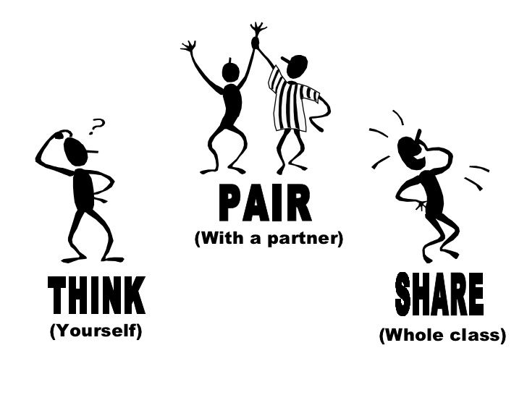
Student Questions ~ Teaching as Ministry ~ do 1 Q this slide + 1 Q next 2 slides
In this chapter, Knight speaks about how teacher’s purpose is to “seek and save that which is lost”. What do we do when we have students who do not want to be saved? Students who are against the faith or even atheists.
What would it look like in a public school for a teacher to save that which is lost when they have immense restrictions put on them?
If a student asks about God in a public school what are the steps that you can take to help with that?
How can teachers show service to others (“the essence of Christian love and Christlike character”) in our profession?

Slide 6
Student Questions ~ Teaching as Ministry
If a student rejects God in front of the class or rejects your views of God, what is the right way to handle the situation?
How can a teacher who has stumbled in their position in the front of a classroom regain the trust of the students?
Seeing how effective these three teaching strategies were for Jesus (captivating, illustrations, questions), why aren't these the primary basis for approaching our classrooms?

Slide 7
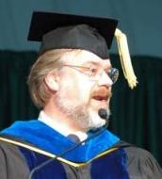
Prof’s Questions ~ Teaching as Ministry
Why is the view of the student so crucial for all of this? Is the student good or bad?
How is the following statement different from what is typically meant by “mission”?
“The entire process entails a restoration of the image of God in individuals through the agency of the Holy Spirit. Education is one arm of God’s restorative and reconciling effort. It may therefore be seen as a redemptive activity.” (p. 207)
Look at the primary and secondary purposes of education on p. 213. How do these work together?
Are students better equipped to be reconcilers if we have addressed their character development, knowledge acquisition, job preparation, and their social, emotional, and physical health? Do these things make them more spiritually healthy and able to work toward reconciliation in God’s kingdom?

Slide 8
Student Questions ~ Christian view of Curriculum~ do 1 Q this slide + 1 Q next 2 slides
If you aren't going into a teaching career, what do you value most about the education you have gotten already or what do you value in the education of your future kids based on a Christian approach?
“The teaching of any topic in a Christian school is not a modification of the approach used in non-Christian schools. It is rather a radical reorientation of that topic within the philosophical framework of Christianity.” What does this radical reorientation look like?
How does a Christian school check themselves to make sure that they are maintaining a Christian focus in how they educate their students?

Slide 9
Prof’s Questions ~ Christian view of Curriculum
Explain these quotations:
“Nuclear physics is not explained in the Bible. That, however, does not mean that nuclear physics is not connected with God’s natural laws and that it does not have moral and ethical implications…” (p. 225).
“Much truth exists outside of the Bible, but it is important to note that no truth exists outside the metaphysical framework of the Bible.” (p. 226)
Special and general revelation – “both shed light on each other, since all truth has its origin in God.” (p. 228)

Slide 10
Prof’s Questions ~ Christian view of Curriculum
What insights can you gain from Knight’s methods section (pp. 245-253) for teaching strategies in your content area?
What’s the “informal” (or “hidden”) curriculum (p. 240)? The “null” curriculum (p. 242)?
Explain this quotation: “Christian education and the Christian school must therefore be seen in terms of both the conservative and revolutionary roles of Christianity.” (p. 254)

Slide 11
Knight’s approach to teaching literature ~ replicate in content area groups (Business/Math, Biology, Social Studies, The Arts?)
Decide which parts of the content area to include in the curriculum (p. 229). In literature, this means deciding which short stories, poems, novels, and plays to study. What does this mean in your assigned/chosen content area? Give some specific examples of age-appropriate and restoration-appropriate content and how you decided to include this content.
Knight implies that reading literature just for escape, enjoyment, or to be “educated” is misguided and is not the main point (p. 231). What aspects of learning your content area are analogous to these misguided aspects of studying literature? What *is* the main point of studying your content area?
Knight says, “The study of literature in a Christian institution can be richer than similar study in non-Christian institutions” (p. 232). Can you say the same about your content area? Why?

Slide 12
Knight’s approach to teaching literature ~ replicate in content area groups (Business/Math, Biology, Social Studies, The Arts?)
Knight says, “The essential thing in literary study is not the passing on of a body of knowledge, but the development of a skill—the ability to think critically and to interpret literary insights from the perspective of the biblical worldview” (p. 233). What would be the essential thing in your content area?
Knight says worldviews are often subliminal and accepted without challenge (p. 234). What are some widely accepted “biases and assumptions” (p. 238) in your content area? How can a biblical framework (p. 237) help avoid hidden biases and assumptions in your content area?

Slide 13
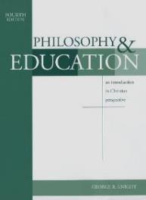
Final Knight quotations
“Even the search for correct doctrine and a unified theology can become a game that shuts us away from God. The only integration point for the Christian individual and the Christian school is Jesus Christ.” (p. 244)
“Life is meaningless outside of Christ…. People profit nothing if they gain the whole world and lose their souls. From this perspective, Christian educational goals are broader than those of secularized education, since Christian education seeks to prepare the young for both the present world and the world to come.” (p. 259)
The incarnate Word is with us, is still speaking, is present always, yet leaves no sign but everything that is.
--Wendell Berry

