Slide 1
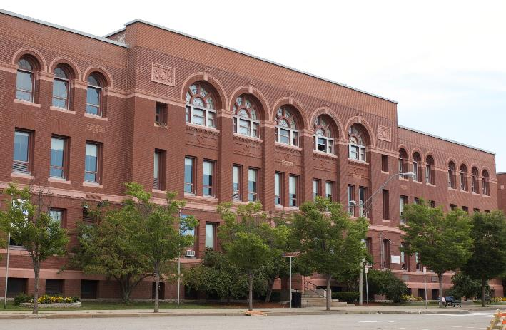
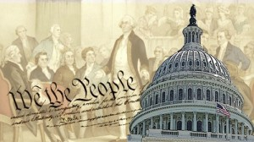
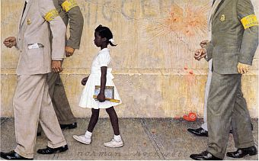
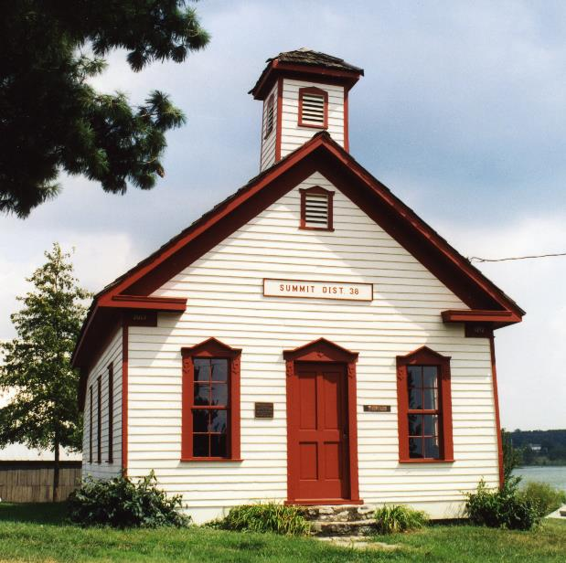
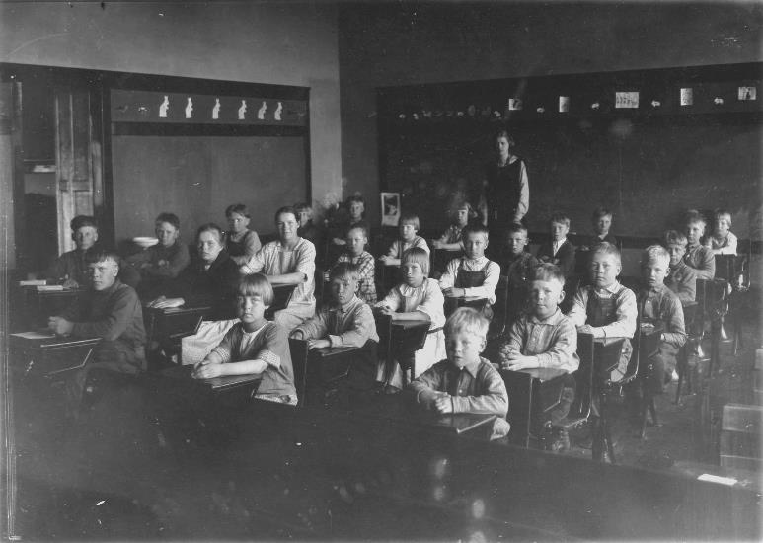
History of Education
EDUC 300 & CORE 310
Dr. Stephen D. Holtrop
Dordt College
Sept. 27, 2016

Slide 2
Before we launch into the history of American education, are there any questions on the
–isms from last week?
Progressivism (experiential) Dewey student-centered
Humanism (humane education) Glasser & Maslow student-centered
Perennialism (Great Books) Adler, Bloom curriculum-centered
Essentialism (back to basics) Hirsch curriculum-centered
Reconstructionism (fix the world)
Futurism (prepare students) Toffler
Critical Pedagogy (Marxist) McClaren
Behaviorism (scientific behavior mod.) Skinner, Pavlov
Deschooling (“the good life”) Illich
Homeschooling, Unschooling
(choices) Holt

Slide 3
Group presentations on historical eras [next week]
(Review the following slides on the eras.)
Groups will discuss one of the historical eras and give a short presentation during the next two class times. Groups should discuss and present on:
Main issues and events of the historical era
Pros and cons of the era
Address issues and questions on the following slides
Evidence (if any) of the prevailing attitudes in the era
toward:
  The view of the student
  The view of the teacher
  The view of the curriculum
  The view of work
  Values
Each member of a group should participate in the
presentation.

Slide 4
Groups:
Colonial Era
Age of Reform – Common School Era
Progressive Era
Public High School Era
Post-WWII Equity Era
Equal-Rights Era
Reform & Standards Era

Slide 5
Proposal regarding Chapters 5 & 7 [next week]
Read:
Knight, Chapter 5 “The Postmodern Impulse” pp. 89-102 (13 pp.)
Knight, Chapter 7 “Analytic Philosophy and Education” pp. 147-160 (13 pp.)
Discussion Forum 6:
Just write two burning questions, one on each chapter.
Do not do the paragraphs proving you read it and applied it to your own educational situations.
7:00

Slide 6

Midterm Test ~ General Information [in 2 weeks]
Due: Oct. 11 at 9:45 pm. Covers court cases, historical eras, and Knight chapters 1-7.
Format: This test is open-book, open-notes. Please put your full name at the top of your document. Number your answers to correspond to the questions. I also would appreciate headings in each essay to show transitions to new court cases, historical eras, or new philosophical components. Do not worry about term-paper-perfect spelling, punctuation, and grammar, but make sure your sentences make sense. Please save your three essays in a single Word or PDF document and submit on the Canvas course site by 9:45pm on Oct. 11.
Content: Essays will deal with court cases, history of education, and philosophies from all three categories studied: traditional, modern and postmodern, and contemporary (which includes Chap. 7, Analytic Philosophy). The essay questions will ask you to compare
and contrast specifics among philosophies, bring in personal examples at times, and
evaluate the philosophies through a Christian lens.
See study guide (Word doc) on Canvas – in Modules, under Week 5.

Slide 7

History of education
Goals:
Understand the significant events for each era
Evaluate how each era viewed students, teachers, curriculum, knowledge, work, and values
Analyze trend data in American education and evaluate "The American Experiment"

Slide 8
History of Education
Eras:
Colonial education (education in the
North vs. education in the South)
The Common School era (include
assumptions held by opposition groups)
The Progressive Movement (Dewey and others)
  The Public High School (including the curriculum battles)
The Post-War (WWII) Era (evidenced in the expansion of education)
  The Equal-Rights Era (evidenced in unequal access)
The Reform and Standards Era (including competing goals)

Slide 9
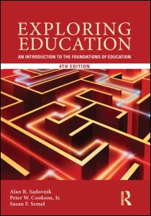
Citation for History of Education PDF
“History of Education” Chapter 3 from:
By Alan R. Sadovnik, Peter W. Cookson, Jr., Susan F. Semel
2013
Exploring Education: An Introduction to the Foundations of Education, 4th Edition
Routledge

Slide 10
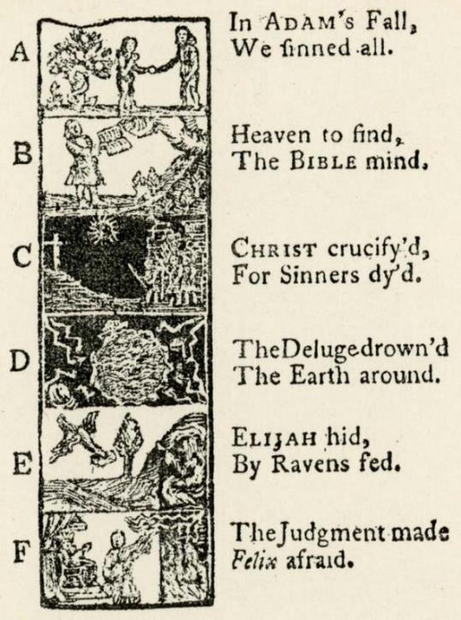
Colonial education
History/Colonial
Groups: Please address these issues…
Why were nine universities started in the colonies before 1776?
Explain The Old Deluder Satan Law. What’s the perspective on education here? Why didn’t many towns establish these dame schools?
Why do we have the phrase “back to basics” when colonial schools offered public speaking, art, surveying, navigation, and modern foreign languages? What’s the perspective on education here?
Why did reading the classics work for sons of the elite but not girls, regular folks, or native Americans? What conflicting perspectives were at work here?
How did the Quakers differ in their perspectives? Results?
What were the main perspectives on educating slaves?
How were each of these debated in this era?
    View of the student, teacher, curriculum, knowledge, work, values
7:15

Slide 11

Your Qs on Colonial education
Why did people not implement Ben Franklin’s ideas sooner? It seems like he was spot on in his ideas about what education should be. How do you think each era would feel about our current education system today? Would they approve, disapprove, or be completely disgusted?
Do you think that teaching in the way of the colonial era would still work today for certain kids? There are still some kids today that would need discipline like that, would that work for them?

Slide 12
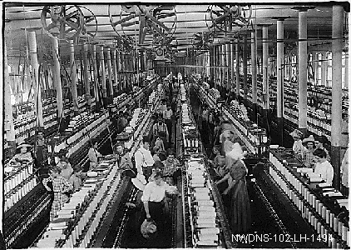
The Common School era
History/Common School
Groups: Please address these issues…
How did the Industrial Revolution affect education? What perspectives on education prevailed as schools adjusted to…
  Factories
  Urban growth
  Immigrants
  Right to vote
  Social reform
How were each of these debated in this
era?
    View of the student, teacher,
    curriculum, knowledge, work, values

Slide 13
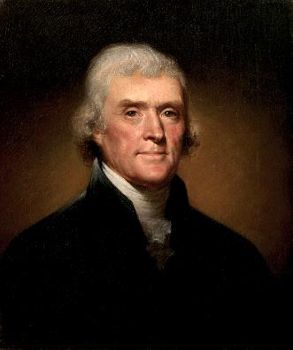
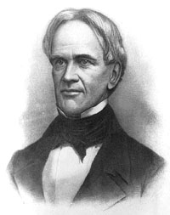
The Common School era
History/Common School
How is Horace Mann’s perspective similar to
Thomas Jefferson’s? How are they different?
  Is American education actually
  “the great equalizer”?
Which groups were opposed to free public education? Why?
Which groups of students were not benefitting as much from all this educational progress? What perspectives were missing, according to these groups, in the mainstream educational system?
How were each of these debated in this era?
    View of the student, teacher, curriculum, knowledge, work, values
Groups: Please address these issues…

Slide 14

Your Qs on the Common School era
How is it that Christianity was a large focus of the literacy in the education system when many people were not Christians, but had other religions?

Slide 15
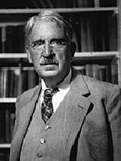
The Progressive Movement
History/Progressive Movement
How does the Progressive Movement remind you of some education problems today? How did schools change to accommodate society’s changes?
What were some of John Dewey’s main perspectives?
In what ways was Dewey misunderstood?
How might our perspectives today be different from those of the Progressive Movement?
How were each of these debated in this era?
    View of the student, teacher, curriculum, knowledge, work, values
Groups: Please address these issues…
7:30

Slide 16

Your Qs on the Progressive Movement
Why does utilitarianism looked at as a negative in most settings when it seems like it is something that would be very beneficial to the student because they are learning then all utility things?

Slide 17
The Public High School
History/Public High School
Why was the shift from selective high schools to
compulsory high schools so monumental?
    Clashing perspectives. (What is today’s similar
    debate?)
  Classical subjects vs. modern subjects
  (Latin & Greek vs. science & English)
  College entrance requirements
  Preparation for life
  Common curriculum
What big economic phenomenon occurred in this period and how do you think it affected education?
How were each of these debated in this era?
    View of the student, teacher, curriculum, knowledge, work, values
Groups: Please address these issues…

Slide 18
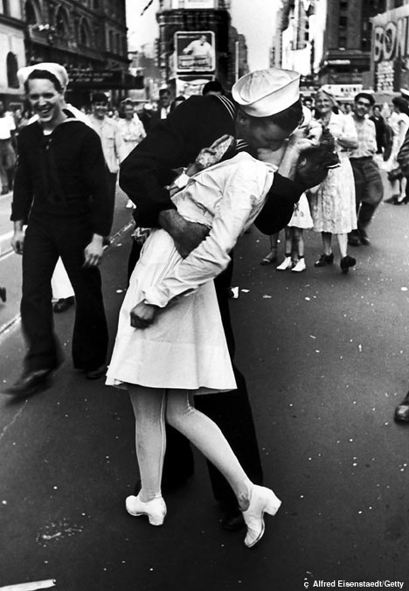
The Post-War (WWII) Era
History/Post-War
Why are equity and excellence seen as competing
principles?
    Why would student-centered schooling be in such
    contrast to knowledge-centered schooling? How do these differing perspectives affect the view of the student, curriculum, knowledge, work, and values?
    Unpack this charge: Progressive education sacrificed
    intellectual goals for social goals (p. 74).
    Does education track poor and working class children into nonacademic vocational programs (tracking, laning)? Critique this.
How were each of these debated in this era?
    View of the student, teacher, curriculum, knowledge, work, values
Groups: Please address these issues…

Slide 19

The Post-War (WWII) Era
History/Post-War
    What happened to American education after Sputnik (1957)? What caused a recent resurgence in STEM emphases?
    How did civil rights, the antiwar movement, and poverty affect American education?
    What overall effect did all this social unrest have on teaching methods in high schools and colleges? Speculate reasons.
    Which Post-War government program did a lot for college enrollments?
How were each of these debated in this era?
    View of student, teacher, curriculum, knowledge, work, value
Groups: Please address these issues…

Slide 20

Your Qs on The Post-War (WWII) Era
Is there an element of choice that was lost in the Age of Reform and Post World Wars Era? Was that a disservice to education at the time?
Do you agree that era's can go into multiple categories? Which eras would it be harder to be a teacher or be the student?
7:45

Slide 21
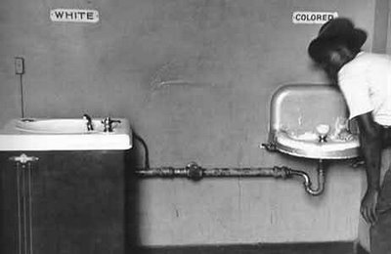
The Equal-Rights Era
History/Equal-Rights
Recall existing precedent of racial segregation
Plessy v. Ferguson (1896)
Plessy (P) attempted to sit in an all-white railroad car. After
refusing to sit in the black railway carriage car, Plessy was
arrested for violating an 1890 Louisiana statute that provided
for segregated “separate but equal” railroad accommodations. Those using facilities not designated for their race were criminally liable under the statute.
At trial with Justice John H. Ferguson (D) presiding, Plessy was found guilty on the grounds that the law was a reasonable exercise of the state’s police powers based upon custom, usage, and tradition in the state. Plessy filed a petition for writs of prohibition and certiorari in the Supreme Court of Louisiana against Ferguson, asserting that segregation stigmatized blacks and stamped them with a badge of inferiority in violation of the Thirteenth and Fourteenth amendments. The court found for Ferguson and the Supreme Court granted cert.
Groups: Please address these issues…

Slide 22
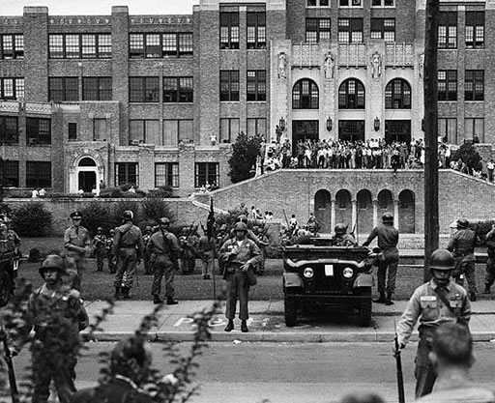
The Equal-Rights Era
Groups: Please address these issues…
Why did the Supreme Court reverse itself in the 1950s?
Brown v. Board of Education (1954)
This case is a consolidation of several different cases from Kansas, South Carolina, Virginia, and Delaware. Several black children (through their legal representatives, Ps) sought admission to public schools that required or permitted segregation based on race. The plaintiffs alleged that segregation was unconstitutional under the Equal Protection Clause of the Fourteenth Amendment.
In all but one case, a three judge federal district court cited Plessy v. Ferguson in denying relief under the “separate but equal” doctrine. On appeal to the Supreme Court, the plaintiffs contended that segregated schools were not and could not be made equal and that they were therefore deprived of equal protection of the laws.
National Guard at desegregation of Little Rock High School, September 26, 1957

Slide 23
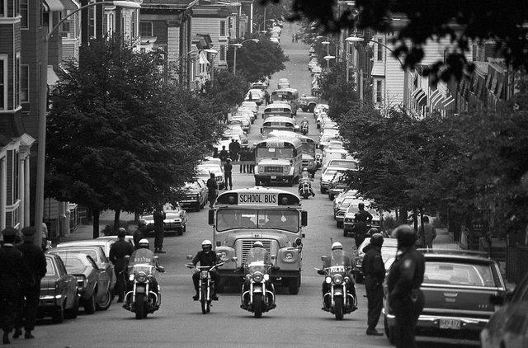
The Equal-Rights Era
History/Equal-Rights
Groups: Please address these issues…
Police-escorted school buses on first day of court-ordered busing, South Boston (1975)
How were each of these debated in this era?
    View of the student, teacher, curriculum, knowledge, work, values

Slide 24

Your Qs on The Equal-Rights Era
It surprised me that it took quite a long time for the idea of equality in education to become expected or normal. What changes are occurring in education today that are influenced by one (or more) of the educational philosophies?
It seemed as though the issue of equity versus excellence kept making it's way into the reading. Should schools place a stronger emphasis on equity or excellence? Is it possible to have a balance between the two?
Do you think that the teachers in the equal rights era were also taught different, causing them to teach at a higher level or a lower level?

Slide 25

The Reform and Standards Era
History/Reform & Standards
Explain the argument that using the schools to ameliorate
social problems resulted in mass mediocrity (p. 81).
A Nation at Risk (1983)
  Claims: High rates of adult illiteracy, declining SAT scores,
  not keeping up with other countries
  “Rising tide of mediocrity”
  "If an unfriendly foreign power had attempted to impose on America the mediocre educational performance that exists today, we might well have viewed it as an act of war.”
  Recommendations:
    New basics: English, math, science, social studies, computer science
    Higher entrance standards for colleges and universities
    Strengthen teacher preparation
    Give teachers more respect and reward
Explain the tension between “excellence” and “equity.”
Groups: Please address these issues…
8:00

Slide 26

The Reform and Standards Era
History/Reform & Standards
Are the schools better as a result of all these reforms?
Clinton:
  Goals 2000 (1994)
Bush:
  No Child Left Behind (2001)
Obama:
  Race to the Top (2009)
  Every Student Succeeds (2015)
What are some pros and cons of the resultant movements?
School choice
Homeschooling
Private schools
Charter schools
Tuition vouchers
Standards movement
  State content standards
  Standardized tests (for teachers and students)
Groups: Please address these issues…
How were each of these debated in this era?
    View of the student, teacher, curriculum, knowledge, work, values

Slide 27

Your Qs on The Reform and Standards Era
Do you think that in the near future we will see any
recurrences of some of the teaching styles from past
historical periods? If so, what styles will we see again?
If not, what new types of teaching styles do you expect
to see in the next couple of decades? (What philosophies
will they emphasize?)
  What are the recurring tensions?
How has changes in how schools are set up and run affected other areas of life? Such as the church as well as economics?
Is it possible to know if the eras directly connect with one -ism, or could multiple -isms relate to the different eras?
From this chapter I was wondering with all the era’s in time which one would be the most influential to the education today as in teaching methods and curriculum design?

Slide 28

History of Education
Review
Can you now…
Understand the significant events for each era?
Evaluate how each era viewed students, teachers, curriculum, knowledge, work, and values?
Any questions on the group presentations on the historical eras next week?
Break 15 min.

