Slide 1
Tonight’s Agenda
Questions: paper, presentation, etc.?
Rubric for the presentation
Education issues
- Groups (jigsaw)
- Class discussion
Break
Course evaluations
Groups prep for next week’s presentations

Slide 2
Groups for final presentations
Social Media
Julianna L, Sarah VW, Michelle N, Carina P, Brittany R
Cooperative Learning (Group Work)
Kathryn C, Brittany H, Mikkel TN, Tracy B
Field Trips
Melinda F, Jodi VO, Amber H, Jessica B
Standards-Based Grading
Megan L, Christy G, Lincoln R, Keana B, Kayla DB
Online Learning (e.g., Khan Academy)
Thomas B, Michael S, Jordyn W, Karina H
Inquiry-Based Learning
JD B, Erica G, Shane S, Joel D

Slide 3
Rubric for final group presentations – 50 points
Concise overview of a teaching method. Philosophical assumptions and historical roots of the method. - 15 points
Philosophical analysis shows awareness of the complexity and depth of the various philosophies. Accurate understanding of the relevant philosophies is apparent. Evaluation of the method is fair and accurate according to the philosophies used. Metaphysics, epistemology, and axiology are included in the analysis. Evaluative statements are adequately supported.
View of the student – 5 points
A defensible philosophical stance on the role of student is clearly presented as part of the analysis of the method and factors into the final evaluation of the method.
View of the teacher – 5 points
A defensible philosophical stance on the role of the teacher is clearly presen -ted as part of the analysis of the method and factors into the final evaluation of the method.
View of curriculum and instruction – 5 points
The method chosen is a commonly used method and broad enough to be evaluated on several philosophical issues. The presentation provides robust philosophical analysis of the method itself as well as of the various apparent philosophical stances often accompanying it.

Slide 4
Rubric for final group presentations
Purpose of education – 5 points
The presentation shows the connection between the method and implied views on the purpose of education.
View of calling / work – 5 points
The presentation shows the connection between the method and implied views on vocation and work.
Quality of presentation – 10 points
The presentation is organized and coherent. Each member of the group had a distinct task in preparation and presentation. (See separate Peer Participation Evaluation form.)* The presentation engages the audience, especially in its style and energy. Thought-provoking questions are included. Absence of writing and technological errors indicates a high level of professional presentation. Technology chosen is appropriate and well designed. The presentation is at least 18 minutes long and not longer than 20.

Slide 5
Issues in Education
How do our philosophies of education inform the dialog on the issues?
Dr. S. Holtrop
ED 300 Philosophy of Education
Fall 2015

Slide 6
Common Core
Multistate education standards
Views of the student
Views of curriculum
Views of purpose of education
Views of the teacher
Influenced by progressivism, constructivism, existentialism, or reconstructivism? Or by a backlash against any of these?
Influenced by perennialism or essentialism? Or a backlash?
Influenced by humanism or behaviorism? Or a backlash?

Slide 7
No Child Left Behind Reform e.g., Elem and Secondary Act – just passed
High-stakes testing and mandated standards/pass rates that proved impossible to reach
Views of the student
Views of curriculum
Views of purpose of education
Views of the teacher
Influenced by progressivism, constructivism, existentialism, or reconstructivism? Or by a backlash against any of these?
Influenced by perennialism or essentialism? Or a backlash?
Influenced by humanism or behaviorism? Or a backlash?

Slide 8
School Lunches Child Nutrition Act needs reauthorization
Requires more fruits and veggies, less salt and processed food
Views of the student
Views of curriculum
Views of purpose of education
Views of the teacher
Influenced by progressivism, constructivism, existentialism, or reconstructivism? Or by a backlash against any of these?
Influenced by perennialism or essentialism? Or a backlash?
Influenced by humanism or behaviorism? Or a backlash?

Slide 9
School Funding Needs reauthorization
Federal grant money esp. to impoverished school districts
Views of the student
Views of curriculum
Views of purpose of education
Views of the teacher
Influenced by progressivism, constructivism, existentialism, or reconstructivism? Or by a backlash against any of these?
Influenced by perennialism or essentialism? Or a backlash?
Influenced by humanism or behaviorism? Or a backlash?

Slide 10
School Choice: Vouchers and Charter Schools
Currently tried on a state- by-state basis with various results
Views of the student
Views of curriculum
Views of purpose of education
Views of the teacher
Influenced by progressivism, constructivism, existentialism, or reconstructivism? Or by a backlash against any of these?
Influenced by perennialism or essentialism? Or a backlash?
Influenced by humanism or behaviorism? Or a backlash?

Slide 11
Achievement Gaps
Persistent data contrasts for minorities, low SES, and girls (in math and science), the “school to prison pipeline”!
Views of the student
Views of curriculum
Views of purpose of education
Views of the teacher
Influenced by progressivism, constructivism, existentialism, or reconstructivism? Or by a backlash against any of these?
Influenced by perennialism or essentialism? Or a backlash?
Influenced by humanism or behaviorism? Or a backlash?

Slide 12
Career and Technical Education
College-Prep vs. Voc-Ed
Views of the student
Views of curriculum
Views of purpose of education
Views of the teacher
Influenced by progressivism, constructivism, existentialism, or reconstructivism? Or by a backlash against any of these?
Influenced by perennialism or essentialism? Or a backlash?
Influenced by humanism or behaviorism? Or a backlash?

Slide 13
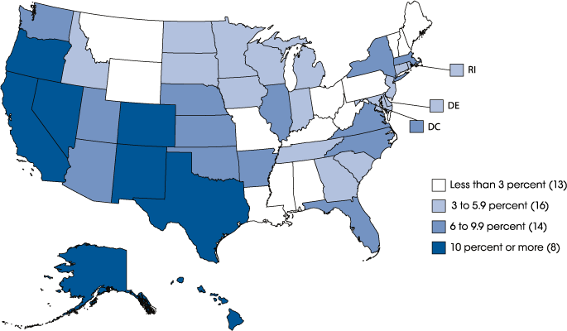
ELL, Migrant, and Immigrant Students
What if language, culture, and mobility limit equal access?
Views of the student
Views of curriculum
Views of purpose of education
Views of the teacher
Influenced by progressivism, constructivism, existentialism, or reconstructivism? Or by a backlash against any of these?
Influenced by perennialism or essentialism? Or a backlash?
Influenced by humanism or behaviorism? Or a backlash?

Slide 14
Teacher Quality / Attractiveness of Teaching
The “typical teacher” is a white woman who stays in teaching 5-10 years. How can we increase career attractiveness?
Views of the student
Views of curriculum
Views of purpose of education
Views of the teacher
Influenced by progressivism, constructivism, existentialism, or reconstructivism? Or by a backlash against any of these?
Influenced by perennialism or essentialism? Or a backlash?
Influenced by humanism or behaviorism? Or a backlash?

Slide 15
Technology
1:1 computing, social media, flipping the classroom, Khan Academy, self-paced learning, online learning, etc.
Views of the student
Views of curriculum
Views of purpose of education
Views of the teacher
Influenced by progressivism, constructivism, existentialism, or reconstructivism? Or by a backlash against any of these?
Influenced by perennialism or essentialism? Or a backlash?
Influenced by humanism or behaviorism? Or a backlash?

Slide 16
School Violence
School shootings, bullying, sexual harassment, hate crimes – Who can even care about gum chewing and tardiness anymore!?
Views of the student
Views of curriculum
Views of purpose of education
Views of the teacher
Influenced by progressivism, constructivism, existentialism, or reconstructivism? Or by a backlash against any of these?
Influenced by perennialism or essentialism? Or a backlash?
Influenced by humanism or behaviorism? Or a backlash?

Slide 17
Gay and Transgendered Students
It’s a lot more than figuring out which bathroom to use.
Views of the student
Views of curriculum
Views of purpose of education
Views of the teacher
Influenced by progressivism, constructivism, existentialism, or reconstructivism? Or by a backlash against any of these?
Influenced by perennialism or essentialism? Or a backlash?
Influenced by humanism or behaviorism? Or a backlash?

Slide 18
Grading
Grade inflation, a failure mindset, “A” for effort, standards-based grading, migraines and suicide caused by performance anxiety, how do grades connect with national testing?
Views of the student
Views of curriculum
Views of purpose of education
Views of the teacher
Influenced by progressivism, constructivism, existentialism, or reconstructivism? Or by a backlash against any of these?
Influenced by perennialism or essentialism? Or a backlash?
Influenced by humanism or behaviorism? Or a backlash?

Slide 19
Where Exactly Do We Stand?
Is the system broken? Or are we doing more for more students than any other country?
Views of the student
Views of curriculum
Views of purpose of education
Views of the teacher
Influenced by progressivism, constructivism, existentialism, or reconstructivism? Or by a backlash against any of these?
Influenced by perennialism or essentialism? Or a backlash?
Influenced by humanism or behaviorism? Or a backlash?

Slide 20
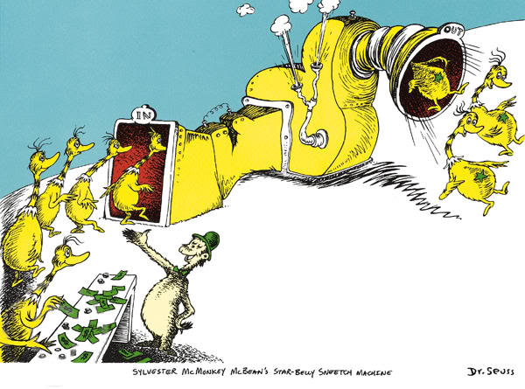
Is College for Everyone?
Should we push college-prep more than tech-prep/voc-ed?
Views of the student
Views of curriculum
Views of purpose of education
Views of the teacher
Influenced by progressivism, constructivism, existentialism, or reconstructivism? Or by a backlash against any of these?
Influenced by perennialism or essentialism? Or a backlash?
Influenced by humanism or behaviorism? Or a backlash?

Slide 21
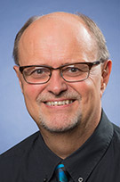
Sources of Top Issues in Education
http://dailycaller.com/2015/01/01/these-will-be-the-five-biggest-education-issues-of-2015/2/
http://www.nea.org/home/IssuesAndAction.html
http://www.education.com/topic/current-education-issues/
http://blogs.edweek.org/edweek/finding_common_ground/2014/01/10_critical_issues_facing_education.html?intc=main-mpsmvs
http://www.ncforum.org/wp-content/uploads/2015/01/PSF_TopTenEducationIssues_v5_web.pdf
Dr. Ed Starkenburg

