Slide 1
Alternative Assessment Would you assess canoeing skills with a spelling test? Dr. Stephen D. Holtrop InspirED Teacher's Convention Lynden, WA October 6, 2016

Slide 2
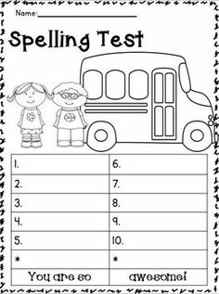
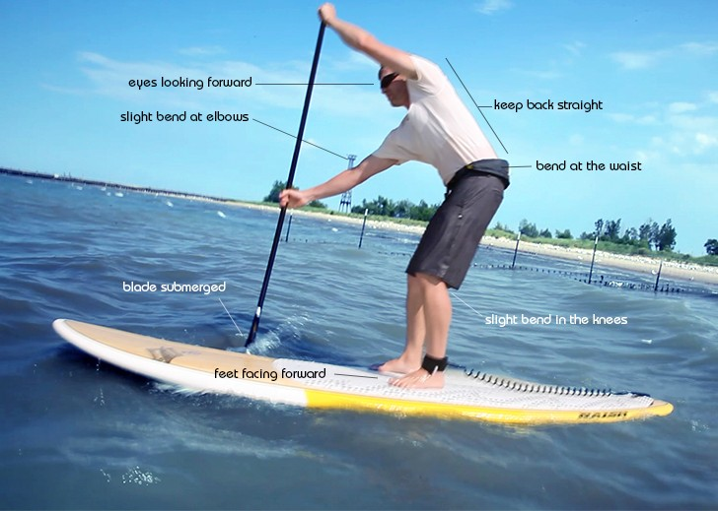
Would you assess canoeing skills with a spelling test?
2:03

Slide 3
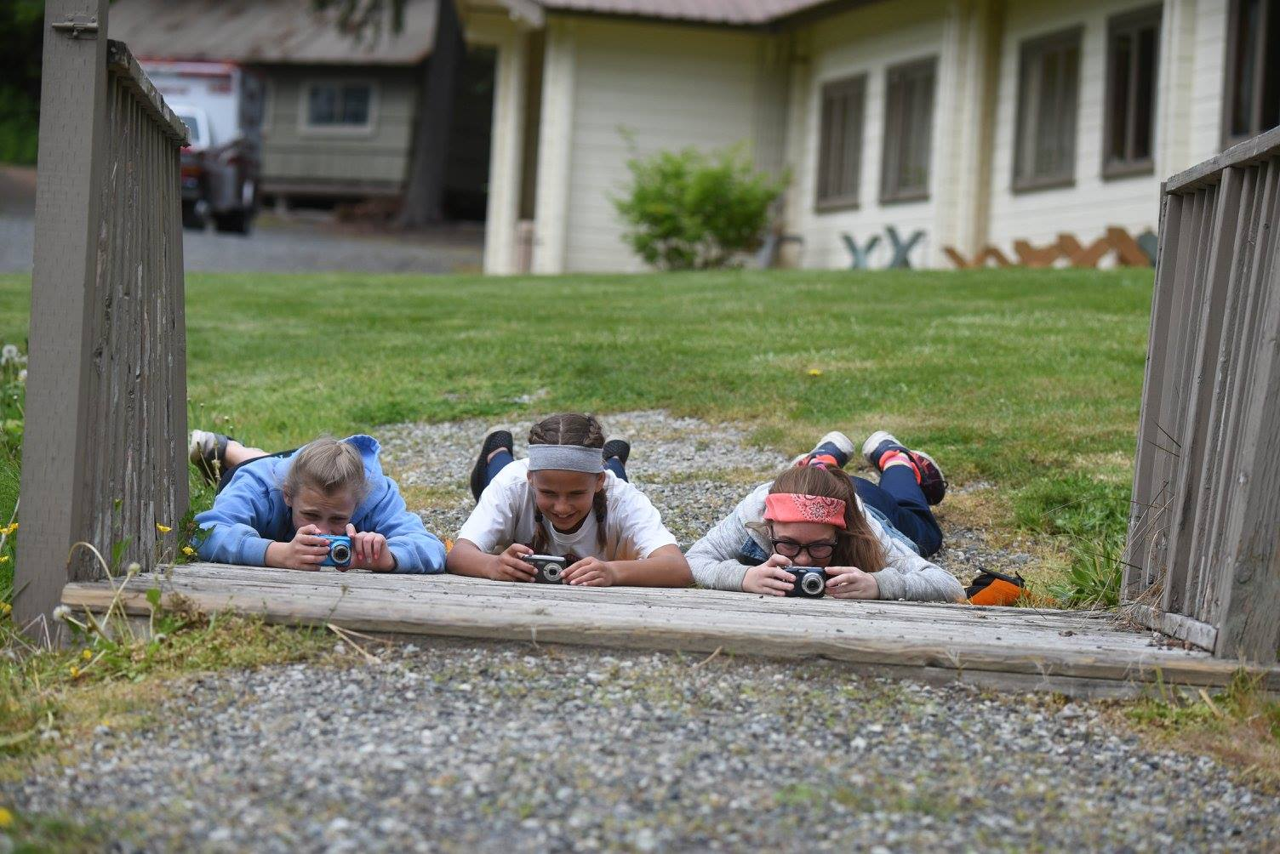
Session description
This session looks at alternative assessment options in various content areas and grade levels. We’ll look at what’s happening with alternative assessment around the country. We’ll discuss with small groups and all together some of the pros, cons, and assumptions about a ton of examples of alternative assessments. We’ll also delve a little more specifically into mastery learning, portfolios, and project-based learning.
2:05

Slide 4
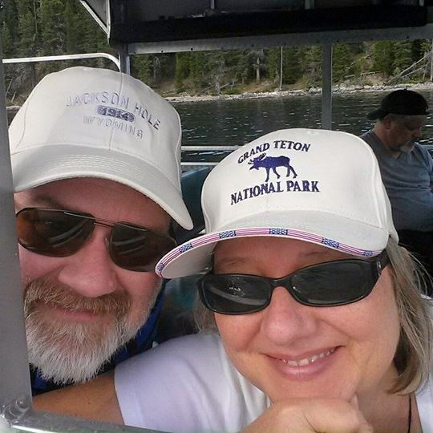
My bio – Steve Holtrop…
Currently teaching curriculum development and action research at the graduate level at Dordt College and philosophy of education at the undergraduate level.
Directing the Master of Education program and the Concurrent Credit program at Dordt.
Previously served at Huntington University, a CCCU college in Indiana, as Dean of Graduate and Adult Programs and taught a variety of graduate and undergraduate courses in the teacher education program.
Taught high school English and journalism at CSI schools in Miami, FL, and Orange City, IA.
Earned a BA in English education from Calvin College and an MA and PhD in curriculum and instruction from the University of Iowa.
Lives with his wife and three grown children in Sioux Center, IA, and enjoys hiking, photography, and sailing whenever possible.
2:07

Slide 5
Audience
Elementary Teachers
Secondary Teachers
Bible
Math
S.S.
Science
L.A.
Technology and other STEM
Specials, academic support, lib.
Administrators
BC
WA
Other countries or states
Political reporters?
2:10

Slide 6
Teaching canoeing – dos and don’ts
The paper and pencil test actually happened to me as a Boy Scout earning canoeing merit badge.
2:11

Slide 7
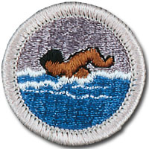
Boy Scout Merit Badge Requirements Swimming
Do the following:
Explain to your counselor how Scouting’s Safe Swim Defense plan anticipates, helps prevent and mitigate, and provides responses to likely hazards you may encounter during swimming activities.
Discuss the prevention and treatment of health concerns that could occur while swimming, including hypothermia, dehydration, sunburn, heat exhaustion, heatstroke, muscle cramps, hyperventilation, spinal injury, stings and bites, and cuts and scrapes.
Before doing the following requirements, successfully complete the BSA swimmer test:
Jump feet first into water over the head in depth. Level off and swim 75 yards in a strong manner using one or more of the following strokes: sidestroke, breaststroke, trudgen, or crawl; then swim 25 yards using an easy, resting backstroke. The 100 yards must be completed in one swim without stops and must include at least one sharp turn. After completing the swim, rest by floating.
Swim continuously for 150 yards using the following strokes in good form and in a strong manner: front crawl or trudgen for 25 yards, back crawl for 25 yards, sidestroke for 25 yards, breaststroke for 25 yards, and elementary backstroke for 50 yards.
Do the following:
Demonstrate water rescue methods by reaching with your arm or leg, by reaching with a suitable object, and by throwing lines and objects. Explain why swimming rescues should not be attempted when a reaching or throwing rescue is possible, and explain why and how a rescue swimmer should avoid contact with the victim.
With a helper and a practice victim, show a line rescue both as tender and as rescuer. The practice victim should be approximately 30 feet from shore in deep water.
2:13

Slide 8
Boy Scout Merit Badge Requirements Swimming
Do the following:
Float face up in a resting position for at least one minute.
Demonstrate survival floating for at least five minutes.
While wearing a properly fitted U.S. Coast Guard–approved life jacket, demonstrate the HELP and huddle positions. Explain their purposes.
Explain why swimming or survival floating will hasten the onset of hypothermia in cold water.
In water over your head, but not to exceed 10 feet, do each of the following:
Use the feet first method of surface diving and bring an object up from the bottom.
Do a headfirst surface dive (pike or tuck), and bring the object up again.
Do a headfirst surface dive to a depth of at least 5 feet and swim underwater for three strokes. Come to the surface, take a breath, and repeat the sequence twice.
Following the guidelines set in the BSA Safe Swim Defense, in water at least 7 feet deep, show a standing headfirst dive from a dock or pool deck. Show a long shallow dive, also from the dock or pool deck.
Explain the health benefits of regular aerobic exercise, and discuss why swimming is favored as both fitness and therapeutic exercise.
2:15

Slide 9
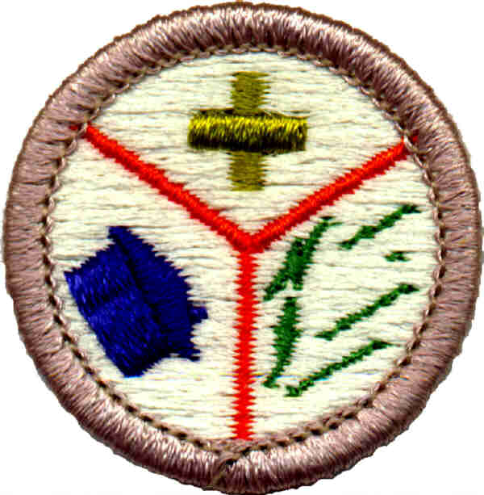
Boy Scout Merit Badge Requirements Emergency Preparedness--condensed
1. Earn the First Aid Merit Badge.
2. Do the following:
Discuss with your counselor the aspects of emergency preparedness: Prepare, Respond, Recover, Prevent, Mitigate
Include in your discussion the kinds of questions that are important to ask yourself as you consider each of these.
Make a chart that demonstrates your understanding of each of the aspects of emergency preparedness in requirement 2a (prepare, respond, recover, prevent, and mitigate) with regard to 10 of the situations listed below. Discuss this chart with your counselor.
Home kitchen fire, etc.
Meet with and teach your family how to get or build a kit, make a plan, and be informed for the situations on the chart you created for requirement 2b. Complete a family plan. Then meet with your counselor and report on your family meeting, discuss their responses, and share your family plan.
3. Show how you could safely save a person from the following: live wire, CO poisoning, clothes on fire, drowning
4. Show three ways of attracting and communicating with rescue planes/aircraft.
5. With another person, show a good way to transport an injured person out of a remote and/or rugged area, conserving the energy of rescuers while ensuring the well-being and protection of the injured person.
2:17

Slide 10
Boy Scout Merit Badge Requirements Emergency Preparedness--condensed
6. Do the following: describe… identify…find out… (e.g. local govt. agencies, etc.)
7. Do the following:
Take part in an emergency service project, either a real one or a practice drill, with a Scouting unit or a community agency.
Prepare a written plan for mobilizing your troop when needed to do emergency service. If there is already a plan, explain it. Tell your part in making it work.
8. Do the following:
Tell the things a group of Scouts should be prepared to do, the training they need , and the safety precautions they should take for the following emergency services: traffic control, group feeding, shelter, sanitation
Prepare a personal emergency service pack for a mobilization call. Prepare a family kit (suitcase or waterproof box) for use by your family in case an emergency evacuation is needed. Explain the needs and uses of the contents.
9. Do ONE of the following:
Using a safety checklist approved by your counselor, inspect your home for potential hazards. Explain the hazards you find and how they can be corrected.
Review or develop a plan of escape for your family in case of fire in your home.
Develop an accident prevention program for five family activities outside the home (such as taking a picnic or seeing a movie) that includes an analysis of possible hazards, a proposed plan to correct those hazards, and the reasons for the corrections you propose.
2:19

Slide 11
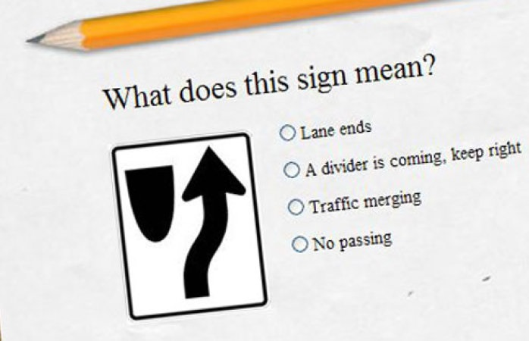
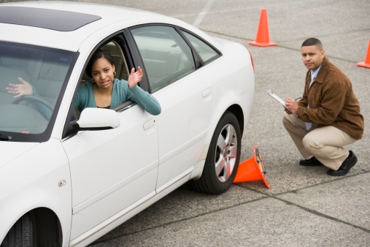
What's the best way to assess whether your teenager is ready to go out on the open road behind the wheel of your car?
2:21

Slide 12
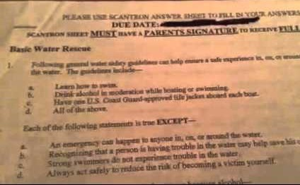
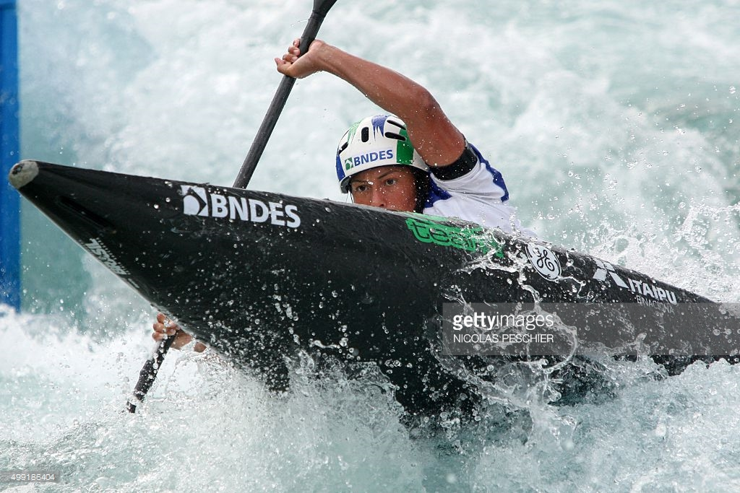
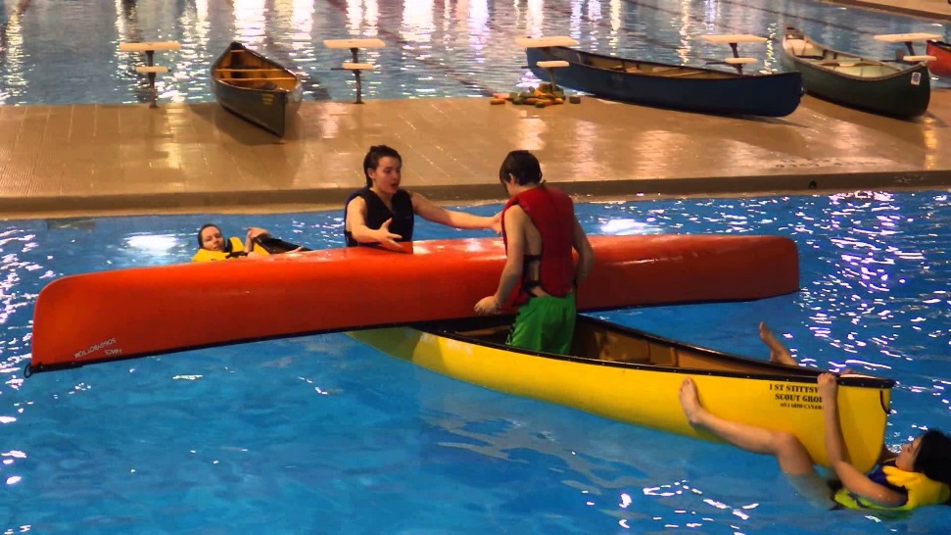
What's the best way to determine whether your pre-teen is ready to be in a canoe on a river with a current without you in the boat?
2:23

Slide 13
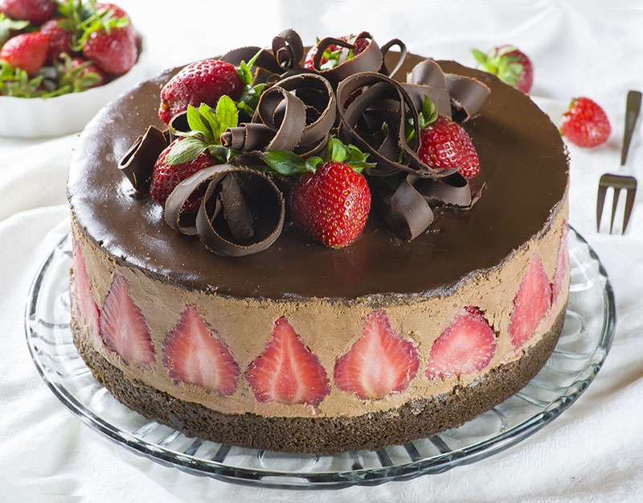
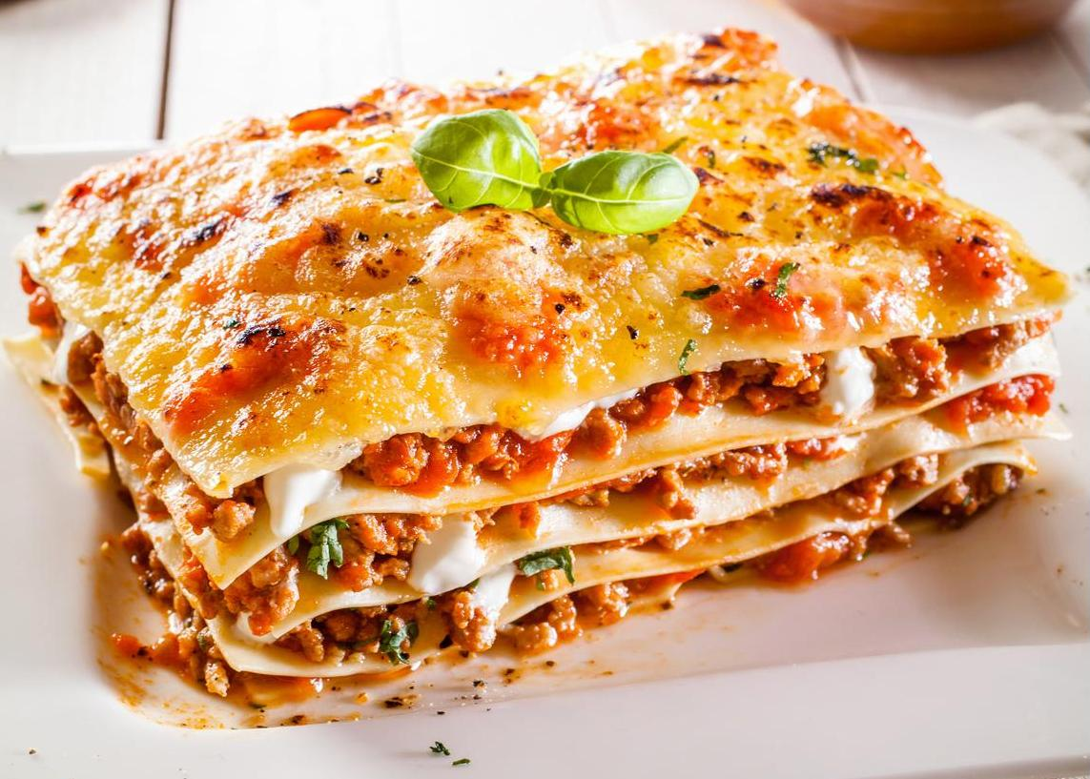
What's the best way to see if somebody knows how to bake a cake or make a tasty lasagna?
I think we'd all agree that they should demonstrate that they can actually do a cake or lasagna.
Now as teachers we can get really creative and skillful at adding a bunch of facts and background and stuff that we're really excited about and that really add to the scope of the content, address some academic standards, or add variety to the learning objectives.
So for example we could teach a whole lot of facts about the history of flour and baking. And I'm sure you could take whole courses just in the history and development of cake decorating. And we could have students memorize lists of ingredients, and maybe even do fractions of different types of measurements for each of the ingredients.
We could do so many similar things with the history of lasagna and where it came from and all the different theories behind it and who are some of the most famous chefs and suppliers of lasagna and maybe even a Venn diagram or word association with all of our feelings about experiencing lasagna for the first time, etc.
2:25

Slide 14
What about assessing writing?
Do we have our students practice a lot of actual writing – doing writing
like driving the car
maneuvering the canoe
trial and error in the kitchen?
Or do we have them memorize parts of speech and diagram sentences and basically perpetuate the error of the 13th century monks who tried to make a Germanic language into a Latin structure and forevermore have instructed us not to split infinitives?
The research on how to most effectively teach writing says to actually have students
do a lot of writing
over and over and over again
in all different styles
trial and error like in the canoe, car, and cake.
But what we often end up doing is like popping the hood on the car and saying to be a good driver you need to identify 100 parts under the hood here and then you'll be a better driver.
And it may be that a champion race car driver knows a lot of parts and knows what they smell like when they're failing and can radio ahead to the pit crew that he's going to need a new inside front tire or a new belt or something. Maybe a new clutch – that smells unique when it’s failing. Good to be able to name that part in this kind of situation.
2:27

Slide 15
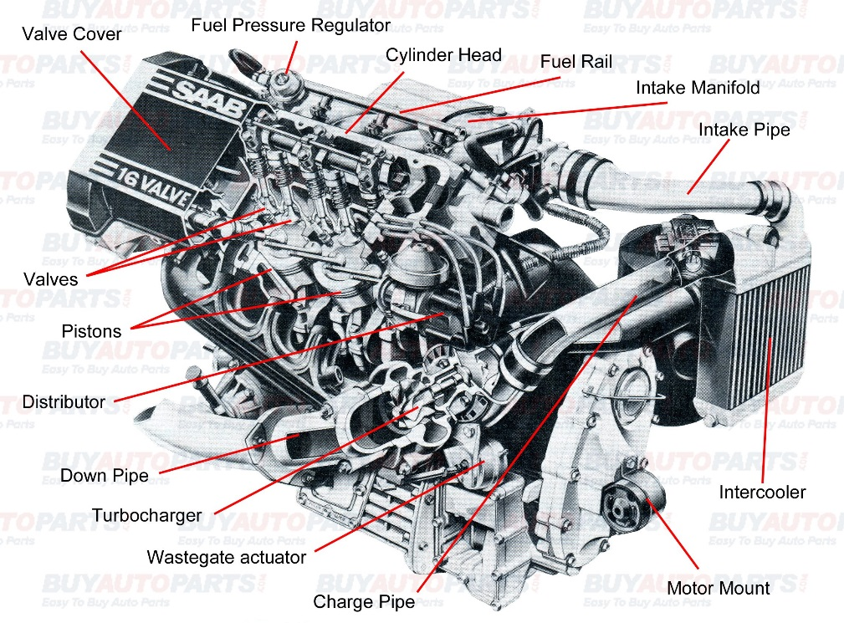
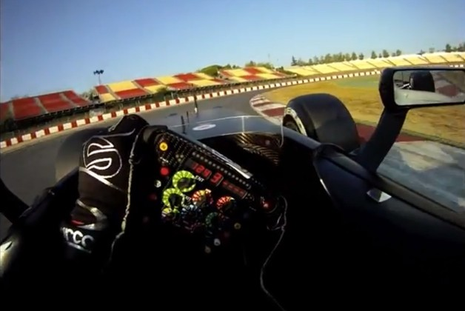
Grammar terms— and how to make better writers
2:29

Slide 16
What about assessing writing?
Most of us need to be able to do with writing what we need to be able to do behind the wheel of a car and that is to get the job done to get from here to there safely without causing accidents, without being awkward and holding up other people.
Certainly without endangering other people or angering them.
Or just confusing the life out of them.
But we don't always put young writers in the canoe in a safe place with a paddle that's not too long.
Somebody did a study that showed that the analytical reasoning required of 6th graders doing sentence diagramming and parts of speech identification is on a par with the analytical reasoning required of graduate students in engineering programs.
2:31

Slide 17
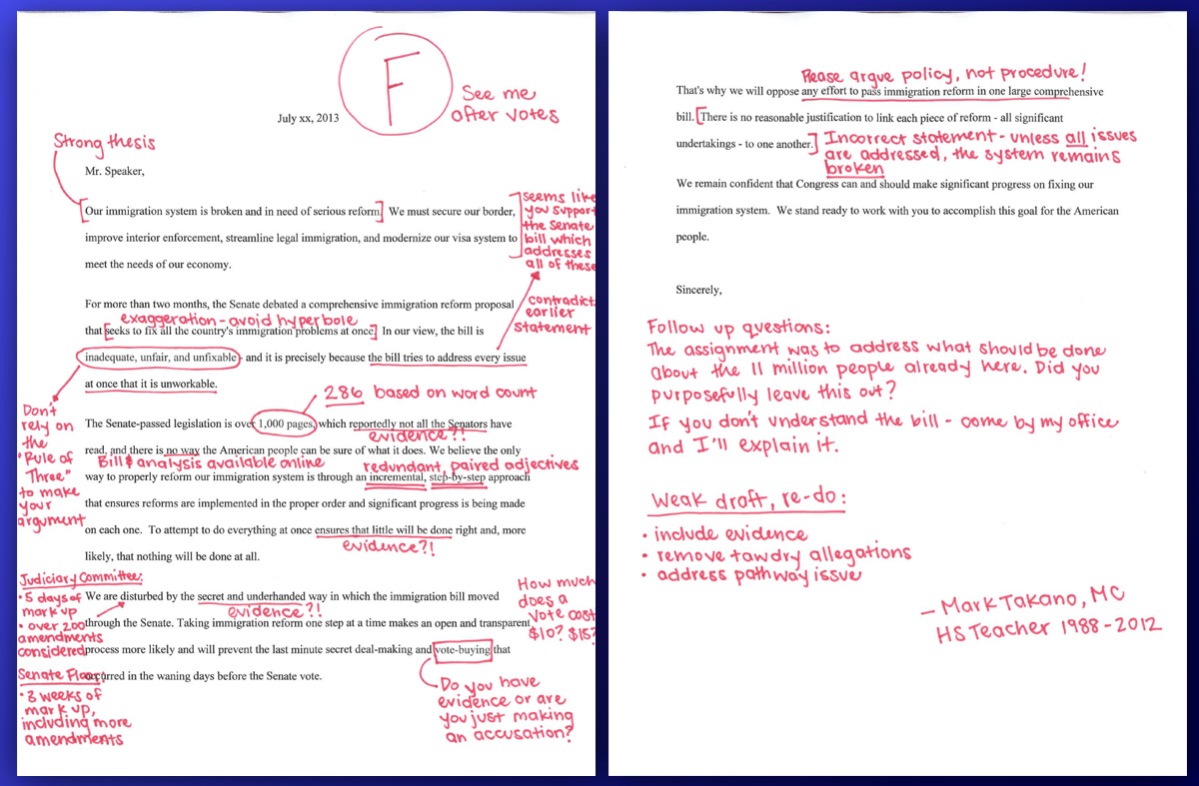
Grammar terms— A short story written by a student with dyslexia
2:33

Slide 18
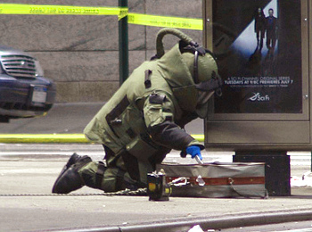
Covering vs. Arriving
We say here's a textbook that's our “curriculum” for the year-- we need to cover it.
Or in recent decades, we modify that and say here are the state standards-- we need to cover them or heads will roll after the students are tested at the end of the year.
Wiggins and McTighe in their famous book called Understanding by Design advocate choosing your assessments before you choose what you're going to cover.
I've had years and years of graduate students coming back for a master's degree and reading that book in my curriculum course at two Christian colleges now and saying this changes everything.
Instead of covering the textbook or covering the standards and then every few weeks and at the end of the quarter giving some tests over what was covered…
Rather, it's more like real life where we say okay the goal is to bake a decent cake or to get enough canoeing skills to go on that thrilling river or to be able to pass the road test for a driver's license or to make that lasagna that doesn’t turn the noodles into pure mush or doesn’t make them so crispy on the edges that it's like trying to bite through giant hunks of plastic.
2:35

Slide 19
Math properties—what’s the overall, 20-year goal?
Property | Example
Commutative Property of Addition a + b = b + a | 2 + 3 = 3 + 2
Commutative Property of Multiplication a • b = b • a | 2 • ( 3 ) = 3 • ( 2 )
Associative Property of Addition a + ( b + c ) = ( a + b ) + c | 2 + ( 3 + 4 ) = ( 2 + 3 ) + 4
Associative Property of Multiplication a • ( b • c ) = ( a • b ) • c | 2 • ( 3 • 4 ) = ( 2 • 3 ) • 4
Distributive Property a • ( b + c ) = a • b + a • c | 2 • ( 3 + 4 ) = 2 • 3 + 2 • 4
2:37

Slide 20
Preparing kids for the future: Computer programming vs. computer using

Slide 21
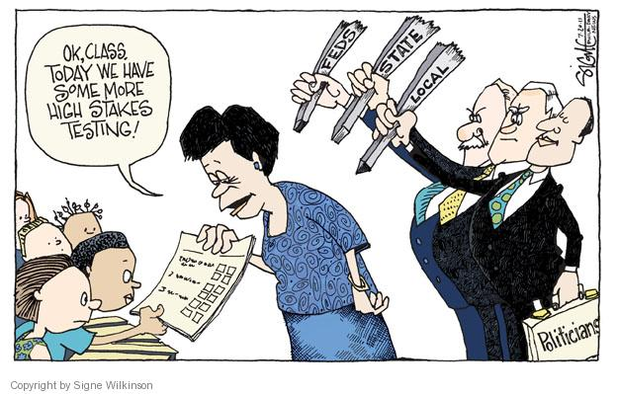
That brings us to the term authentic assessment
This concept was becoming pretty widespread and well accepted in the education world until the standards movement and the testing movement pretty much dictated that we would have to have multiple choice tests more often than ever before and at earlier ages.
And having students practice styles of learning and assessment that didn't fit the coverage approach to curriculum and the high-stakes paper and pencil approach to assessment could mean disaster for the student, for the teacher, and even for the whole school.
2:39

Slide 22
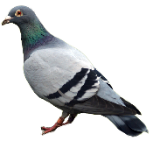
Different philosophies, different assessments
 | Progressivism | Humanism | Perennialism | Essentialism | Behaviorism
View of the student | Naturally inquisitive Active learner, not passive | Unique individual. | People are rational animals. | Learning is hard work – student needs discipline | A highly developed, conditioned animal. No special dignity or freedom.
View of the teacher | Advisor, guide, fellow traveler. Not authoritarian | Not authoritarian. Enable students to pursue interests. | Introduce students to the great works. | The locus of classroom authority & discipline, demands respect | Learn and harness the laws of behavior.
View of the curriculum | Resource materials for students’ natural curiosity. Should not be arbitrarily divided into subjects. | Open classroom, “free” school. Desks in clusters. Activity areas with resource materials. | Great works that have stood the test of time. Textbooks are bad. Avoid vocation training. | Five New Basics | Break up subjects into small steps – reward each step. Training. Performance based standards.
2:41

Slide 23
Different philosophies, different assessments
 | Progressiv-ism | Humanism | Perennialism | Essentialism | Behaviorism
Purpose of education | Awaken natural curiosity, prepare to better society. Education is life. | Create learning environment free from intense competition, harsh discipline, and fear of failure. | Preparation for life. | Transmitting tested facts and truths (basic knowledge) | Create learning environments that lead to desired behaviors.
UbD “sin” temptation | Fun | Fun | Coverage | Coverage
View of Assess-ment | Real-life tasks and challenges tied to the learning unit/project | Real-life tasks with effort to eliminate competition | Ascertain student understanding of samplings from the great works | Ascertain that student has worked hard and shows knowledge of sampled facts and truths | Has the student been adequately conditioned to perform the expected skills and knowledge tasks?
2:43

Slide 24
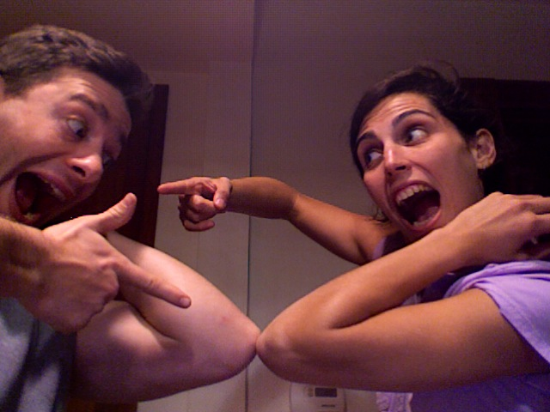
Your turn
Think back *at least* half your life to a time you learned some concept or skill that you still find valuable today.
Craft skill like knitting, quilting, macramé
Use of a specialized tool
Operating heavy machinery, car, semi, riding mower, etc.
A people skill like active listening, reflection, empathy
A spiritual skill like patience, self-control, peace, gentleness
OR if you HAVE to, an academic skill like long division
How were you assessed or evaluated on this skill?
Or how did you prove to yourself that you had the skill down pat?
Tell a partner right now.
2:46

Slide 25
Grant Wiggins (UbD) Wiggins, Grant (1990). The case for authentic assessment. Practical Assessment, Research & Evaluation, 2(2). Retrieved October 1, 2016 from http://PAREonline.net/getvn.asp?v=2&n=2
Authentic assessments require students to be effective performers with acquired knowledge. Traditional tests tend to reveal only whether the student can recognize, recall or "plug in" what was learned out of context. This may be as problematic as inferring driving or teaching ability from written tests alone. (Note, therefore, that the debate is not "either-or": there may well be virtue in an array of local and state assessment instruments as befits the purpose of the measurement.)
Authentic assessments present the student with the full array of tasks that mirror the priorities and challenges found in the best instructional activities: conducting research; writing, revising and discussing papers; providing an engaging oral analysis of a recent political event; collaborating with others on a debate, etc. Conventional tests are usually limited to paper-and-pencil, one-answer questions.
Authentic assessments attend to whether the student can craft polished, thorough and justifiable answers, performances or products. Conventional tests typically only ask the student to select or write correct responses--irrespective of reasons. (There is rarely an adequate opportunity to plan, revise and substantiate responses on typical tests, even when there are open-ended questions). As a result,
Authentic assessment achieves validity and reliability by emphasizing and standardizing the appropriate criteria for scoring such (varied) products; traditional testing standardizes objective "items" and, hence, the (one) right answer for each.
"Test validity" should depend in part upon whether the test simulates real-world "tests" of ability. Validity on most multiple-choice tests is determined merely by matching items to the curriculum content (or through sophisticated correlations with other test results).
Authentic tasks involve "ill-structured" challenges and roles that help students rehearse for the complex ambiguities of the "game" of adult and professional life. Traditional tests are more like drills, assessing static and too-often arbitrarily discrete or simplistic elements of those activities.
2:48

Slide 26
Grant Wiggins (UbD) Wiggins, Grant (1990). The case for authentic assessment. Practical Assessment, Research & Evaluation, 2(2). Retrieved October 1, 2016 from http://PAREonline.net/getvn.asp?v=2&n=2
WHY DO WE NEED TO INVEST IN THESE LABOR-INTENSIVE FORMS OF ASSESSMENT?
While multiple-choice tests can be valid indicators or predictors of academic performance, too often our tests mislead students and teachers about the kinds of work that should be mastered. Norms are not standards; items are not real problems; right answers are not rationales.
What most defenders of traditional tests fail to see is that it is the form, not the content of the test that is harmful to learning; demonstrations of the technical validity of standardized tests should not be the issue in the assessment reform debate. Students come to believe that learning is cramming; teachers come to believe that tests are after-the-fact, imposed nuisances composed of contrived questions--irrelevant to their intent and success. Both parties are led to believe that right answers matter more than habits of mind and the justification of one's approach and results.
A move toward more authentic tasks and outcomes thus improves teaching and learning: students have greater clarity about their obligations (and are asked to master more engaging tasks), and teachers can come to believe that assessment results are both meaningful and useful for improving instruction.
If our aim is merely to monitor performance then conventional testing is probably adequate. If our aim is to improve performance across the board then the tests must be composed of exemplary tasks, criteria and standards.
2:50

Slide 27
Comparing/Contrasting Types of Testing
 | Preparing the Assessment | Grading the Assessment | Long-term Value of the Assessment
Multiple-choice tests & quizzes | Takes a long time. Items need to be analyzed for validity and replaced each year. Hard to include critical thinking. | Fastest – especially with a ScanTron machine | Least
Essay tests | Shorter to prepare but the prompts need to be well thought out and well written | Longer – but “Speed Grader” on Canvas online course management system is really cool | Much more value – students retain more of what they write about. Good questions get students to really think.
Authentic assessment tasks | Can take a long time (esp. the first time). But teachers report it’s less of a “chore” and more part of the overall unit. | Can be time consuming, but again, it’s more of a natural culmination. Teacher stress reduced by rubrics, peer-evals, expert panels, audience, etc. | Best long term value. Students remember most the multi-modal involvements, esp. if they really take ownership of the process & get creative.
2:52

Slide 28
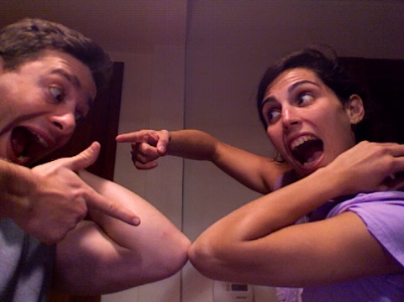
Alternative Assessment Learn NC (UNC School of Education)
Edutopia.org
Essays
Portfolios
Presentations/ demonstrations
Authentic assessments (real-world environment) http://www.learnnc.org/lp/pages/7041
Authentic assessment can include many of the following:
Observation
Interviews
Performance tasks
Exhibitions
Journals
Teacher-created tests
Rubrics
Self- and peer-evaluation
http://www.edutopia.org/assessment-guide-description
Have you used any of these assessments as a teacher (or student)? How did they work out?
Tell a partner right now.
2:54

Slide 29
The National Capitol Language Resource Center (Washington, DC) ~ a project of The George Washington University.
The following criteria define authentic assessment activities:
They are built around topics or issues of interest to the students
They replicate real-world communication contexts and situations
They involve multi-stage tasks and real problems that require creative use of language rather than simple repetition
They require learners to produce a quality product or performance
Their evaluation criteria and standards are known to the student
They involve interaction between assessor (instructor, peers, self) and person assessed
They allow for self-evaluation and self-correction as they proceed
http://www.nclrc.org/essentials/assessing/alternative.htm
2:56

Slide 30
Teach Hub - Alternative Reading Assessments
1. Bookmark
Create a bookmark to match the theme of the last book read.
2. Time Capsule
Put together a group of 5 things from the story of the week.
3. Stuffed Animal
Students can make a stuffed animal that matches the theme of the story read.
4. Business Card
Summarize the story by designing a business card (this will be harder than it sounds).
5. Radio Show
Create a radio program that is set in the same time as the book.
6. Recipe
Make a recipe (or just the instructions) for something that a character in the story might make.
7. Paper Doll
More geared towards the younger set, this activity involves creating paper dolls and costume changes for the characters in the story.
8. Wanted Poster
Make a wanted poster for the antagonist in the book. http://www.teachhub.com/40-alternative-assessments-learning
2:59
Tell a partner: What do you think of these assessments for your students, your own children, or for back when you were in reading classes? How do they contrast with what you’re used to?

Slide 31
Teach Hub - Alternative Writing Assessments
9. Eulogy
Write a eulogy for a word that is overused in the student’s own writing samples.
10. Infomercial
Students will tape a segment that uses persuasion.
11. Bumper Sticker
Design a bumper sticker with a catchy slogan for each of the writing genres.
12. PowerPoint
Pairs can create a slideshow about their writing process from start to finish.
13. Newscast
Students can form teams to create a news program about writing conventions (run-on sentences, spacing, punctuation, etc.)
14. Comic Strip
Draw a comic strip that shows examples of figurative language.
15. Brochure
Create a brochure that explains the steps involved when writing for different audiences.
16. Survey
Create a survey of students’ favorite writing styles or writing pet peeves. Make a graph that explains the results.
3:02
Tell a partner: What do you think of these assessments for your students, your own children, or for back when you were in writing classes? How do they contrast with what you’re used to?

Slide 32
Teach Hub - Alternative Math Assessments
17. Acrostic Poem
Using one math term, such as geometry or algebra, make an acrostic poem.
18. Internet Resource List
Students will find a list of websites that explain the current math concepts correctly.
19. Readers’ Theater
Perform a readers’ theater that is all about the current topic.
20. Crossword Puzzle
Use the vocabulary from the assessed chapter to create a crossword puzzle, including the design and matching clues.
21. Scrapbook Page
Each student makes a page that describes a certain vocabulary word. Combine them to provide a future review tool for students.
22. Paint By Number
More artistically-inclined students may want to create a paint by number portrait that includes math terms and examples. They can also write and solve problems that match the paint-by-number answers.
23. Pattern
Find a pattern in the current math unit that can be explained.
24. Collage
Using magazines, students can cut up and paste math strand examples.
Tell a partner: What do you think of these assessments for your students, your own children, or for back when you were in math classes? How do they contrast with what you’re used to?
3:05

Slide 33
Teach Hub - Alternative Science Assessments
25. Help Wanted Ad
Write an ad to find a “professor” who can help to explain the subject at hand.
26. Singing Telegram
More musically-inclined students may love to create a song about the latest chapter.
27. Calendar
Mark on a calendar (paper or electronic copy) the time frame for how long it takes to see changes in a scientific event (such as erosion or plants growing).
28. Diary
Pen a diary entry from a famous scientist.
29. Advice Column
Students write advice to an “anonymous friend” who has a scientific problem that needs solved.
30. Trivia Game
Students create the questions (and answers) that will be used in a review game.
31. T-shirt
Design a t-shirt that matches the current science concepts.
32. Experiment
No explanation needed for this one.
Tell a partner: What do you think of these assessments for your students, your own children, or for back when you were in science classes? How do they contrast with what you’re used to?
3:08

Slide 34
Teach Hub - Alternative Social Studies Assessments
33. Cheer
Compose a cheer for someone in history who has struggled through something in your latest unit.
34. Fashion Sketch
Draw an example of what a person would wear from the era being studied.
35. Toy
Create a drawing (or a prototype) of a toy that might have been used from the children of that specific time period.
36. Documentary
Recreate an important historical event.
37. Family Tree
Research the family tree of a famous historical person.
38. Time Line
Students create a class timeline as they study different eras. Post the master time line up in the classroom and add as new eras are learned.
39. Speech
Memorize and recite an important historical speech.
40. Museum Exhibit
Students each create a museum “artifact” and set them up in the classroom as a museum, where they will stand next to their artifact to explain and answer questions from visitors. Invite other classes or parents to come do a walkthrough of your museum. http://www.teachhub.com/40-alternative-assessments-learning
Tell a partner: What do you think of these assessments for your students, your own children, or for back when you were in social studies classes? How do they contrast with what you’re used to?
3:11

Slide 35
Alternative Assessment Benefits
Often because of class size or as a method for saving timing in grading, traditional testing has been utilized.
Alternative assessment gives the student the opportunity to demonstrate the depth and scope of what they have learned rather than being limited to just a few responses on a traditional test or exam.
The compression of an entire semester of work into a single hour of testing that can account for a major portion of a grade can often be a misrepresentation of the efforts of students.
A portfolio of work is an example of alternative assessments where a student has selected or developed the work they think best depicts their study skills and understanding of concepts.
It is also an overall great teacher resource for showing what lesson plans were effective and which were not.
In the same way that traditional assessments can show the flaws of poorly understood concepts when viewed at a holistic classroom level, the same can be true with alternative assessments. http://www.teach-nology.com/currenttrends/alternative_assessment/
3:13

Slide 36
Advantages & Disadvantages of Alternative Assessments
They provide a means of assessing valued skills that cannot be directly assessed with traditional tests.
They provide a more realistic setting for student performance than traditional tests.
They focus on student performance and the quality of work performed by students.
They can be easily aligned with established learning outcomes. http://ctl.byu.edu/using-alternative-assessments
But the process can be costly in terms of time, effort, equipment, materials, facilities, or funds.
Rating process is sometimes more subjective than traditional exams.
Tell a partner how important these pros and cons are to your teaching situation.
3:15

Slide 37
Guidelines for Constructing Alternative Assessments
Define the instructional outcome you want to assess as clearly and unambiguously as possible in terms of both the subject-matter content and the set of skills or operations that a skillful performer would exhibit.
Example: Students will perform five types of Cha Cha steps in correct dance position without error.
Distinguish between those outcomes that can validly be assessed solely by performance assessments and those that can be assessed just as effectively by objective measures.
Students would have a difficult time demonstrating dance steps on paper.
Create tasks that elicit evidence of the student’s ability to perform the targeted skill.
Task: Set aside a block of classroom time for students to dance with a partner, two or three couples at a time. Allow students to dance for at least 2 minutes so they have time to demonstrate all the steps they know. Students should have sufficient time to practice the steps before they are assessed.
Decide what kinds of teacher guidance [scaffolding] can be used while still allowing students the freedom to learn and do it their own way.
Students may do the steps in whatever order they would like. Teacher may put the names of the different steps on the board to help students remember them if needed.
Try out the assessment and make revisions as necessary.
Revisions could include giving more detailed instructions and expectations to the students or inviting an assistant to write down dictated comments while the teacher keeps his or her attention on the dancers. http://ctl.byu.edu/using-alternative-assessments
3:17

Slide 38
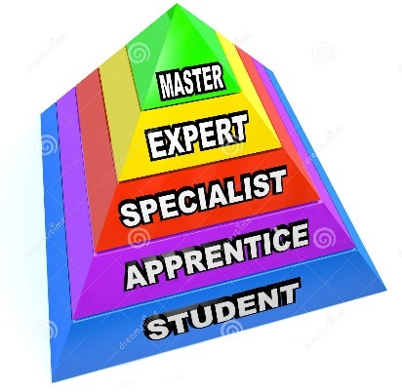
Mastery Learning
By definition, mastery learning is a method of instruction where the focus is on the role of feedback in learning. Furthermore, mastery learning refers to a category of instructional methods which establishes a level of performance that all students must master before moving on to the next unit (Slavin, 1987).
Thus, through one or more trials, students have to achieve a specified level of content knowledge [or skill] prior to progression on to a next unit of instruction.
Slavin, R. E. (1987). Mastery learning reconsidered. Review of Educational Research, 57, 175-213. http://www.nyu.edu/classes/keefer/waoe/motamediv.htm
3:18

Slide 39
Mastery learning
Synonyms:
Criterion-based learning
Specifications grading
Mandatory-A assignment
Partners/groups:
What did this look like when you experienced it?
How could you use mastery learning for one week, unit, or project?
3:20

Slide 40
What is a portfolio?
A student portfolio is a systematic collection of student work and related material that depicts a student's activities, accomplishments, and achievements in one or more school subjects.
The collection should include evidence of student reflection and self-evaluation, guidelines for selecting the portfolio contents, and criteria for judging the quality of the work.
The goal is to help students assemble portfolios that illustrate their talents, represent their writing capabilities, and tell their stories of school achievement... (Venn, 2000, pp. 530-531) http://www.unm.edu/~devalenz/handouts/portfolio.html
3:21

Slide 41
Advantages of Portfolio Assessment
Promoting student self-evaluation, reflection, and critical thinking.
Measuring performance based on genuine samples of student work.
Providing flexibility in measuring how students accomplish their learning goals.
Enabling teachers and students to share the responsibility for setting learning goals and for evaluating progress toward meeting those goals.
Giving students the opportunity to have extensive input into the learning process.
Facilitating cooperative learning activities, including peer evaluation and tutoring, cooperative learning groups, and peer conferencing.
Providing a process for structuring learning in stages.
Providing opportunities for students and teachers to discuss learning goals and the progress toward those goals in structured and unstructured conferences.
Enabling measurement of multiple dimensions of student progress by including different types of data and materials. (Venn, 2000, p. 538) http://www.unm.edu/~devalenz/handouts/portfolio.html
3:22

Slide 42
Disadvantages of Portfolio Assessment
Requiring extra time to plan an assessment system and conduct the assessment.
Gathering all of the necessary data and work samples can make portfolios bulky and difficult to manage.
Developing a systematic and deliberate management system is difficult, but this step is necessary in order to make portfolios more than a random collection of student work.
Scoring portfolios involves the extensive use of subjective evaluation procedures such as rating scales and professional judgment, and this limits reliability.
Scheduling individual portfolio conferences is difficulty and the length of each conference may interfere with other instructional activities. (Venn, 2000, p. 538)
From: Venn, J. J. (2000). Assessing students with special needs (2nd ed.). Upper Saddle River, NJ: Merrill. http://www.unm.edu/~devalenz/handouts/portfolio.html
3:23

Slide 43
Portfolios
Where have you seen portfolios used well?
Which subject areas or kinds of assignments seem to fit best with portfolio grading?
Pros and cons?
Would this be an alternative assessment you would try?
3:25

Slide 44
Project-Based Learning
Project Based Learning is a teaching method in which students gain knowledge and skills by working for an extended period of time to investigate and respond to an authentic, engaging and complex question, problem, or challenge. In Gold Standard PBL, Essential Project Design Elements include:
Key Knowledge, Understanding, and Success Skills - The project is focused on student learning goals, including standards-based content and skills such as critical thinking/problem solving, collaboration, and self-management.
Challenging Problem or Question - The project is framed by a meaningful problem to solve or a question to answer, at the appropriate level of challenge.
Sustained Inquiry - Students engage in a rigorous, extended process of asking questions, finding resources, and applying information.
Authenticity - The project features real-world context, tasks and tools, quality standards, or impact – or speaks to students’ personal concerns, interests, and issues in their lives.
Student Voice & Choice - Students make some decisions about the project, including how they work and what they create.
Reflection - Students and teachers reflect on learning, the effectiveness of their inquiry and project activities, the quality of student work, obstacles and how to overcome them.
Critique & Revision - Students give, receive, and use feedback to improve their process and products.
Public Product - Students make their project work public by explaining, displaying and/or presenting it to people beyond the classroom.
https://www.bie.org/about/what_pbl
3:26

Slide 45
Project-Based Learning
Have you seen PBL anywhere?
Pros and cons?
If you start small with PBL, what would you start with?
3:28

Slide 46
Wrap up
There are pros and cons of traditional school testing.
There are “real-world” options and alternatives.
Imply different views of the student and the curriculum
Can be more time consuming but more rewarding
Bottom line: which type of assessment best shows student attainment of desired knowledge and skills?
3:29

Slide 47
Thank You!

Slide 48
 | Dordt College Programs
MEd | Master of Education Two-year program, online Teacher Leadership track School Leadership track (principal’s license) | Contact Steve Holtrop Steve.Holtrop@Dordt.edu https://www.dordt.edu/academics/med
CCP | Concurrent Credit Program Dordt credit for high school courses Human biology, statistics, calculus, composition, literature, communication Compatible with AP curricula Dordt transcript can go anywhere | Contact Steve Holtrop Steve.Holtrop@Dordt.edu http://dordt.edu/admissions/concurrent_credit/
Pro-Tech | Pro-Tech Program (target launch: Fall 2017) Two-year program: hands-on, skill-focused Associate of Science degree: Manufacturing technology Farm operations and management Reformed perspective On-campus community experience | Contact Jade Van Holland Jade.VanHolland@dordt.edu http://dordt.edu/academics/pro_tech/
/
1st course ½ price!
3:30

