Slide 1
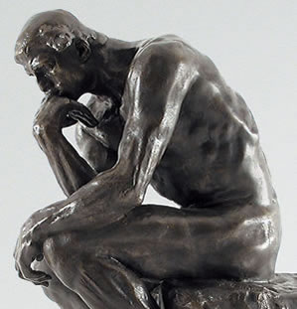
Welcome to EDUC 300/ CORE 310 Philosophy of Education
Spring 2017
Dr. Stephen D. Holtrop

Slide 2
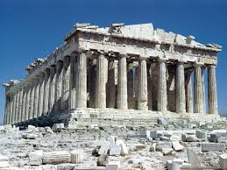
What Is Philosophy?
Tonight’s Topics:
What do we think when we hear “philosophy”?
Philosophy in Acts 17
Philosophy today
Philosophy in education
A personal Philos. of Educ.
Group activity: chart
Syllabus, rubric, Canvas
Legal cases
Presentations (not graded)
And what’s it good for?

Slide 3
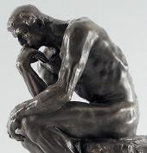
What do YOU think of when you hear the word “Philosophy”?
Deep?
Out there?
Out of touch?
Integrated, consistent?
Egg-headed?
Really smart?
Skeptical?
In touch with God?
Abstract?
Meta…something?

Slide 4
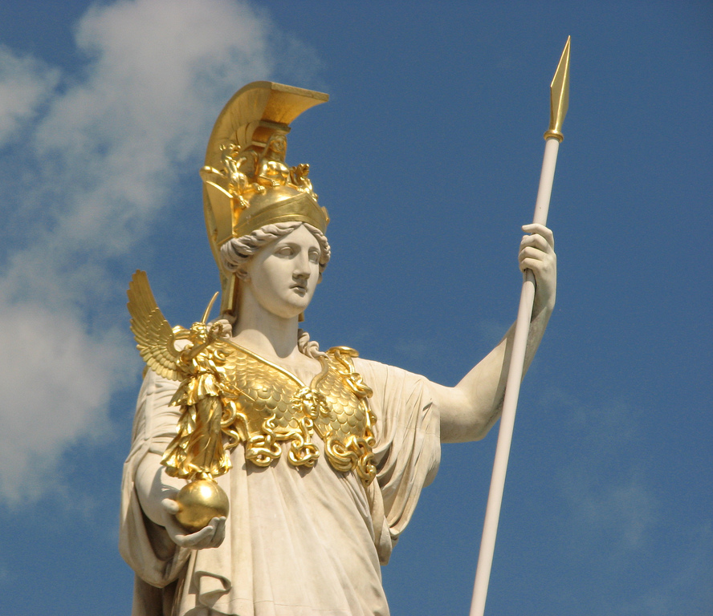
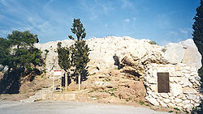
Athens, GReece
Engraved plaque containing Apostle Paul's Areopagus sermon.

Slide 5
Acts 17:16-34 (NIV) In Athens (3 slides)
Slide 1: Paul encounters a very philosophical environment
¹⁶ While Paul was waiting for them in Athens, he was greatly distressed to see that the city was full of idols. ¹⁷ So he reasoned in the synagogue with both Jews and God-fearing Greeks, as well as in the marketplace day by day with those who happened to be there.
Engraved plaque containing Apostle Paul's Areopagus sermon.
¹⁸ A group of Epicurean and Stoic philosophers began to debate with him. Some of them asked, “What is this babbler trying to say?” Others remarked, “He seems to be advocating foreign gods.” They said this because Paul was preaching the good news about Jesus and the resurrection. ¹⁹ Then they took him and brought him to a meeting of the Areopagus, where they said to him, “May we know what this new teaching is that you are presenting?²⁰ You are bringing some strange ideas to our ears, and we would like to know what they mean.” ²¹ (All the Athenians and the foreigners who lived there spent their time doing nothing but talking about and listening to the latest ideas.)

Slide 6
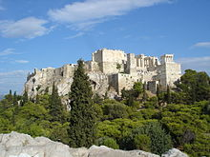
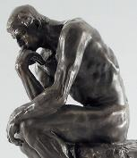
Acts 17:16-34 (NIV) In Athens (slide 2 of 3)
Slide 2: Paul sets up his philosophical argument
Acropolis from Areopagus.
²² Paul then stood up in the meeting of the Areopagus and said: “People of Athens! I see that in every way you are very religious. ²³ For as I walked around and looked carefully at your objects of worship, I even found an altar with this inscription: to an unknown god. So you are ignorant of the very thing you worship—and this is what I am going to proclaim to you.
²⁴ “The God who made the world and everything in it is the Lord of heaven and earth and does not live in temples built by human hands. ²⁵ And he is not served by human hands, as if he needed anything. Rather, he himself gives everyone life and breath and everything else. ²⁶ From one man he made all the nations, that they should inhabit the whole earth; and he marked out their appointed times in history and the boundaries of their lands.
²⁷ God did this so that they would seek him and perhaps reach out for him and find him, though he is not far from any one of us. ²⁸ ‘For in him we live and move and have our being.’^{[a]} As some of your own poets have said, ‘We are his offspring.’^{[b]}

Slide 7
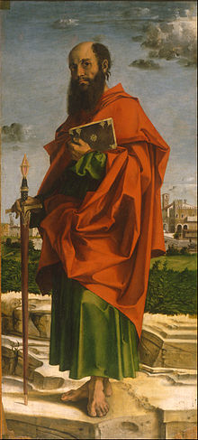
Acts 17:16-34 (NIV) In Athens
Slide 3: Paul proves
his point
²⁹ “Therefore since we are God’s offspring, we should not think that the divine being is like gold or silver or stone—an image made by human design and skill. ³⁰ In the past God overlooked such ignorance, but now he commands all people everywhere to repent. ³¹ For he has set a day when he will judge the world with justice by the man he has appointed. He has given proof of this to everyone by raising him from the dead.”
³² When they heard about the resurrection of the dead, some of them sneered, but others said, “We want to hear you again on this subject.” ³³ At that, Paul left the Council. ³⁴ Some of the people became followers of Paul and believed. Among them was Dionysius, a member of the Areopagus, also a woman named Damaris, and a number of others.
Saint Paul by Bartolomeo Montagna

Slide 8
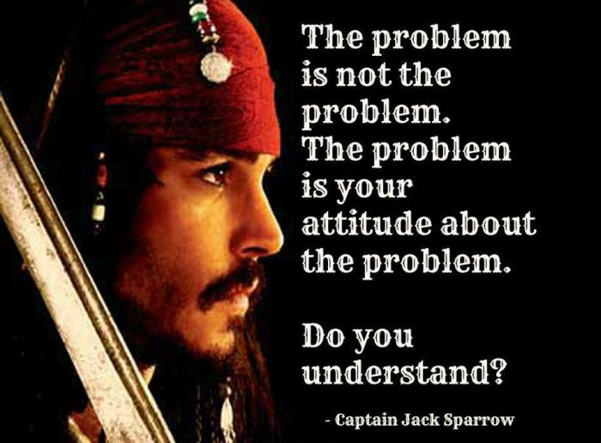
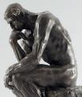
Philo + sophy
“To learn is a natural pleasure, not confined to philosophers, but common to all people.”
Aristotle
(384-322 BC)
Philo = love of
Sophy = wisdom

Slide 9
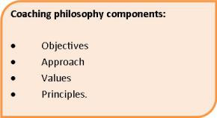
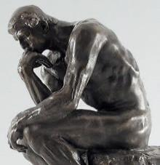
Philosophy today… From coachgrowth.wordpress.com What is a coaching philosophy?
A coaching philosophy is a statement of what you value and how you will approach your coaching role. It covers your purpose as a coach and how you will approach player development and winning. Your coaching philosophy consists of your major objectives and the beliefs and principles that you adhere to in order to achieve your objectives.
From gonnasayit.com
“Yogi Berra Was A Philosophical Genius”
“It's déjà vu all over again.”
”When you come to a fork in the road, take it.“
“It ain’t over ’til it’s over.”
“Ninety percent of this game is half-mental.”

Slide 10
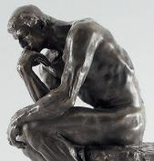
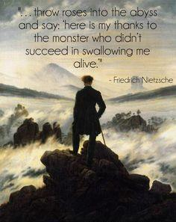
Does Philosophy have a
bad reputation?

Slide 11
Tidbit: Psychology was originally a branch of philosophy
7:00

Slide 12
Philosophy of Education
What is it (in general)?
Who should have one?
What should we expect in a philosophy of education course?
What are the positives of having a philosophy of education?
Any negatives?

Slide 13
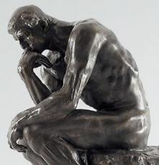
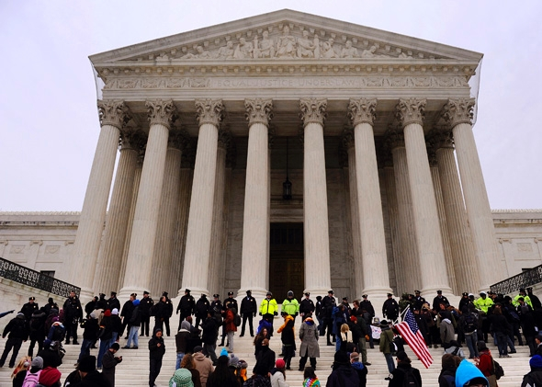
Why do I need a philosophy of education?
Teachers?
Parents?
Administrators?
Tax payers?
Community leaders?
School board members?
Church members?
Citizens?
Students?

Slide 14
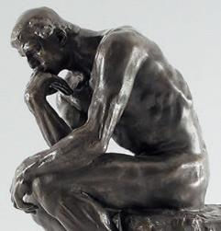
Why do I need a philosophy of education?
What other system…
Involves so many years of everyone’s life?
Employs more professionals?
Spends more public money on a social service?
What cultural system has as much influence on people’s development? (Church, family, media?)

Slide 15
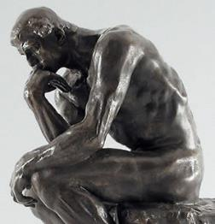
Why do I need a philosophy of education? This is the heart of the course! How do different philosophies impact these aspects of education:
View of the student
E.g.: worker, citizen, product, sinner, image of God
View of the curriculum
View of the school/schooling
View of classroom management
View of knowledge
View of work (or “calling”)
View of last things
View of values
(or view of what’s valuable)

Slide 16
Big challenges facing education
Funding Budgets | Teaching methods change | Proliferation of standardized tests | Focus on achievement vs. creativity | Diverse classrooms
Safety and bullying | Equal opportunity | Keeping up with society’s demands | Standards and assessment | CHANGE
Language gap with diversity | WHAT to teach | Well-rounded students | Respect for all involved, esp. teachers | Tests tied to funding
Technology | Behavior tied to home environment | Distribution of resources | Poverty’s effects | Parental involvement
Grading and school structure | Unequal outcomes | Technology | Special needs
7:15

Slide 17
Introductions and attendance
See separate PPT

Slide 18
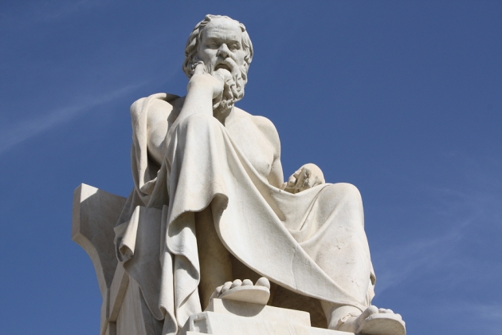
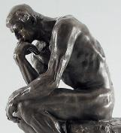
Group activity
Start working on the “Opening Chart”
“What’s your view of…” (5 min.):
Reconvene to discuss the chart all together from 7:20-7:30.

Slide 19
Syllabus Etc.
All available on Canvas
Syllabus
(7:30-7:45)
Rubric for Philosophy of Education Paper
(till 7:50)
Peer Evaluations for Presentations
(FYI)
Canvas Site
(7:50-8:00)

Slide 20
Legal cases related to education:
Skim handout: What are some major themes in legal cases related to education?
Groups: Pick a legal case to present tonight.
Break
Prepare presentations
Do a little additional research on the case.
Tell how it relates to you as a student or teacher or concerned parent/citizen.
What views are implied about the student, the curriculum, and the purpose of schooling?
Presentations 8:45-9:30

Slide 21
Groups present on:
Basics of the case
Tell how it relates to you as a student or teacher or concerned parent/citizen.
What views are implied about the student, the curriculum, and the purpose of schooling?

Slide 22
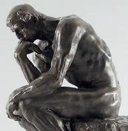
Dietrick Bonhoeffer
“The ultimate test of a moral society is the kind of world it leaves to its children.”

