Slide 1
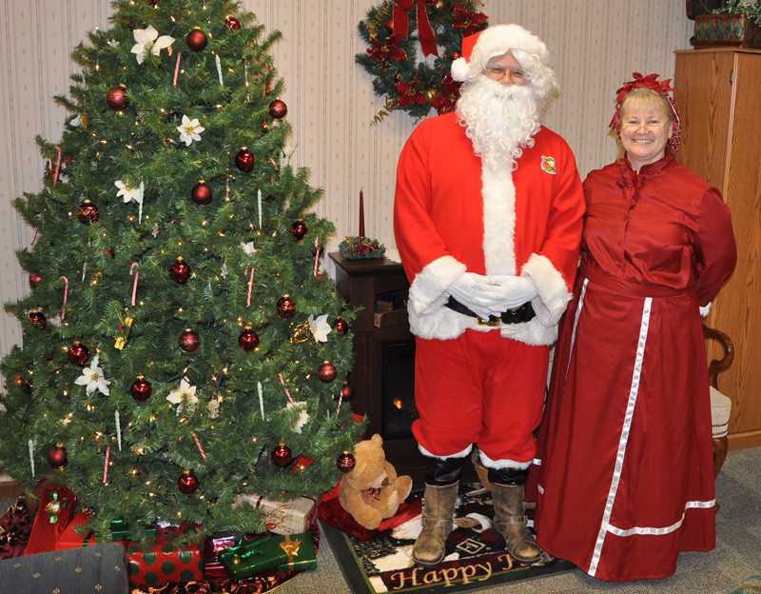
A little bit
About me
Notes:
Picture with quotation in perspective
(Basic)
To reproduce the effects on this slide, do the following:
On the Home tab, in the Slides group, click Layout, and then click Blank.
On the Insert tab, in the Text group, click Text Box, and then on the slide, drag to draw the text box.
Enter text in the text box, select the text, and then on the Home tab, in the Font group, select Georgia from the Font list, enter 27 in the Font Size box, and then click Italic.
On the Home tab, in the Paragraph group, click Align Text Left to align the text left in the text box.
Select the text box. Under Drawing Tools, on the Format tab, in the WordArt Styles group, click Text Fill, and then under Theme Colors click White, Background 1 (first row, first option from the left).
Under Drawing Tools, on the Format tab, in the WordArt Styles group, click Text Effects, point to 3-D Rotation, and then under Perspective, click Perspective Relaxed Moderately (second row, second option from the left).
Under Drawing Tools, on the Format tab, in the WordArt Styles group, click Text Effects, point to 3-D Rotation, and then click 3-D Rotation Options.
In the Format Text Effects dialog box, click 3-D Rotation in the left pane, and then do the following in the right pane:
In the Y box, enter 324.8°.
In the Perspective box, enter 80°.
To reproduce the background on this slide, do the following:
On the Design tab, in the Background group, click Background Styles, and then click Format Background.
In the Format Background dialog box, click Fill in the left pane, and then in the right pane click Picture or texture fill.
Under Insert from, click File.
In the Insert Picture dialog box, select a picture and then click Insert.

Slide 2
Places I’ve lived
Notes:
Picture with quotation in perspective
(Basic)
To reproduce the effects on this slide, do the following:
On the Home tab, in the Slides group, click Layout, and then click Blank.
On the Insert tab, in the Text group, click Text Box, and then on the slide, drag to draw the text box.
Enter text in the text box, select the text, and then on the Home tab, in the Font group, select Georgia from the Font list, enter 27 in the Font Size box, and then click Italic.
On the Home tab, in the Paragraph group, click Align Text Left to align the text left in the text box.
Select the text box. Under Drawing Tools, on the Format tab, in the WordArt Styles group, click Text Fill, and then under Theme Colors click White, Background 1 (first row, first option from the left).
Under Drawing Tools, on the Format tab, in the WordArt Styles group, click Text Effects, point to 3-D Rotation, and then under Perspective, click Perspective Relaxed Moderately (second row, second option from the left).
Under Drawing Tools, on the Format tab, in the WordArt Styles group, click Text Effects, point to 3-D Rotation, and then click 3-D Rotation Options.
In the Format Text Effects dialog box, click 3-D Rotation in the left pane, and then do the following in the right pane:
In the Y box, enter 324.8°.
In the Perspective box, enter 80°.
To reproduce the background on this slide, do the following:
On the Design tab, in the Background group, click Background Styles, and then click Format Background.
In the Format Background dialog box, click Fill in the left pane, and then in the right pane click Picture or texture fill.
Under Insert from, click File.
In the Insert Picture dialog box, select a picture and then click Insert.

Slide 3
My Education
High school:
Eastern Christian (NJ)
College:
Calvin (MI) – English, education, religion
M.A. & Ph.D.:
University of Iowa – English Education
Notes:
Picture with quotation in perspective
(Basic)
To reproduce the effects on this slide, do the following:
On the Home tab, in the Slides group, click Layout, and then click Blank.
On the Insert tab, in the Text group, click Text Box, and then on the slide, drag to draw the text box.
Enter text in the text box, select the text, and then on the Home tab, in the Font group, select Georgia from the Font list, enter 27 in the Font Size box, and then click Italic.
On the Home tab, in the Paragraph group, click Align Text Left to align the text left in the text box.
Select the text box. Under Drawing Tools, on the Format tab, in the WordArt Styles group, click Text Fill, and then under Theme Colors click White, Background 1 (first row, first option from the left).
Under Drawing Tools, on the Format tab, in the WordArt Styles group, click Text Effects, point to 3-D Rotation, and then under Perspective, click Perspective Relaxed Moderately (second row, second option from the left).
Under Drawing Tools, on the Format tab, in the WordArt Styles group, click Text Effects, point to 3-D Rotation, and then click 3-D Rotation Options.
In the Format Text Effects dialog box, click 3-D Rotation in the left pane, and then do the following in the right pane:
In the Y box, enter 324.8°.
In the Perspective box, enter 80°.
To reproduce the background on this slide, do the following:
On the Design tab, in the Background group, click Background Styles, and then click Format Background.
In the Format Background dialog box, click Fill in the left pane, and then in the right pane click Picture or texture fill.
Under Insert from, click File.
In the Insert Picture dialog box, select a picture and then click Insert.

Slide 4
High School English Teaching:
Unity Christian HS (student teaching)
Hudsonville, MI
Westminster Christian High School (AP English)
Miami, FL
Unity Christian High School (English & journalism)
Orange City, IA
Notes:
Picture with quotation in perspective
(Basic)
To reproduce the effects on this slide, do the following:
On the Home tab, in the Slides group, click Layout, and then click Blank.
On the Insert tab, in the Text group, click Text Box, and then on the slide, drag to draw the text box.
Enter text in the text box, select the text, and then on the Home tab, in the Font group, select Georgia from the Font list, enter 27 in the Font Size box, and then click Italic.
On the Home tab, in the Paragraph group, click Align Text Left to align the text left in the text box.
Select the text box. Under Drawing Tools, on the Format tab, in the WordArt Styles group, click Text Fill, and then under Theme Colors click White, Background 1 (first row, first option from the left).
Under Drawing Tools, on the Format tab, in the WordArt Styles group, click Text Effects, point to 3-D Rotation, and then under Perspective, click Perspective Relaxed Moderately (second row, second option from the left).
Under Drawing Tools, on the Format tab, in the WordArt Styles group, click Text Effects, point to 3-D Rotation, and then click 3-D Rotation Options.
In the Format Text Effects dialog box, click 3-D Rotation in the left pane, and then do the following in the right pane:
In the Y box, enter 324.8°.
In the Perspective box, enter 80°.
To reproduce the background on this slide, do the following:
On the Design tab, in the Background group, click Background Styles, and then click Format Background.
In the Format Background dialog box, click Fill in the left pane, and then in the right pane click Picture or texture fill.
Under Insert from, click File.
In the Insert Picture dialog box, select a picture and then click Insert.

Slide 5
Huntington University, Huntington, IN
Education Department Faculty
Department Chair
Accreditation Coordinator
Core Curriculum Director
Dean of Graduate and Adult Programs
Notes:
Picture with quotation in perspective
(Basic)
To reproduce the effects on this slide, do the following:
On the Home tab, in the Slides group, click Layout, and then click Blank.
On the Insert tab, in the Text group, click Text Box, and then on the slide, drag to draw the text box.
Enter text in the text box, select the text, and then on the Home tab, in the Font group, select Georgia from the Font list, enter 27 in the Font Size box, and then click Italic.
On the Home tab, in the Paragraph group, click Align Text Left to align the text left in the text box.
Select the text box. Under Drawing Tools, on the Format tab, in the WordArt Styles group, click Text Fill, and then under Theme Colors click White, Background 1 (first row, first option from the left).
Under Drawing Tools, on the Format tab, in the WordArt Styles group, click Text Effects, point to 3-D Rotation, and then under Perspective, click Perspective Relaxed Moderately (second row, second option from the left).
Under Drawing Tools, on the Format tab, in the WordArt Styles group, click Text Effects, point to 3-D Rotation, and then click 3-D Rotation Options.
In the Format Text Effects dialog box, click 3-D Rotation in the left pane, and then do the following in the right pane:
In the Y box, enter 324.8°.
In the Perspective box, enter 80°.
To reproduce the background on this slide, do the following:
On the Design tab, in the Background group, click Background Styles, and then click Format Background.
In the Format Background dialog box, click Fill in the left pane, and then in the right pane click Picture or texture fill.
Under Insert from, click File.
In the Insert Picture dialog box, select a picture and then click Insert.

Slide 6
Dordt College (since 2014)
Education Department Faculty
Director of Graduate Studies
Director of Concurrent Credit Program
Teach Philosophy of Education
Taught Lifespan Development
Grad courses:
Curriculum Development
Graduate Research Project
Notes:
Picture with quotation in perspective
(Basic)
To reproduce the effects on this slide, do the following:
On the Home tab, in the Slides group, click Layout, and then click Blank.
On the Insert tab, in the Text group, click Text Box, and then on the slide, drag to draw the text box.
Enter text in the text box, select the text, and then on the Home tab, in the Font group, select Georgia from the Font list, enter 27 in the Font Size box, and then click Italic.
On the Home tab, in the Paragraph group, click Align Text Left to align the text left in the text box.
Select the text box. Under Drawing Tools, on the Format tab, in the WordArt Styles group, click Text Fill, and then under Theme Colors click White, Background 1 (first row, first option from the left).
Under Drawing Tools, on the Format tab, in the WordArt Styles group, click Text Effects, point to 3-D Rotation, and then under Perspective, click Perspective Relaxed Moderately (second row, second option from the left).
Under Drawing Tools, on the Format tab, in the WordArt Styles group, click Text Effects, point to 3-D Rotation, and then click 3-D Rotation Options.
In the Format Text Effects dialog box, click 3-D Rotation in the left pane, and then do the following in the right pane:
In the Y box, enter 324.8°.
In the Perspective box, enter 80°.
To reproduce the background on this slide, do the following:
On the Design tab, in the Background group, click Background Styles, and then click Format Background.
In the Format Background dialog box, click Fill in the left pane, and then in the right pane click Picture or texture fill.
Under Insert from, click File.
In the Insert Picture dialog box, select a picture and then click Insert.

Slide 7
Previously taught courses in
Writing, Literature (online adult program)
Business research project (F2F adult program)
Gender in society (J-term with my wife)
Thematic instruction (elem ed.)
Secondary methods
Reading in the content areas
Integration of technology (undergrad & grad)
Curriculum development (grad)
Action research (grad)
Notes:
Picture with quotation in perspective
(Basic)
To reproduce the effects on this slide, do the following:
On the Home tab, in the Slides group, click Layout, and then click Blank.
On the Insert tab, in the Text group, click Text Box, and then on the slide, drag to draw the text box.
Enter text in the text box, select the text, and then on the Home tab, in the Font group, select Georgia from the Font list, enter 27 in the Font Size box, and then click Italic.
On the Home tab, in the Paragraph group, click Align Text Left to align the text left in the text box.
Select the text box. Under Drawing Tools, on the Format tab, in the WordArt Styles group, click Text Fill, and then under Theme Colors click White, Background 1 (first row, first option from the left).
Under Drawing Tools, on the Format tab, in the WordArt Styles group, click Text Effects, point to 3-D Rotation, and then under Perspective, click Perspective Relaxed Moderately (second row, second option from the left).
Under Drawing Tools, on the Format tab, in the WordArt Styles group, click Text Effects, point to 3-D Rotation, and then click 3-D Rotation Options.
In the Format Text Effects dialog box, click 3-D Rotation in the left pane, and then do the following in the right pane:
In the Y box, enter 324.8°.
In the Perspective box, enter 80°.
To reproduce the background on this slide, do the following:
On the Design tab, in the Background group, click Background Styles, and then click Format Background.
In the Format Background dialog box, click Fill in the left pane, and then in the right pane click Picture or texture fill.
Under Insert from, click File.
In the Insert Picture dialog box, select a picture and then click Insert.

Slide 8
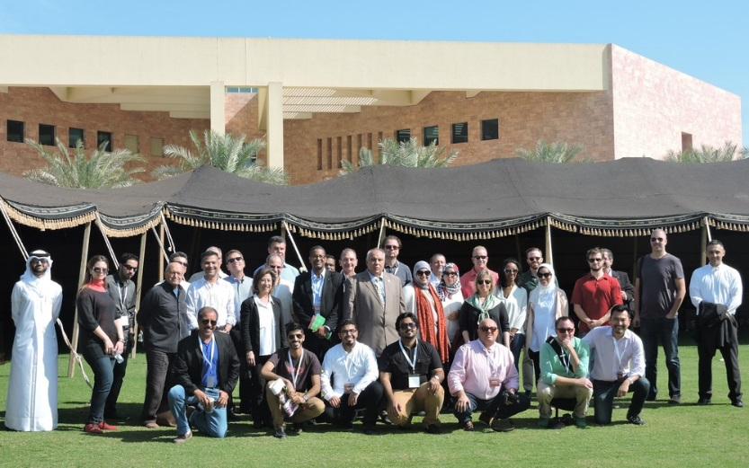
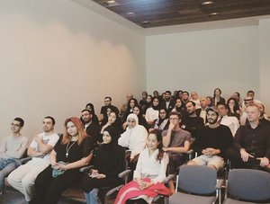
Conference presentations on
faith integration
diversity, multicultural education
learning outcomes
accreditation
alternative assessment
institutional assessment
grad & adult learning
Notes:
Picture with quotation in perspective
(Basic)
To reproduce the effects on this slide, do the following:
On the Home tab, in the Slides group, click Layout, and then click Blank.
On the Insert tab, in the Text group, click Text Box, and then on the slide, drag to draw the text box.
Enter text in the text box, select the text, and then on the Home tab, in the Font group, select Georgia from the Font list, enter 27 in the Font Size box, and then click Italic.
On the Home tab, in the Paragraph group, click Align Text Left to align the text left in the text box.
Select the text box. Under Drawing Tools, on the Format tab, in the WordArt Styles group, click Text Fill, and then under Theme Colors click White, Background 1 (first row, first option from the left).
Under Drawing Tools, on the Format tab, in the WordArt Styles group, click Text Effects, point to 3-D Rotation, and then under Perspective, click Perspective Relaxed Moderately (second row, second option from the left).
Under Drawing Tools, on the Format tab, in the WordArt Styles group, click Text Effects, point to 3-D Rotation, and then click 3-D Rotation Options.
In the Format Text Effects dialog box, click 3-D Rotation in the left pane, and then do the following in the right pane:
In the Y box, enter 324.8°.
In the Perspective box, enter 80°.
To reproduce the background on this slide, do the following:
On the Design tab, in the Background group, click Background Styles, and then click Format Background.
In the Format Background dialog box, click Fill in the left pane, and then in the right pane click Picture or texture fill.
Under Insert from, click File.
In the Insert Picture dialog box, select a picture and then click Insert.

Slide 9
Personal:
Married, 3 grown children
Live in Sioux Center
Hobbies: hiking, photography, sailing
Attend Covenant CRC (elder)
Notes:
Picture with quotation in perspective
(Basic)
To reproduce the effects on this slide, do the following:
On the Home tab, in the Slides group, click Layout, and then click Blank.
On the Insert tab, in the Text group, click Text Box, and then on the slide, drag to draw the text box.
Enter text in the text box, select the text, and then on the Home tab, in the Font group, select Georgia from the Font list, enter 27 in the Font Size box, and then click Italic.
On the Home tab, in the Paragraph group, click Align Text Left to align the text left in the text box.
Select the text box. Under Drawing Tools, on the Format tab, in the WordArt Styles group, click Text Fill, and then under Theme Colors click White, Background 1 (first row, first option from the left).
Under Drawing Tools, on the Format tab, in the WordArt Styles group, click Text Effects, point to 3-D Rotation, and then under Perspective, click Perspective Relaxed Moderately (second row, second option from the left).
Under Drawing Tools, on the Format tab, in the WordArt Styles group, click Text Effects, point to 3-D Rotation, and then click 3-D Rotation Options.
In the Format Text Effects dialog box, click 3-D Rotation in the left pane, and then do the following in the right pane:
In the Y box, enter 324.8°.
In the Perspective box, enter 80°.
To reproduce the background on this slide, do the following:
On the Design tab, in the Background group, click Background Styles, and then click Format Background.
In the Format Background dialog box, click Fill in the left pane, and then in the right pane click Picture or texture fill.
Under Insert from, click File.
In the Insert Picture dialog box, select a picture and then click Insert.

Slide 10
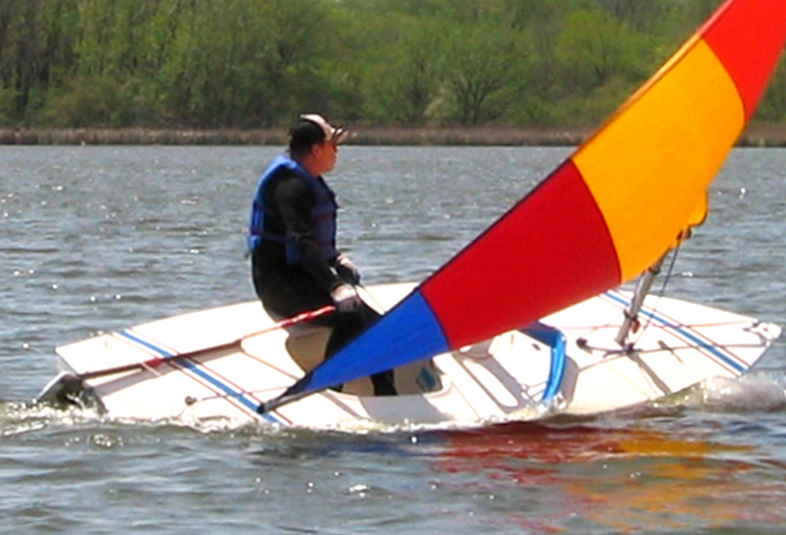
When I first wanted to be a teacher:
Teaching sailing merit badge at a Boy Scout camp near Port Jervis, NY
Notes:
Picture with quotation in perspective
(Basic)
To reproduce the effects on this slide, do the following:
On the Home tab, in the Slides group, click Layout, and then click Blank.
On the Insert tab, in the Text group, click Text Box, and then on the slide, drag to draw the text box.
Enter text in the text box, select the text, and then on the Home tab, in the Font group, select Georgia from the Font list, enter 27 in the Font Size box, and then click Italic.
On the Home tab, in the Paragraph group, click Align Text Left to align the text left in the text box.
Select the text box. Under Drawing Tools, on the Format tab, in the WordArt Styles group, click Text Fill, and then under Theme Colors click White, Background 1 (first row, first option from the left).
Under Drawing Tools, on the Format tab, in the WordArt Styles group, click Text Effects, point to 3-D Rotation, and then under Perspective, click Perspective Relaxed Moderately (second row, second option from the left).
Under Drawing Tools, on the Format tab, in the WordArt Styles group, click Text Effects, point to 3-D Rotation, and then click 3-D Rotation Options.
In the Format Text Effects dialog box, click 3-D Rotation in the left pane, and then do the following in the right pane:
In the Y box, enter 324.8°.
In the Perspective box, enter 80°.
To reproduce the background on this slide, do the following:
On the Design tab, in the Background group, click Background Styles, and then click Format Background.
In the Format Background dialog box, click Fill in the left pane, and then in the right pane click Picture or texture fill.
Under Insert from, click File.
In the Insert Picture dialog box, select a picture and then click Insert.

Slide 11
Now about
YOU!
Your name
Major
Home town
Hobby, sport
How you got interested in your major
Notes:
Picture with quotation in perspective
(Basic)
To reproduce the effects on this slide, do the following:
On the Home tab, in the Slides group, click Layout, and then click Blank.
On the Insert tab, in the Text group, click Text Box, and then on the slide, drag to draw the text box.
Enter text in the text box, select the text, and then on the Home tab, in the Font group, select Georgia from the Font list, enter 27 in the Font Size box, and then click Italic.
On the Home tab, in the Paragraph group, click Align Text Left to align the text left in the text box.
Select the text box. Under Drawing Tools, on the Format tab, in the WordArt Styles group, click Text Fill, and then under Theme Colors click White, Background 1 (first row, first option from the left).
Under Drawing Tools, on the Format tab, in the WordArt Styles group, click Text Effects, point to 3-D Rotation, and then under Perspective, click Perspective Relaxed Moderately (second row, second option from the left).
Under Drawing Tools, on the Format tab, in the WordArt Styles group, click Text Effects, point to 3-D Rotation, and then click 3-D Rotation Options.
In the Format Text Effects dialog box, click 3-D Rotation in the left pane, and then do the following in the right pane:
In the Y box, enter 324.8°.
In the Perspective box, enter 80°.
To reproduce the background on this slide, do the following:
On the Design tab, in the Background group, click Background Styles, and then click Format Background.
In the Format Background dialog box, click Fill in the left pane, and then in the right pane click Picture or texture fill.
Under Insert from, click File.
In the Insert Picture dialog box, select a picture and then click Insert.

