Slide 1
Group Debates
EDUC 300 Philosophy of Education
Fall 2017

Slide 2
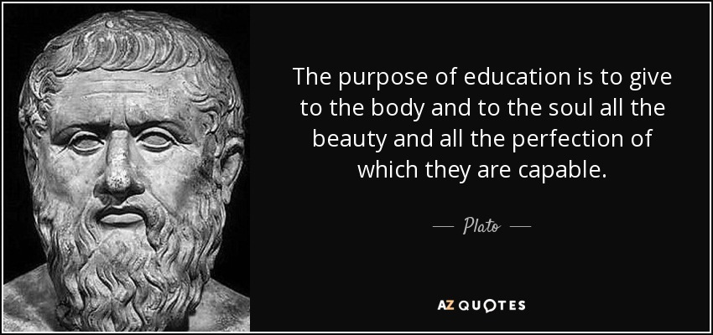
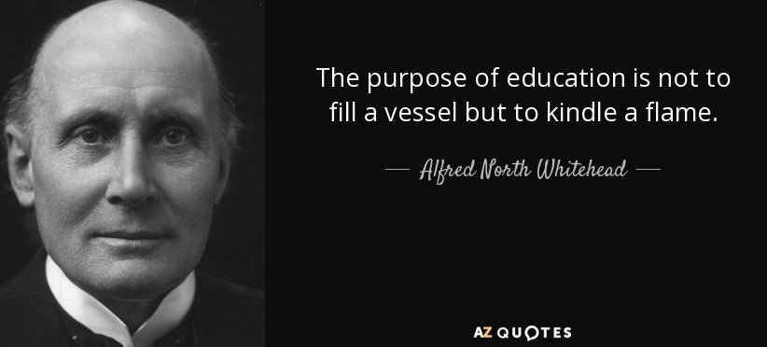
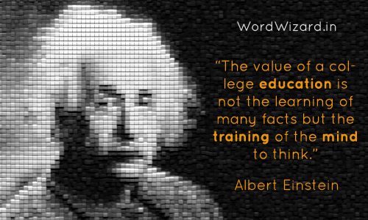
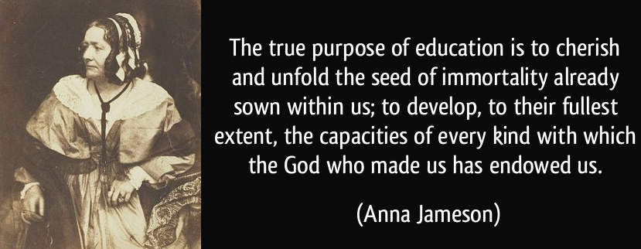

Slide 3
Debate Topic: Purpose of Education (Week 2: Knight Chapters 1-2)
Discuss: Review Knight’s “Role of School in Society” section in Chapter 1 and “Philosophic Issues and Educational Goals and Practices” in Chapter 2.
List the different purposes of education you see in these sections.
Groups pick one of the stakeholders in education (listed below).
Stakeholders: the state, the federal government, employers, the local community, the church, the family, the student, the teacher.
Brainstorm and write a sentence expressing the purpose(s) of education for that stakeholder.
Find online news articles, editorials, or stakeholder websites that illustrate this stakeholder’s view of the purpose of education.
Evaluate the pros and cons of these perspectives from a biblical stance.
Write a sentence that describes your group’s consensus for now on the purpose of education today in America.

Slide 4
Debate Topic: View of Curriculum & Assessment (Week 3: Knight Chapter 3)
Discuss: How would each –ism in Chapter 3 view the curriculum? How would each –ism view assessment of student learning?
List the different views of these that you see in this chapter.
Groups pick one of the views of the curriculum (listed below).
Views of the curriculum: time-tested truths, tools for exploration, resources on the journey, debatable propositions, cultural artifacts, a record of human knowledge and accomplishment, resources for constructing individual knowledge, programmable tidbits for reinforcing memories.
Brainstorm and write a sentence expressing this view of the curriculum.
Find articles or educational resources online that illustrate or support this view of the curriculum.
Write a sentence that describes the function of assessment for this view of the curriculum.
Evaluate the pros and cons of this view from a biblical stance.
Write a sentence that describes your group’s consensus for now on your view of the curriculum.

Slide 5
Debate Topic: View of the Student (Week 4: Knight Chapter 4, History of Education)
How would each –ism in Chapter 4 view the student?
List the different views of the student that you see in this chapter.
Groups pick one of the views of the student (listed below).
Views of the student: Image of God, sinner, brain on a stick, self-actualizer, evolved animal, future worker, future whole person, living in the present
Brainstorm and write a sentence expressing this view of the student.
Find articles or educational resources online that illustrate this view of the student.
Evaluate the pros and cons of this view from a biblical stance.
Write a sentence that describes your group’s consensus for now on your view of the student.
What implications does this view of the student have for one’s view of the curriculum and the purpose of education?

Slide 6
Debate Topic: View of the Teacher (Week 5: Knight Chapter 6)
How would each –ism in Chapter 6 view the teacher?
List the different views of the teacher that you see in this chapter.
Groups pick one of the views of the teacher (listed below).
Views of the teacher: shepherd, cop, facilitator, coach, fellow traveler, experienced guide, trainer, seed planter
Brainstorm and write a sentence expressing this view of the teacher.
Find articles or educational resources online that illustrate this view of the teacher. (Articles on classroom management might help illustrate this view of the teacher.)
Evaluate the pros and cons of this view from a biblical stance.
Write a sentence that describes your group’s consensus for now on your view of the teacher.
What implications does this view of the teacher have for one’s view of classroom management?
What implications does this view of the teacher have for one’s view of the student, curriculum and purpose of education?

Slide 7
Debate Topic: View of Calling and Work (Week 6: Knight Chapters 5 & 7)
How would each –ism in Chapters 5 & 7 view calling and work?
List the different views of calling and work that you see in these chapters.
Groups pick one of the views of calling and work (listed below).
Views of calling and work: maximize income & minimize effort, learn to avoid life’s pitfalls, be all you can be, live for the present, be a well-rounded person, be clever, life is the journey not the destination, learn to be rather than do, use your gifts for God’s kingdom, be a child of God
Brainstorm and write a sentence expressing this view of calling/work.
Find articles or educational resources online that illustrate this view of calling/work.
Evaluate the pros and cons of this view from a biblical stance.
Write a sentence that describes your group’s consensus for now on your view of calling/work.
What implications does this view of calling/work have for your view of the student, teacher, curriculum and purpose of education?

