Slide 1
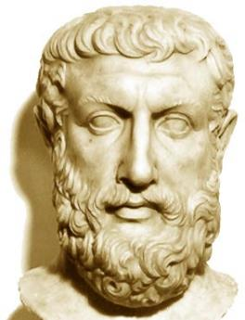
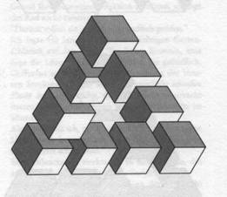
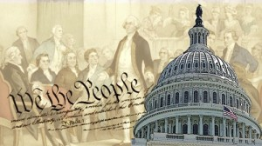
Philosophy of Education Sept. 5, 2017
EDUC 300 & CORE 310
Dr. Stephen D. Holtrop
Dordt College

Slide 2
Tonight’s agenda
Brief review and questions
Quick preview of what to look for and expect in History of Education (reading and presentations)
Knight Chapter 1 – brief overview
Knight Chapter 2
Metaphysics
Epistemology
Axiology
Group debates
Looking ahead to Chapter 3

Slide 3
General questions about the course?
Syllabus
Structure of the course
Expectations
Canvas
Discussion forums
Discussion groups
Assignment submissions
Announcements?
Other handouts (on Canvas)
Rubric for the philosophy paper
Group work: individual accountability
Poll Everywhere

Slide 4
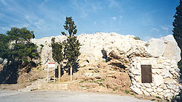
Review
Love of
Wisdom
Philosophy is Greek for ____ of ______.
Table partners: How was the Apostle Paul reacting to the philosophies in Athens (as told in Acts 17)?
Engraved plaque containing Apostle Paul's Areopagus sermon.

Slide 5
Review
Why is philosophy of education relevant for teachers? (Can you name some aspects or applications of philosophy of education?)
View of… | Greek or Latin word
Student | Anthropology
Subjects | Curriculum
Knowledge & Truth | Epistemology
Work | Vocation
Last things | Eschatology
Values | Axiology

Slide 6
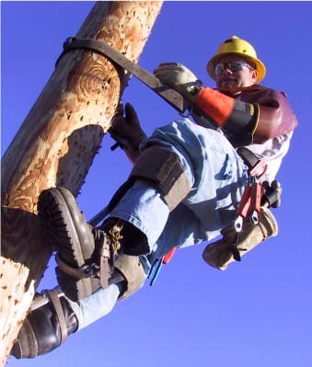
Review
Why is philosophy of education relevant for other adults?
What other system has as much influence on as many people and employs as many people?
Teachers, parents, administrators, citizens/tax payers, community leaders, church members, quasi-teachers
Why can’t we just skip having a philosophy of education?
No one can skip having a worldview.
Whether or not we use the big words, we still have the assumptions the words describe.

Slide 7
Review Legal Issues in Education
There is a question on the midterm about the court cases.
Can you compare/contrast several cases…
Tell how they relate to you as a student or teacher or concerned parent/citizen?
Analyze the views that are stated or implied about the student, the teacher, the curriculum, the purpose of schooling, and the concept of vocation?
Describe some of the competing principles (values, perspectives) in these education-related legal cases?

Slide 8
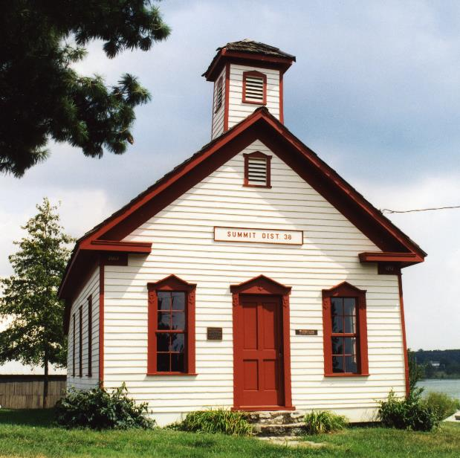
Preview for Week 4 Group presentations on historical eras ~reading due next week (Review the following slides on the eras.)
Groups will discuss one of the historical eras and give a short presentation on Sept. 19.
Read your group’s historical era section right away. Read the whole chapter by Sept. 19.
Groups should discuss and present on:
Main issues and events of the historical era
Pros and cons of the era
Address issues and questions on the following slides

Slide 9
Preview for Week 4 Group presentations on historical eras ~reading due next week (Review the following slides on the eras.)
Also: Provide evidence of the prevailing attitudes in the era toward:
The view of the student
The view of the teacher
The view of the curriculum
Purpose of education
The view of work
Values
Each member of a group should participate in the presentation.
You may choose your own groups, making sure to include everyone in the class.

Slide 10
Preview for Week 4 History of education Goals:
Understand the significant events for each era
Evaluate how each era viewed students, teachers, curriculum, knowledge, work, and values
Analyze trend data in American education and evaluate "The American Experiment"

Slide 11
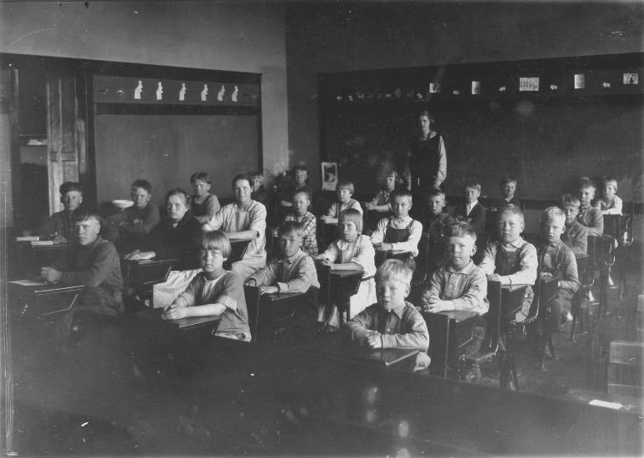
Preview for Week 4 History of Education
History/
Colonial education (education in the North vs. education in the South)
The Common School era (include assumptions held by opposition groups)
The Progressive Movement (Dewey and others)
The Public High School (including the curriculum battles)
The Post-War (WWII) Era (evidenced in the expansion of education)
The Equal-Rights Era (evidenced in unequal access)
The Reform and Standards Era (including competing goals)

Slide 12
Preview for Week 4 Citation for History of Education PDF
“History of Education” Chapter 3 (on Canvas) from:
By Alan R. Sadovnik, Peter W. Cookson, Jr., Susan F. Semel
2013
Exploring Education: An Introduction to the Foundations of Education, 4th Edition
Routledge

Slide 13
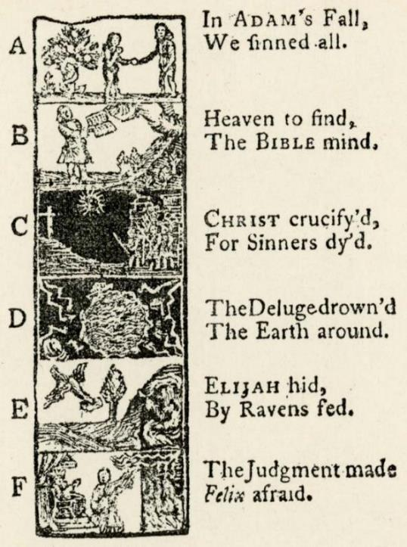
Preview for Week 4 Colonial education
History/Colonial
Groups: Please address these issues…
Why were nine universities started in the colonies before 1776?
Explain The Old Deluder Satan Law. What’s the perspective on education here? Why didn’t many towns establish these dame schools?
Why do we have the phrase “back to basics” when colonial schools offered public speaking, art, surveying, navigation, and modern foreign languages? What’s the perspective on education here?
Why did reading the classics work for sons of the elite but not girls, regular folks, or native Americans? What conflicting perspectives were at work here?
How did the Quakers differ in their perspectives? Results?
What were the main perspectives on educating slaves?
How were each of these debated in this era?
View of the student, teacher, curriculum, knowledge, work, values
Horn Book

Slide 14
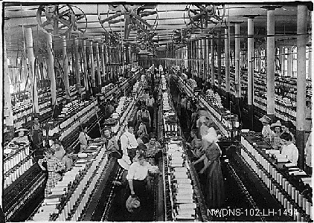
Preview for Week 4 The Common School era
History/Common School
Groups: Please address these issues…
How did the Industrial Revolution affect education? What perspectives on education prevailed as schools adjusted to…
Factories
Urban growth
Immigrants
Right to vote
Social reform
How were each of these debated in this era?
View of the student, teacher, curriculum, knowledge, work, values
Child Labor

Slide 15
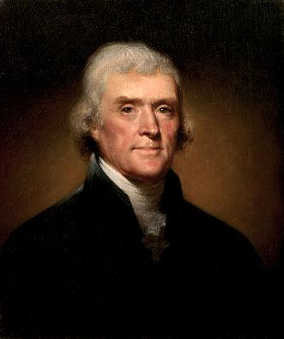
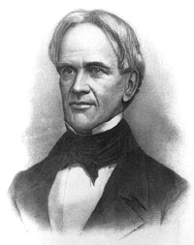
Preview for Week 4 The Common School era
History/Common School
How is Horace Mann’s perspective similar to Thomas Jefferson’s? How are they different?
Is American education “the great equalizer”?
Which groups were opposed to free public education? Why?
Which groups of students were not benefitting as much from all this educational progress? What perspectives were missing, according to these groups, in the mainstream educational system?
How were each of these debated in this era?
View of the student, teacher, curriculum, knowledge, work, values
Jefferson and Mann
Groups: Please address these issues…

Slide 16
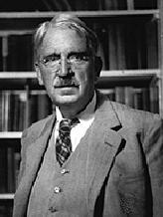
Preview for Week 4 The Progressive Movement
History/Progressive Movement
How does the Progressive Movement remind you of some education problems today? How did schools change to accommodate society’s changes?
What were some of John Dewey’s main perspectives?
In what ways was Dewey misunderstood?
How might our perspectives today be different from those of the Progressive Movement?
How were each of these debated in this era?
View of the student, teacher, curriculum, knowledge, work, values
Dewey
Groups: Please address these issues…

Slide 17
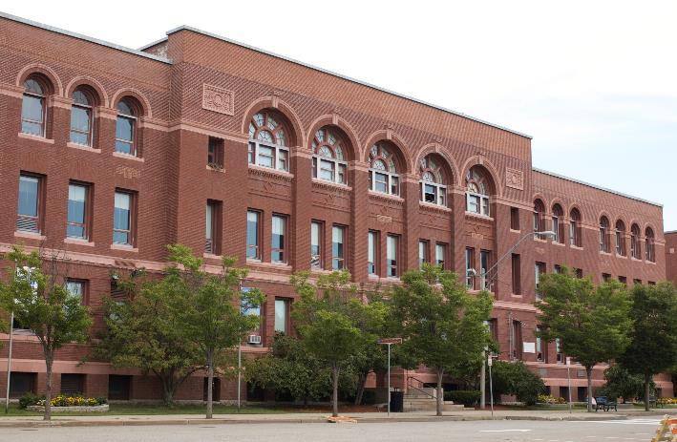
Preview for Week 4 The Public High School
History/Public High School
Why was the shift from selective high schools to compulsory high schools so monumental?
Clashing perspectives. (What’s today’s similar debate?)
Classical subjects vs. modern subjects (Latin & Greek vs. science & English)
College entrance requirements
Preparation for life
Common curriculum
What big economic phenomenon occurred in this period and how do you think it affected education?
How were each of these debated in this era?
View of the student, teacher, curriculum, knowledge, work, values
Groups: Please address these issues…

Slide 18
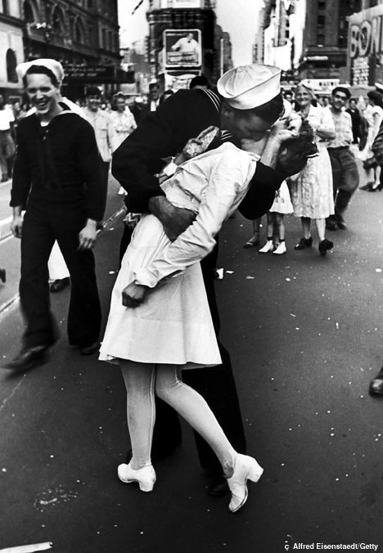
Preview for Week 4 The Post-War (WWII) Era
History/Post-War
Why are equity and excellence seen as competing principles?
Why would student-centered schooling be in such contrast to knowledge-centered schooling? How do these differing perspectives affect the view of the student, curriculum, knowledge, work, and values?
Unpack this charge: Progressive education sacrificed intellectual goals for social goals (p. 74).
Does education track poor and working class children into nonacademic vocational programs? Critique this.
How were each of these debated in this era?
View of the student, teacher, curriculum, knowledge, work, values
Groups: Please address these issues…

Slide 19
Preview for Week 4 The Post-War (WWII) Era
History/Post-War
What happened to American education after Sputnik (1957)? What caused a recent resurgence in STEM emphases?
How did civil rights, the antiwar movement, and poverty affect American education?
What overall effect did all this social unrest have on teaching methods in high schools and colleges? Speculate reasons.
Who knows what single Post-War government program did a lot for college enrollments?
How were each of these debated in this era?
View of student, teacher, curriculum, knowledge, work, value
Groups: Please address these issues…

Slide 20
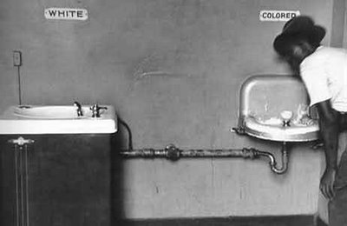
Preview for Week 4 The Equal-Rights Era
History/Equal-Rights
Recall existing precedent of racial segregation
Plessy v. Ferguson (1896)
Plessy (P) attempted to sit in an all-white railroad car. After refusing to sit in the black railway carriage car, Plessy was arrested for violating an 1890 Louisiana statute that provided for segregated “separate but equal” railroad accommodations. Those using facilities not designated for their race were criminally liable under the statute.
At trial with Justice John H. Ferguson (D) presiding, Plessy was found guilty on the grounds that the law was a reasonable exercise of the state’s police powers based upon custom, usage, and tradition in the state. Plessy filed a petition for writs of prohibition and certiorari in the Supreme Court of Louisiana against Ferguson, asserting that segregation stigmatized blacks and stamped them with a badge of inferiority in violation of the Thirteenth and Fourteenth amendments. The court found for Ferguson and the Supreme Court granted cert.
Groups: Please address these issues…

Slide 21
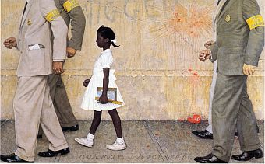
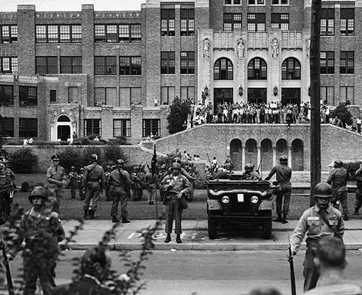
Preview for Week 4 The Equal-Rights Era
Groups: Please address these issues…
Why did the Supreme Court reverse itself in the 1950s?
Brown v. Board of Education (1954)
This case is a consolidation of several different cases from Kansas, South Carolina, Virginia, and Delaware. Several black children (through their legal representatives, Ps) sought admission to public schools that required or permitted segregation based on race. The plaintiffs alleged that segregation was unconstitutional under the Equal Protection Clause of the Fourteenth Amendment.
In all but one case, a three judge federal district court cited Plessy v. Ferguson in denying relief under the “separate but equal” doctrine. On appeal to the Supreme Court, the plaintiffs contended that segregated schools were not and could not be made equal and that they were therefore deprived of equal protection of the laws.
National Guard at desegregation of Little Rock High School, September 26, 1957

Slide 22
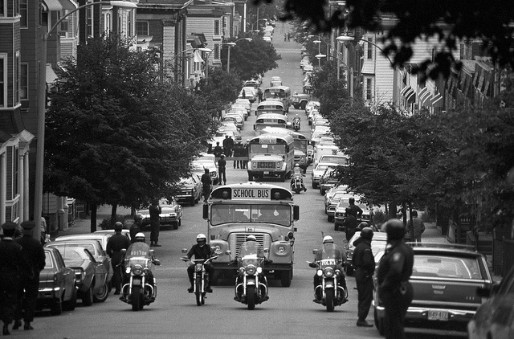
Preview for Week 4 The Equal-Rights Era
History/Equal-Right
Groups: Please address these issues…
Police-escorted school buses on first day of court-ordered busing, South Boston (1975)
How were each of these debated in this era?
View of the student, teacher, curriculum, knowledge, work, values

Slide 23
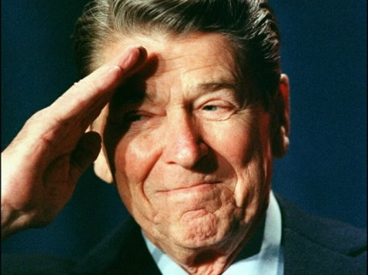
Preview for Week 4 The Reform and Standards Era
History/Reform/Standards
Explain the argument that using the schools to ameliorate social problems resulted in mass mediocrity (p. 81).
A Nation at Risk (1983)
High rates of adult illiteracy, declining SAT scores, not keeping up with other countries
“Rising tide of mediocrity”
"If an unfriendly foreign power had attempted to impose on America the mediocre educational performance that exists today, we might well have viewed it as an act of war.”
Recommendations:
New basics: English, math, science, social studies, computer science
Higher entrance standards for colleges and universities
Strengthen teacher preparation
Give teachers more respect and reward
Explain the tension between “excellence” and “equity.”
Reagan
Groups: Please address these issues…

Slide 24
Preview for Week 4 The Reform and Standards Era
History/Reform/Standards
Are the schools better as a result of all these reforms?
Clinton: Goals 2000 (1994)
Bush: No Child Left Behind (2001)
Obama: Race to the Top (2009)
Every Student Succeeds (2015)
What are some pros and cons of the resultant movements?
School choice
Homeschooling
Private schools
Charter schools
Tuition vouchers
Standards movement
State content standards
Standardized tests (for teachers and students)
Groups: Please address these issues…
How were each of these debated in this era?
View of the student, teacher, curriculum, knowledge, work, values

Slide 25
Preview for Week 4 History of Education Review
Can you now…
Understand the significant events for each era?
Evaluate how each era viewed students, teachers, curriculum, knowledge, work, and values?
Please sign up for eras to present during the next two weeks.

Slide 26
Knight: Chapter 1 (brief overview)
Why philosophy?
Why apply it to education?
Student question: A lot of the concepts in this chapter were hard to grasp right away and they made you think. One that I had trouble understanding was figure 2 on page 11 in chapter one. The diagram is trying to explain the relationship of selected learning-related concepts.
2-minute groups: Points to Ponder, p. 12
Discuss 1 question in each group

Slide 27
Knight: Chapter 2 Philosophical issues in education
Knight/
Metaphysics
Epistemology
Axiology

Slide 28
Knight: Chapter 2 Philosophical issues in education
Knight/
Metaphysics
What is real?
Epistemology
What is true?
Axiology
What is valued?

Slide 29
Metaphysics
What is Metaphysics?
What does this literally mean in Greek?
What all is included in metaphysics (pp. 16-18)?
What does –ology mean in Greek?
Cosmology, which is _________
Theology, which is _________
Anthropology, which is _________
Ontology (“is”ology) , which is _________
What is real?
What does this all have to do with education?

Slide 30
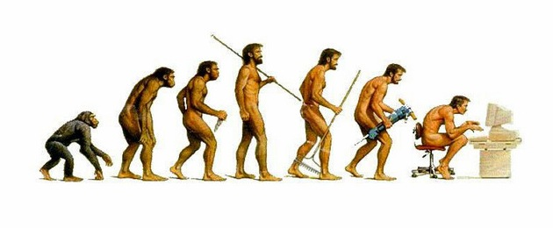
Metaphysics - Anthropology
Knight/Metaphysics/Anthropology
One aspect of metaphysics is anthropology.
Which, again, is ____________
How does the view of the student make a difference in education?
Student as “naked ape.”
Student is essentially good.
Student is essentially sinful.
Student is made in God’s image.

Slide 31
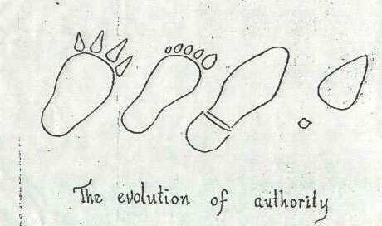
Metaphysics - Anthropology
Knight/Metaphysics/Anthropology
Dr. Nancy Pearcy speaking at the First Mondays Lecture in September (2014)
How does the view of the student differ between…
The Genesis 1 approach?
The Genesis 3 approach?
Table groups: why does philosophical anthropology matter in education?

Slide 32
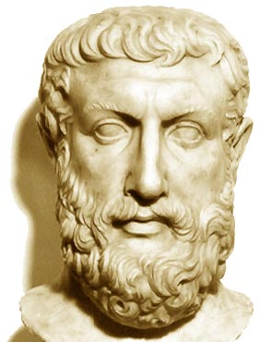
Metaphysics - Ontology
Knight/Metaphysics/Ontology
Got to here on 1/19/17
Another aspect of metaphysics is ontology.
Which, again, is ____________
How does the view of “what is” make a difference in education?
Do things exist (are they real) even if there are no humans to experience them?
If a tree falls in a forest and no one’s there to hear it, does it still make a noise? How do you know?
Is your concept of “green” the same as mine? How do we know either way?
Parmenides was among the first to propose an ontological characterization of the fundamental nature of reality.

Slide 33
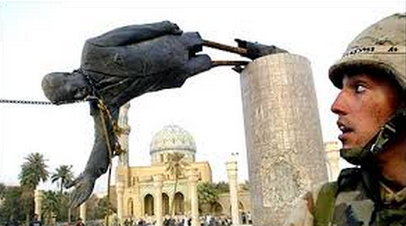
Metaphysics - Ontology
Knight/Metaphysics/Ontology
Do learners all construct their own knowledge in their own way? (“Constructivism”)
If we as learners are made in God’s image, but God is omniscient, is learning part of the fallen world or the created order?
Can humans think something into existence? E.g., the terrorist state in the Middle-East? Or the American Dream? Or the failure of the public schools? Or the failure of one or more branches of the federal government?
Do these concepts (e.g., liberty, privacy, rights, truth, reality) actually “exist”?
(Table partners) Comment on this: Every teacher in America has strong perspectives on these examples which can come into his/her teaching every day.

Slide 34
Student questions from Canvas discussions (metaphysics: real)
Knight/
Why do people get so caught up on metaphysics?
I would maybe say that metaphysics is slightly higher on the importance scale, but wouldn't say one is better than the other. It is necessary to have the facts and figures, but human thought and activity bring education to a whole other level. My question is, "What is your opinion? Do you think one is better than the other?“

Slide 35
Epistemology
Knight/Epistemology
What is Epistemology?
What does this literally mean in Greek?
What all is included in Epistemology (pp. 20-26)?
What are some down-to-earth issues in Dimensions of Knowledge?
What are some down-to-earth issues in Sources of Knowledge?
What are some down-to-earth issues in Validity of Knowledge?
Explain in your own words the metaphysical-epistemological dilemma (p. 27).
What does faith or worldview have to do with the dilemma?
(See Amy-Mal exchange on FB.)
What is true?
Table groups: What does this all have to do with education?

Slide 36
Student questions from Canvas discussions (epistemology: truth)
Knight/
How can we make sure that our methodologies and practices are consistent with our educational philosophy? How do we know when they are not consistent? How much self-reflection does it take to make sure we remain consistent with our philosophy?

Slide 37
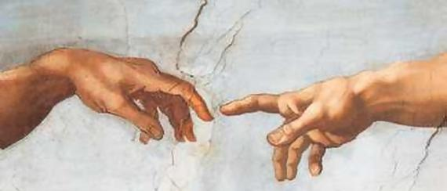
Axiology
Knight/Axiology
What is Axiology?
What does this literally mean in Greek? Study of ______
What all is included in Axiology (pp. 29-31)?
Why would ethics be part of the K-12 educational process?
I’ve noticed a lot of emphasis on ethical dilemmas in TV cop shows like NCIS, MI-5, Luther. What do you think is going on with that? Does this matter to educators?

Slide 38
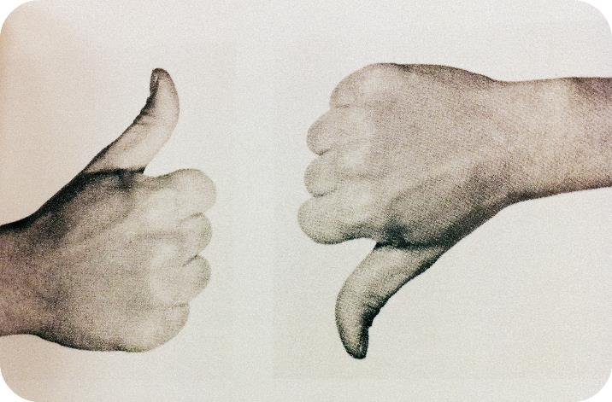
Axiology
Knight/Axiology
Are ethical standards and moral values absolute or relative?
Do universal moral values exist?
Monogamy?
Respect life?
Respect property?
Does the end ever justify the means?
Can morality be separated from religion?
Who or what forms the basis of ethical authority?
From Knight p. 30

Slide 39
Axiology
Knight/Axiology
Why is aesthetics part of Knight’s look at the landscape of philosophy of education?
React to this: “Human beings are aesthetic beings, and it is just as impossible to avoid teaching aesthetics in the school, home, media, or church as it is to avoid inculcating ethical values.” (p. 31)
Should we teach values in the public schools? If so, whose values?
Do you think there could be such a thing as a Christian floor plan for a school? (A Dordt grad student studied this in a research project for a school in BC.)
What is valued?
Table groups: What does this all have to do with education?

Slide 40
Student questions from Canvas discussions (axiology: ethics and aesthetics)
Knight/
In a forever changing world how do we determine what is of the most important value?
If everything you think you know is based off of your own reality, then why do people like to think that what someone else believes is wrong/false? I understand that everyone has their own beliefs and no one is going to believe in something that they think is wrong, but if we can all come to the understanding that our social views, political views, religious views, and the way we view education all come from assumptions we have made to certain questions we have had, why do people feel the need to condemn others for the way they view life. Does this come from lack of self awareness or an excess of self awareness?
How can we best explain everyone's Christian or not, purpose? As a Christian I believe my purpose is to glorify God in all that I do. But what about those who always ask the question…”what is my purpose” I think Aristotle was the one the purposed this question, and I agree, everyone wants to have a purpose. How does one also best explain that through the midst of suffering?

Slide 41
Student questions from Canvas discussions (axiology: ethics and aesthetics)
Knight/
Giving Students the Right Values:
In todays culture a lot of people but a lot of pressure of making sure you go to the right school. Is this a good thing because it encourages kids to pursue a formal education or does this need to change to allow kids to experience their own life? Should schools be focused on morality or should that be left more for the church and family?
However, can it be dangerous to only expose children to the beliefs you, as a parent, have? Should we allow our children to be educated about other types of beliefs, even if we do not agree with these beliefs as Christians, to better educate them to defend the beliefs they do have?
How can people like me who never plan on becoming educators encourage and push these ideas forward? Like the author said, there is so much focus on just getting money and pushing people through and I feel that would cause an outside "voice of reason" to be drowned out?

Slide 42
Student questions from Canvas discussions (axiology: ethics and aesthetics)
Knight/
Christians in the Public Schools:
On page 35, the book brings forth a challenge for Christian educators, “The challenge for Christian educators is to select and develop educational practices that harmonize with their beliefs and are, at the same time, feasible in their social, political, and economic context.” As a Christian and public teacher how do you address this challenge?
Should ethics be less of a focus in school and more on aesthetics? How to we make sure we are properly sharing our ethical view without crossing the lines of preaching at our student?
In what ways can you integrate Christian theology in teachings in a public school setting?

Slide 43
Student questions from Canvas discussions (axiology: ethics and aesthetics)
Knight/
Aesthetics:
If our society is driven by technology and it also depends on aesthetics (because humans are aesthetic beings), then why do these two categories not intertwine in the education system?
Can/should aesthetics include sports and physical activity?
How are metaphysics, epistemology, and axiology used together in one curriculum? Are they supposed to be taught separately or can they be taught together as one question asked to the students?

Slide 44
Review Knight: Chapter 2
Knight/Review
On the midterm:
Can you now…
Define and understand what's included in metaphysics?
What “is” / What’s “real”
Apply metaphysics to education?
Define and understand what's included in epistemology?
What’s “true” / What’s “knowledge”
Apply epistemology to education?
Define and understand what's included in axiology?
What do we value – morally (ethics), aesthetically
Apply axiology to education?

Slide 45
Looking ahead
Week 3 Jan. 26 | Read Knight, Chapter 3 “Traditional Philosophies” (25 pp.) Idealism Realism Neo-Scholasticism Do discussion forum 2 on Canvas (in groups this week)

Slide 46
Groups of 3: applications to education
Think:
What is real, true, and valued?
How do these questions help us with thorny concepts like:
Scientific “facts”
“True” history, “true” news
“Truths” about human nature
Teaching our “values”
Voting our “values”
Discuss:
See “debate” Powerpoint

