Slide 1
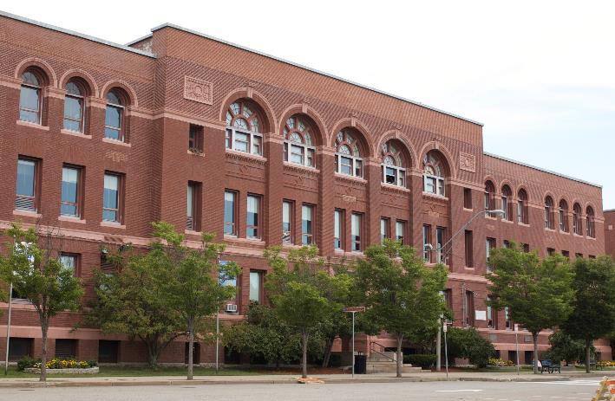
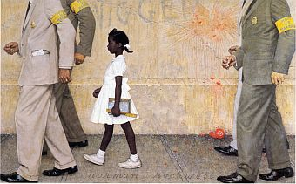
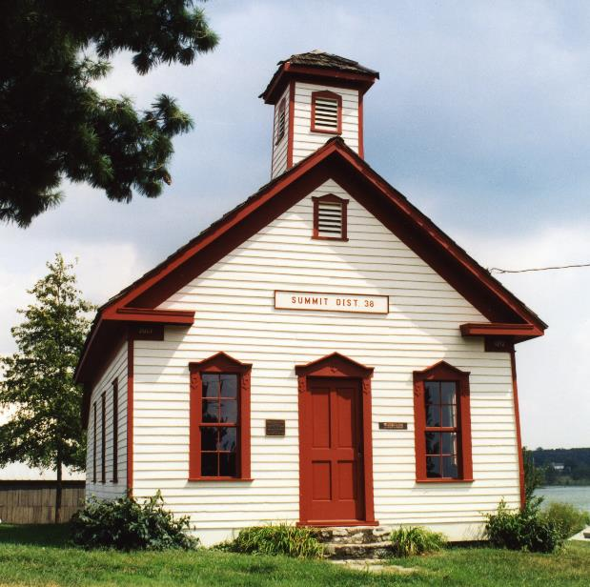
The American Experiment
EDUC 300 & CORE 310
Dr. Stephen D. Holtrop
Dordt College
Sept. 27, 2016
8:15

Slide 2
“The American Experiment”
American Experiment
So, has the 300-year-old American education system of a free education for everyone been a success?
“The U.S. school system has expanded to serve more students for longer periods of time than any other system in the modern world.” (p. 82)
Or:
"If an unfriendly foreign power had attempted to impose on America the mediocre educational performance that exists today, we might well have viewed it as an act of war.” (Nation at Risk, 1983)

Slide 3
“The American Experiment”
What are some arguments for the position that the American education system meets the needs of the elites to control immigrants and the working class but does little to elevate the disadvantaged?
Train factory workers
Socialize immigrants
Create social stability and social control
Watered down academic standards
Allan Bloom The Closing of the American Mind (1987)
E.D. Hirsch Cultural Literacy (1987)

Slide 4
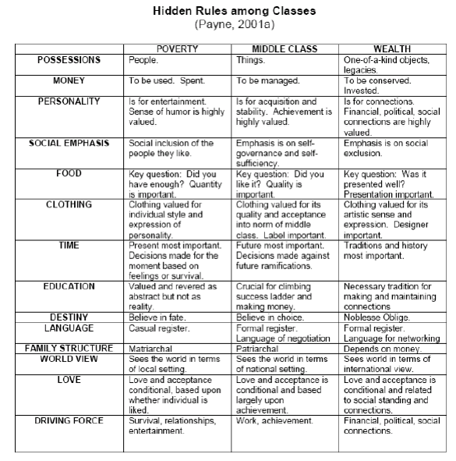
“The American Experiment”
Which is more important to understand as a teacher:
Race differences among students
Poverty differences among students
See a more readable Ruby Payne chart on the Canvas Modules

Slide 5
Group discussion:
Thinking back on your reading of the History of Education and your group preparations on the historical eras…
What seem to be some prevalent but possibly competing assumptions about the purpose of education through the eras?
What competing views of the student can you identify?
What competing views of the curriculum and the teacher can you identify?
Is it possible to have a one-size-fits-all approach to education in such a geographically large and culturally diverse country?
8:30

Slide 6
“The American Experiment”
American Experiment
Are we expecting too much from our schools?
The American Dream vs. The New Normal
Look at everything we expect of CSI schools:
http://www.csionline.org/principles-for-christian-education
Which of these school characteristics are most challenging?

Slide 7
Quick preview
What is your assumption about the literacy trends and SAT score trends over the last 20 years?
Overall?
For different races?

Slide 8
Literacy scores
American Experiment
Average prose, document, and quantitative literacy scores of adults age 16 or older, by selected characteristics: 1992 and 2003
Characteristic | Prose |  | Document |  | Quantitative
 | 1992 | 2003 | 1992 | 2003 | 1992 | 2003
Total | 276 | 275 | 271 | 271 | 275 | 283
Sex
Male | 276 | 272 | 274 | 269 | 283 | 286
Female | 277 | 277 | 268 | 272 | 269 | 279
Race/ethnicity¹
White | 287 | 288 | 281 | 282 | 288 | 297
Black | 237 | 243 | 230 | 238 | 222 | 238
Hispanic | 234 | 216 | 238 | 224 | 233 | 233
From the National Center for Educational Statistics http://nces.ed.gov/fastfacts/#

Slide 9
SAT scores: critical reading
American Experiment
SAT mean scores of college-bound seniors, by race/ethnicity: Selected years, 1986–87 through 2011–12
Race/ethnicity | 1986–87 | 1990–91 | 1996–97 | 1999–2000 | 2000–01 | 2001–02 | 2002–03 | 2003–04 | 2004–05 | 2005–06 | 2006–07 | 2007–08 | 2008–09 | 2009–10 | 2010–11 | 2011–12 | 2013-14 | 2014-15
SAT-Critical reading
All students | 507 | 499 | 505 | 505 | 506 | 504 | 507 | 508 | 508 | 503 | 502 | 502 | 501 | 501 | 497 | 496 | 497 | 495
White | 524 | 518 | 526 | 528 | 529 | 527 | 529 | 528 | 532 | 527 | 527 | 528 | 528 | 528 | 528 | 527 | 529 | 529
Black | 428 | 427 | 434 | 434 | 433 | 430 | 431 | 430 | 433 | 434 | 433 | 430 | 429 | 429 | 428 | 428 | 431 | 431
Mexican American | 457 | 454 | 451 | 453 | 451 | 446 | 448 | 451 | 453 | 454 | 455 | 454 | 453 | 454 | 451 | 448 | 450 | 448
Puerto Rican | 436 | 436 | 454 | 456 | 457 | 455 | 456 | 457 | 460 | 459 | 459 | 456 | 452 | 454 | 452 | 452 | 456 | 456
Other Hispanic | 464 | 458 | 466 | 461 | 460 | 458 | 457 | 461 | 463 | 458 | 459 | 455 | 455 | 454 | 451 | 447 | 451 | 449
Asian/Pacific Islander | 479 | 485 | 496 | 499 | 501 | 501 | 508 | 507 | 511 | 510 | 514 | 513 | 516 | 519 | 517 | 518 | 523 | 525
American Indian/Alaska Native | 471 | 470 | 475 | 482 | 481 | 479 | 480 | 483 | 489 | 487 | 487 | 485 | 486 | 485 | 484 | 482 | 483 | 481
Other | 480 | 486 | 512 | 508 | 503 | 502 | 501 | 494 | 495 | 494 | 497 | 496 | 494 | 494 | 493 | 491 | 493 | 490
From the National Center for Educational Statistics http://nces.ed.gov/fastfacts/#

Slide 10
SAT scores: math
American Experiment
SAT mean scores of college-bound seniors, by race/ethnicity: Selected years, 1986–87 through 2011–12
Race/ethnicity | 1986–87 | 1990–91 | 1996–97 | 1999–2000 | 2000–01 | 2001–02 | 2002–03 | 2003–04 | 2004–05 | 2005–06 | 2006–07 | 2007–08 | 2008–09 | 2009–10 | 2010–11 | 2011–12
SAT-Mathematics
All students | 501 | 500 | 511 | 514 | 514 | 516 | 519 | 518 | 520 | 518 | 515 | 515 | 515 | 516 | 514 | 514
White | 514 | 513 | 526 | 530 | 531 | 533 | 534 | 531 | 536 | 536 | 534 | 537 | 536 | 536 | 535 | 536
Black | 411 | 419 | 423 | 426 | 426 | 427 | 426 | 427 | 431 | 429 | 429 | 426 | 426 | 428 | 427 | 428
Mexican American | 455 | 459 | 458 | 460 | 458 | 457 | 457 | 458 | 463 | 465 | 466 | 463 | 463 | 467 | 466 | 465
Puerto Rican | 432 | 439 | 447 | 451 | 451 | 451 | 453 | 452 | 457 | 456 | 454 | 453 | 450 | 452 | 452 | 452
Other Hispanic | 462 | 462 | 468 | 467 | 465 | 464 | 464 | 465 | 469 | 463 | 463 | 461 | 461 | 462 | 462 | 461
Asian/Pacific Islander | 541 | 548 | 560 | 565 | 566 | 569 | 575 | 577 | 580 | 578 | 578 | 581 | 587 | 591 | 595 | 595
American Indian/Alaska Native | 463 | 468 | 475 | 481 | 479 | 483 | 482 | 488 | 493 | 494 | 494 | 491 | 493 | 492 | 488 | 489
Other | 482 | 492 | 514 | 515 | 512 | 514 | 513 | 508 | 513 | 513 | 512 | 512 | 514 | 514 | 517 | 516
From the National Center for Educational Statistics http://nces.ed.gov/fastfacts/#
8:45

Slide 11
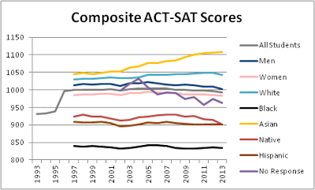

Slide 12
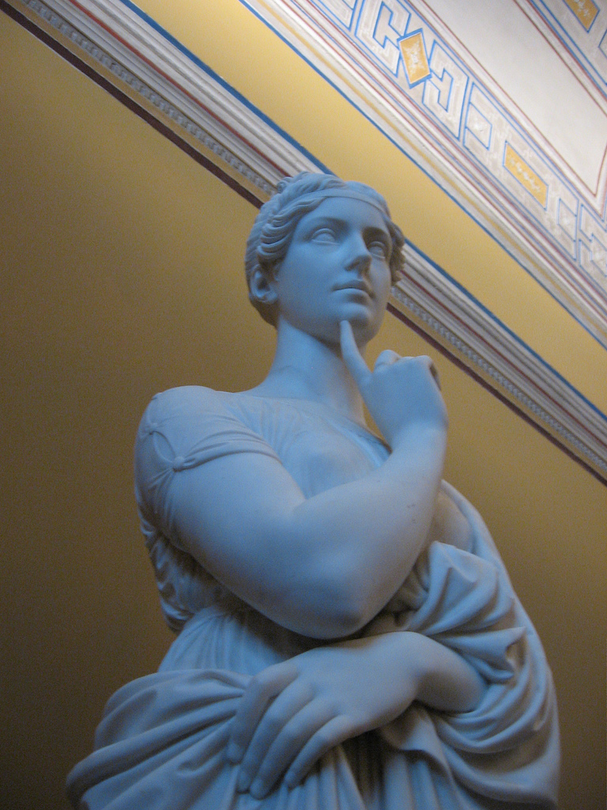
Quick preview
What is your assumption about the trends in drop out rates and school crime rates over the last 20 years?
Do different races have different drop out rates?
Do you think rates within racial groups would differ between SES groups?

Slide 13
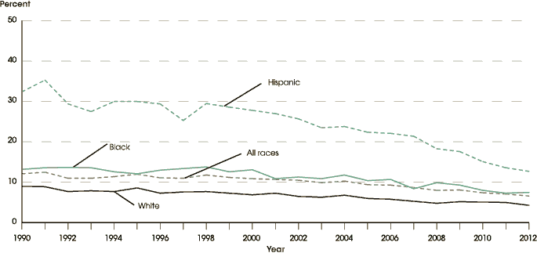
Drop-out rates
American Experiment
From the National Center for Educational Statistics http://nces.ed.gov/fastfacts/#

Slide 14
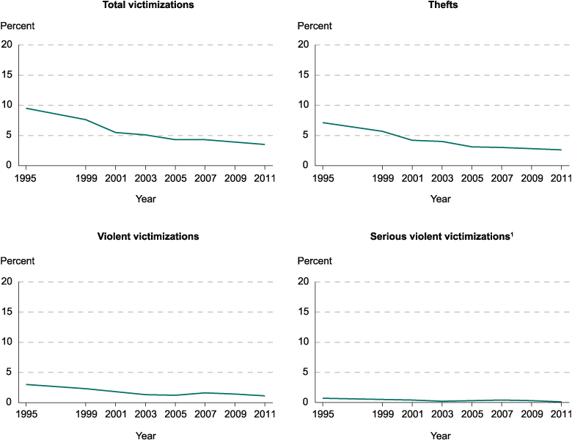
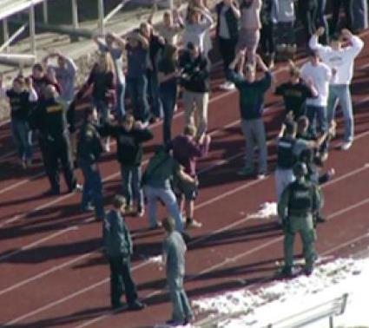
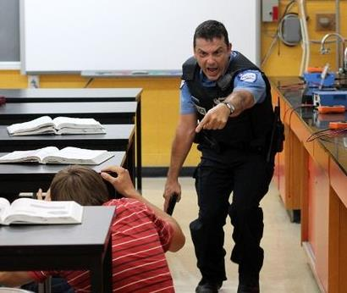
School crime rates
American Experiment
http://nces.ed.gov/fastfacts/#
From the National Center for Educational Statistics http://nces.ed.gov/fastfacts/#

Slide 15
Special needs students served
American Experiment
Percentage distribution of students 6 to 21 years old served under Individuals with Disabilities Education Act, Part B, by educational environment and type of disability: Fall 2010
Type of disability | All environments | Regular school, time outside general class |  |  | Separate school for students with disabilities | Separate residential facility | Parentally placed in regular private schools¹ | Homebound/ hospital placement | Correctional facility
 |  | Less than 40 percent | 40–79 percent | 80 percent or more
All students with disabilities | 100 | 14.2 | 20.1 | 60.5 | 3 | 0.4 | 1.2 | 0.4 | 0.3
Autism | 100 | 34.1 | 18.1 | 38.5 | 7.9 | 0.5 | 0.6 | 0.3 | #
Deaf-blindness | 100 | 33.4 | 11.9 | 23 | 18.2 | 9.6 | 0.7 | 3.2 | #
Developmental delay | 100 | 16.1 | 19.8 | 62.4 | 0.9 | 0.1 | 0.6 | 0.2 | #
Emotional disturbance | 100 | 21.3 | 18.3 | 42.1 | 13.1 | 2 | 0.2 | 1.1 | 1.8
Hearing impairments | 100 | 14.1 | 16.7 | 56.1 | 8.3 | 3.4 | 1.2 | 0.2 | 0.1
Intellectual disability | 100 | 47.7 | 26.8 | 17.9 | 6.2 | 0.4 | 0.2 | 0.5 | 0.3
Multiple disabilities | 100 | 45.9 | 15.9 | 13 | 19.7 | 1.8 | 0.4 | 3.1 | 0.2
Orthopedic impairments | 100 | 22.9 | 16.2 | 53.3 | 4.9 | 0.2 | 0.8 | 1.7 | 0.1
Other health impairments² | 100 | 10.6 | 23 | 62.4 | 1.6 | 0.2 | 1 | 0.9 | 0.3
Specific learning disabilities | 100 | 7.3 | 25.6 | 65.1 | 0.6 | 0.1 | 0.9 | 0.2 | 0.3
Speech or language impairments | 100 | 4.7 | 5.5 | 86.5 | 0.3 | # | 2.9 | 0.1 | #
Traumatic brain injury | 100 | 20.9 | 23.6 | 47.4 | 5.1 | 0.5 | 0.7 | 1.7 | 0.1
Visual impairments | 100 | 11.8 | 13.4 | 63.7 | 5.5
9:00

Slide 16
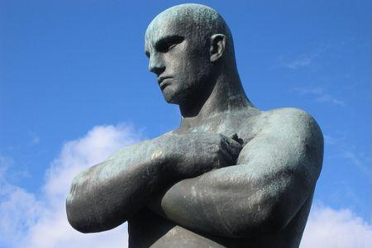
Quick preview
What is your assumption about the general benefits of a college education?
Employment rates for college grads vs. high school grads
Earning power for college grads vs. high school grads
College graduation rates
What percentage of adults went to college?
Which states are highest and lowest for going to college?
Which races are highest and lowest for going to college?
Which gender is higher for master’s degrees?

Slide 17
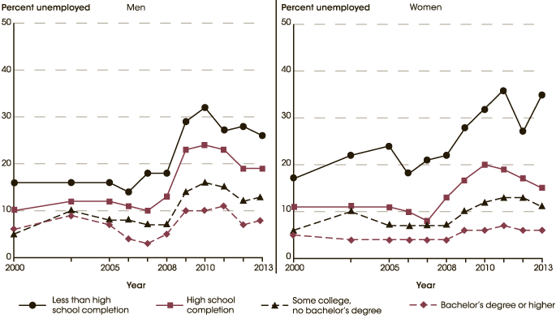
College grads’ employment rates
American Experiment
From the National Center for Educational Statistics http://nces.ed.gov/fastfacts/#

Slide 18
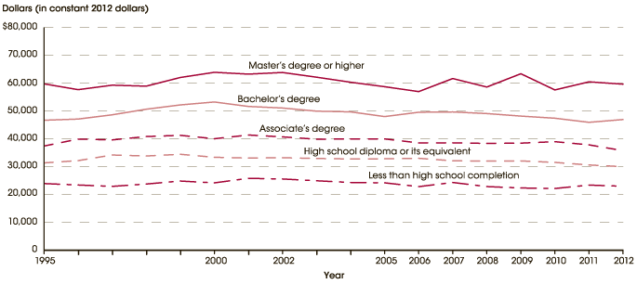
College graduates’ earning power
American Experiment
From the National Center for Educational Statistics http://nces.ed.gov/fastfacts/#

Slide 19
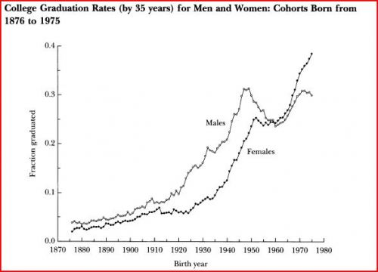
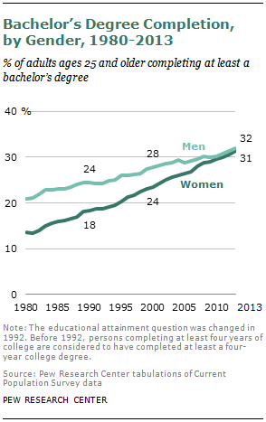
College Graduation Rates

Slide 20
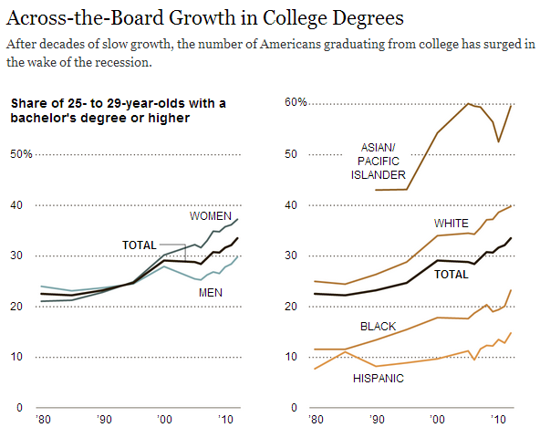
College Graduation Rates

Slide 21
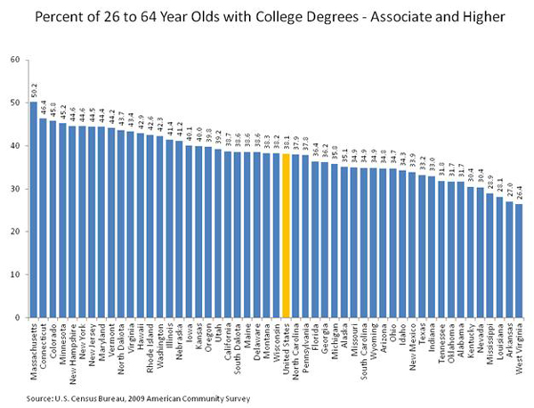
College degrees by state
Iowa
9:15

Slide 22
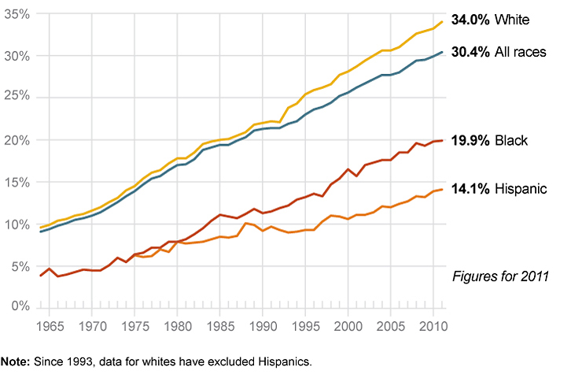
College degrees by race

Slide 23
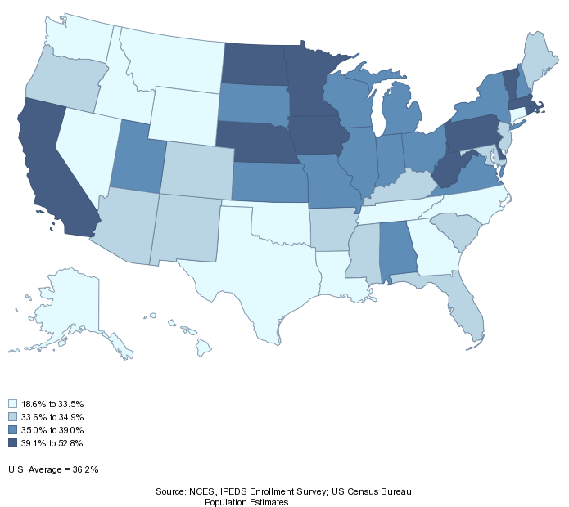
18-24 Year Olds in College (TUGS)

Slide 24
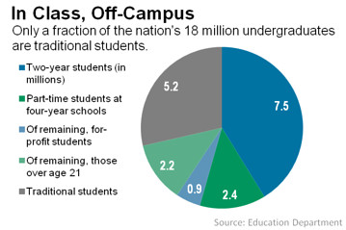
Non-traditional undergrads

Slide 25
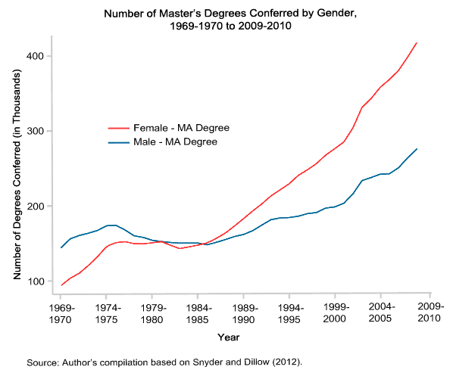
Master’s degrees

Slide 26
The American Experiment Review
Can you now…
Analyze trend data in American education and evaluate "The American Experiment“
Take a stand on whether the “The American Experiment” is working?
Evaluate the areas of strengths and areas of weaknesses in “The American Experiment”?
How does this view contrast with what you know about the educational systems in other countries?
9:30

Slide 27
If there’s time left tonight…
Please start working in your groups on your historical era presentations for next week.

