Slide 1
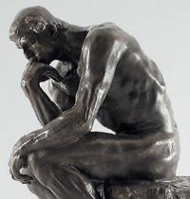
Week 4: Modern Philosophies
EDUC 300/ CORE 310
Knight Chapter 4
Dr. S. Holtrop

Slide 2
Activities tonight
Sign up for group presentations on historical eras
Questions on “American Experiment” PPT?
Questions/comments on Ruby Payne chart?
Knight Chapter 4
comparison chart
Poll Everywhere
Weekly debate (personal philosophy prep)
Views of the student

Slide 3
Learning Objectives for This Week
The philosophies this week are Pragmatism and Existentialism.
You will …
Understand basic concepts about the two philosophies.
Be able to apply useful components of the two philosophies to your intended educational situation.
Compare and contrast the two philosophies and critique them from a Christian perspective.

Slide 4
Some basics on the 2 philosophies see analytical chart (on Canvas)
 | Pragmatism | Existentialism
In a nutshell | Practical-ness (American) | Revolt against trad. philos.
Who? | Dewey, Wm James, | Kierkegaard, Nietzsche, Sartre
Main emphases or essential concepts | People can know what their senses experience. | Existence before essence. Individualism.
View of truth (What is real?) | The cave is all we have. Truth is what works. Truth is relative. | Truth as choice. You are what you choose to be. Sartre: Man is nothing else but what he makes of himself.
View of values | Beliefs are private. Ethically good is what works. Six of the Ten Commandments work for all. | All about individual choice. Knight: Frightful task of producing values out of nothing. Sartre: condemned to be free.
View of aesthetics | Concepts of beauty depend on how people feel about something. | Revolt against public standard. What is beautiful to me is beautiful, and who can contradict me?
See analytical chart (handout)
7:00

Slide 5
Some basics on the 2 philosophies see analytical chart (on Canvas)
 | Pragmatism | Existentialism
View of the student | Students have experiences, solve problems, adapt to changing world. Felt needs. | Students are free agents and shouldn’t be forced to be cogs in the machine. Unique individuality.
View of the teacher | Teachers are more experienced fellow travelers | Facilitator.
View of the curriculum (Best subjects? Why?) | Students at the center. Problem solving. Thematic units. Field trips. Project method. Process. | Student choice. Many options. Literature and the arts. Avoid uniformity.
Purpose of education | Learn process. Participate in the democracy of learning. Learn how to change society. | Foster creativity in the individual. Find ways to provide choices to students. Help them explore great ideas esp. in lit. & art.
View of work/ calling | Do something to help society. | Be yourself. Just for yourself.
See analytical chart (handout)
7:00

Slide 6
Review and Extension 3-minute Group Conference Use the filled out analytical charts to help you find similarities between the traditional and the modern philosophies:
 | Pragmatism | Existentialism
Idealism
Realism
Neo-Scholasticism
7:05

Slide 7
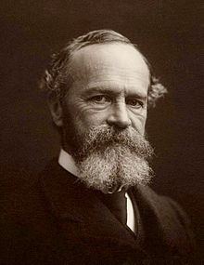
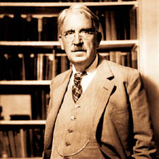
Pragmatism
How is vocational education (tech, career ed.) an example of pragmatism?
What would a pragmatist say about standardized testing?
What would a pragmatist say about arming teachers with guns?
Who is the authority in a pragmatist classroom?
John Dewey
William James
Philosopher, psychologist, physician. Taught first psych course in America.

Slide 8
Discussion Forum Questions -- Pragmatism
Are there studies that compare the two practices (hands-on vs. traditional) that indicate one way is better than the other? if there are such studies, how should we apply the results they produce in our classrooms?
When did society make the switch from school being preparation for life rather than a part of life as seen in pragmatism?
Should schools stress that the school experience is actually life- students spend 13+ years of their life in school. Should we be agreeing with this statement, is that not life?
Dewey
7:15

Slide 9
Discussion Forum Questions -- Pragmatism
Can someone please explain the steps that were explained in the pragmatism section in different words? (MDR)
Can Christians be pragmatists or does that reject the truth of God being constant, since pragmatists don’t really believe in constants?
Can Christians be proved through pragmatism or are they at odds with each other?
As Christians, how can we implement the pragmatism view into the classroom?
Dewey
7:15

Slide 10
Think-Pair-Share
Come up with an example of pragmatism in your own schooling.
E.g., an example of pragmatism could be student choice of reading materials in middle school.
Do you think your teacher realized the influence of this –ism at the time?
7:20

Slide 11
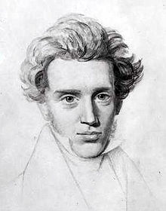
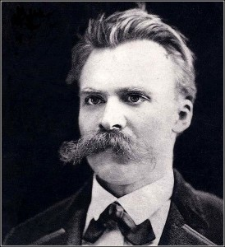
Existentialism
Søren Aabye Kierkegaard was a Danish Christian philosopher, theologian, poet, social critic and religious author who is widely considered to be the first existentialist philosopher.
Born: May 5, 1813, Denmark–Norway
Died: November 11, 1855, Copenhagen, Denmark
Influenced: Jacques Derrida, Paul Tillich, Karl Barth
Friedrich Wilhelm Nietzsche was a German philosopher, cultural critic, poet, philologist, and Latin and Greek scholar whose work has exerted a profound influence on Western philosophy and modern intellectual history. --Wikipedia
Born: October 15, 1844, Röcken, Germany
Died: August 25, 1900, Weimar, Germany
Influenced: André Gide, Maurice Barrès, Oscar Levy

Slide 12
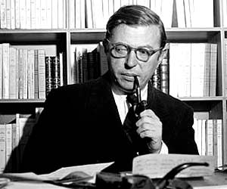
Existentialism
Sartre
Jean Paul Sartre
(1905-1980)
Listen to Jean-Paul Sartre – “In Our Time” BBC Radio 4 (1 min.)
https://www.youtube.com/watch?v=CJm31WIYTOs
And “Sartre in Ten Minutes” (1 min 30 sec):
https://www.youtube.com/watch?v=_ba3kvofvyg

Slide 13
Existentialism
Explain: “Existence precedes essence.”
How is school choice an existential concept?
Would an existential feminist say that most college-educated women should try to be managers and bosses or that educated women are free to choose to be at-home moms if they want?

Slide 14
Discussion Forum Questions -- Existentialism
Is there such a thing as a mistake in existentialism? Is there such thing as a heaven/ hell?
Where does ethics fit into the existentialism belief if everyone is concerned about their individual self?
What would classroom discipline look like from an existentialist point of view?
Existentialists say choose for the sake of choosing. Clearly this ignores the importance of values and morals which begs the question: Is choosing for the sake of choosing better than not choosing at all?
Sartre
7:25

Slide 15
Discussion Forum Questions -- Existentialism
Can two people ever have the same truth with an existentialist mindset? How can an existentialist ever tell a realist that what they experience isn’t true?
Since free will is huge with existentialism, does that mean everything is ethically okay?
what drives a person to want to be an existentialist? What is the draw? How would the students respond to a teacher who is focused primarily on the individual?
Do these choices affect other people, not just the individual as the text implies? Or is this such an individualistic mindset that the actions of these people are not influenced by others and do not affect others?
Sartre
7:25

Slide 16
Think-Pair-Share
Come up with an example of existentialism in your own schooling.
Do you think your teacher realized the influence of this –ism at the time?
7:30

Slide 17
Phone Poll: Poll Everywhere
If you had to do a field experience in one of the following, which would you choose?
A school focusing on pragmatism
A school focusing on existentialism
7:45

Slide 18
7:45
Notes:
If you had to do a field experience in one of the following, which would you choose? https://www.polleverywhere.com/multiple_choice_polls/OWBBOYADU8MZcWe

Slide 19
Fall 2014 Results…
7:45

Slide 20
Fall 2015 Results

Slide 21
Fall 2016 Results…

Slide 22
Fall 2017 Results…

Slide 23
Jigsaw: In small groups, evaluate each philosophy’s compatibility with Christianity
 | Pragmatism | Existentialism
Pros (useful for teachers?)
Cons
Compatibility w/ Chr. worldview
Incompatibility w/ Chr. worldview
Implications for: curriculum design methods of instruction assessment classroom management
8:00

Slide 24
Debate Topic: View of the Student (Week 4: Knight Chapter 4, History of Education)
How would each –ism in Chapter 4 view the student?
List the different views of the student that you see in this chapter.
Groups pick one of the views of the student (listed below).
Views of the student: Image of God, sinner, brain on a stick, self-actualizer, evolved animal, future worker, future whole person, living in the present
Brainstorm and write a sentence expressing this view of the student.
Find articles or educational resources online that illustrate this view of the student.
Evaluate the pros and cons of this view from a biblical stance.
Write a sentence that describes your group’s consensus for now on your view of the student.
What implications does this view of the student have for one’s view of the curriculum and the purpose of education?

