Slide 1
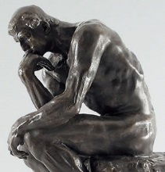
Groups for Oct. 3 presentations
Historical Era | Group Members
Age of Reform – Common School Era | McKenna | Sarah | Spencer
Progressive Era | Kaylee | Jessica | Abby
Public High School Era | Heath | Morgan | Kaylee
Post-WWII Equity Era | Hannah | Logan | Michaela
Equal-Rights Era | Rachel | Karina | Austin
Reform & Standards Era | Brandon | Caleb | Andrea
See rubric for presentation expectations

