Slide 1
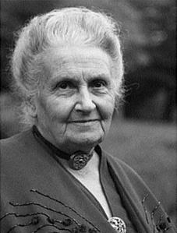
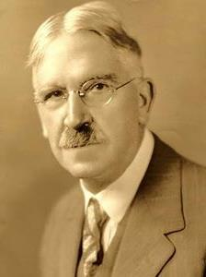
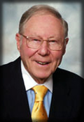
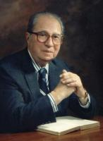
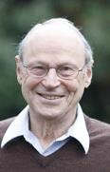
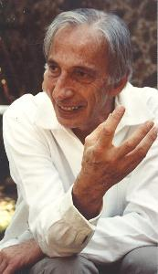
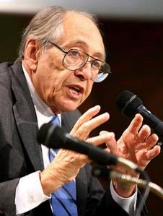
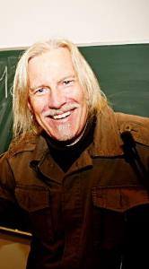
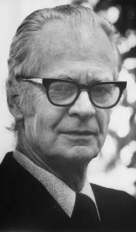
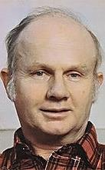
Contemporary Theories (10) of Education
EDUC 300 / CORE 310
Knight Chapter 6
Dr. S. Holtrop
Spring 2017

Slide 2
Course Schedule for Next Few Weeks
Week 6 Oct. 3 | Presentations on historical eras (6 groups) ~ 4-5 minutes per person Read Knight, Chapter 5 & 7 (32 pp.). Do Discussion Forum 5.
Oct. 10 | No class. (Kind of a post-Heartland break.) (Start outlining paper?)
Week 7 Oct. 17 | Read Knight, Chapter 8-9 (41 pp.). Read handout as assigned. Do Discussion Forum 6 (see new options).
Week 8 Oct. 24 | Mid-term Test

Slide 3
Groups for Oct. 3 presentations
Historical Era | Group Members
Age of Reform – Common School Era | McKenna | Sarah | Spencer
Progressive Era | Kaylee | Jessica | Abby
Public High School Era | Heath | Morgan | Kaylee
Post-WWII Equity Era | Hannah | Logan | Michaela
Equal-Rights Era | Rachel | Karina | Austin
Reform & Standards Era | Brandon | Caleb | Andrea
See rubric for presentation expectations

Slide 4
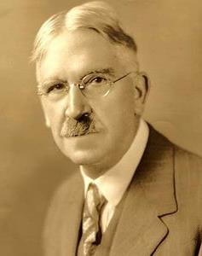
Progressivism
10
Student-centered. Sometimes called experimentalism or experientialism.
Dewey, Montessori, Freud, Rousseau
Reacting against traditional education
Directly descended from Pragmatism (see p. 104)
Student seen as naturally inquisitive, active learner
Teacher seen as adviser, guide, fellow traveler
Montessori: “Never help a child with a task at which he feels he can succeed.”
Curriculum and vocation both focus on changing the world for the better
Curriculum should be the resource materials for students’ natural curiosity
Maria Montessori (1870-1952) Italian physician & educator
John Dewey (1859-1952) Educator, University of Chicago

Slide 5
Your Progressivism Qs
10
I have been hearing a lot in the news about Betsy DeVos and her secretary of education position. Many progressives are not in favor of her taking on this role. Why is this??
What are some negatives of progressivism?
Maria Montessori,
John Dewey

Slide 6
Your Progressivism Qs
10
As we have seen throughout this course, the most relevant and powerful learning to the modern world individual is transformative education. Could it be that to experience transformation a learner must be intrinsically motivated? Does intrinsic motivation itself lead to many of the qualities we find in transformative education? (eg. creativity, innovation, collaboration, flexibility and pluralism.)
What are the downfalls of an education system that is excessively student-centered?
Maria Montessori,
John Dewey

Slide 7
Progressivism Table Talk Topics (Groups will be assigned different items below)
10
Pros
Cons
Compatibility with Christian worldview
Personal experience in a Progressivist learning situation
Implications for Curriculum design
Implications for Methods of instruction
Implications for Assessment
Implications for Classroom management
Important take-aways for parents & board members
Maria Montessori,
John Dewey

Slide 8
Humanism in Education
9
Student-centered. Sometimes called enlightened, evolved, or humane education.
Maslow, (early) Holt, Glasser
Reacting against mindless, inhumane schools
Influenced by progressivism (with more emphasis on the student than on changing society)
Student seen as a unique individual
Teacher enables students to pursue their interests
Open classroom, “free” school, desks in clusters, activity areas with resource materials
Avoid intense competition, harsh discipline, fear of failure
William Glasser (1925-2013) psychologist: Reality Therapy, Choice Theory

Slide 9
Your Humanism Q’s
9
Why are most humanistic proposals aimed at elementary education? Middle school and high school should also be structured in this way.
Most schools or curriculum statements say that they are “child centered education.” Shouldn’t this be a given? What else would it be centered around, is this not the point of having schools?
Would it be frowned upon in a humanistic classroom to punish a student for something wrong he/she did? Or is it an acceptable punishment if it is not “harsh”?
William Glasser (1925-2013) psychologist: Reality Therapy, Choice Theory

Slide 10
Humanism Table Talk Topics
9
Pros
Cons
Compatibility with Christian worldview
Personal experience in a Humanist learning situation
Implications for Curriculum design
Implications for Methods of instruction
Implications for Assessment
Implications for Classroom management
Important take-aways for parents & board members
William Glasser, psychologist: Reality Therapy, Choice Theory

Slide 11
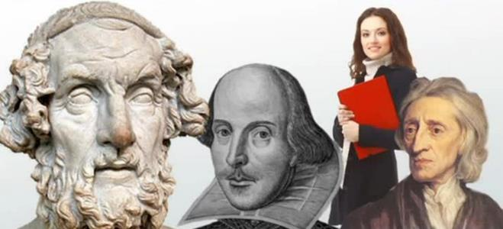
Perennialism
8
Return to the absolutes (“perennial” truths)
Adler, Bloom
Reacting against progressivism
Influenced by neo-scholasticism (with more emphasis on the classics that have stood the test of time, timeless truths, knowledge is universally consistent)
Student seen as a rational animal (neo-scholastic view)
Teacher introduces students to the great works
Teacher is a curriculum expert (more than a student expert)
Primary sources, not textbooks, avoid vocational training, preparation for a full life
Is perennialism more student-centered or curriculum-centered?
Mortimer Adler (1902-2001) American philosopher and educator
(Great Books)

Slide 12
Your Perennialism Q’s
8
What does a Perennialist classroom look like?
Since perennialists do not believe that vocational or professional training is part of education, do they view college as education?
Why is it that textbooks tend to summarize the great ideas of classical thinkers instead of letting students read them for themselves? Is it a time issue or is it a fear of lack of comprehension?
Mortimer Adler (1902-2001) American philosopher and educator
(Great Books)

Slide 13
Perennialism Table Talk Topics
8
Pros
Cons
Compatibility with Christian worldview
Personal experience in a Perennialist learning situation
Implications for Curriculum design
Implications for Methods of instruction
Implications for Assessment
Implications for Classroom management
Important take-aways for parents & board members
Mortimer Adler (Great Books)

Slide 14
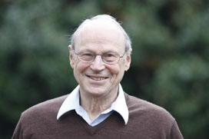
Essentialism
After break?
7
Back to the basics (3 R’s)
Example: E.D. Hirsch
Reacting against progressivism
Influenced by ancient idealism and realism
Learning is hard work – student needs discipline
The teacher is the locus on classroom authority and discipline, demands respect
Five New Basics movement
Education transmits tested facts and truths (basics)
Christian fundamentalism aligned with essentialism against secular humanism
Is essentialism more student-centered or curriculum-centered?
E.D. Hirsch (b. 1928) author, founder of CoreKnowledge.org

Slide 15
Your Essentialism Qs
After break?
7
Should the current “basics” still be the requirements, or should they be updated? And if so, what should be the new basics?
Have people become smarter since we have moved away from essentialism? Is there a way to test this?
As a teacher, would you rather be the locus of classroom authority or a guide?
E.D. Hirsch (b. 1928) author, founder of CoreKnowledge.org

Slide 16
Essentialism Table Talk Topics
7
Pros
Cons
Compatibility with Christian worldview
Personal experience in a Essentialist learning situation
Implications for Curriculum design
Implications for Methods of instruction
Implications for Assessment
Implications for Classroom management
Important take-aways for parents & board members
E.D. Hirsch (b. 1928) author, founder of CoreKnowledge.org

Slide 17
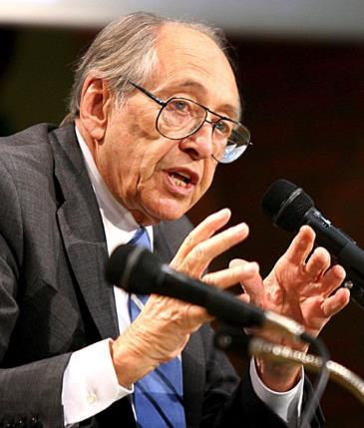
Reconstructionism & Futurism
6&5
Reconstructionism:
Fix the world’s problems (as evidenced in the Great Depression, & now?). Change the world for the better. Student constructs own knowledge.
Curriculum exposes problems in human culture. Teachers shouldn’t hide their own convictions.
Futurism:
Face forward. Against past theories and approaches. Extension and modification of reconstructionism.
Curriculum critically examines the current order. Provides lots of choices. Forget about changing the world—it’s changing without us—just get students prepared!
Alvin Toffler (b. 1928) futurist, author, Future Shock

Slide 18
Reconstructionism & Futurism Table Talk Topics
6&5
Pros
Cons
Compatibility with Christian worldview
Personal experience in a Reconstructionist or a Futurist learning situation
Implications for Curriculum design
Implications for Methods of instruction
Implications for Assessment
Implications for Classroom management
Important take-aways for parents & board members
Alvin Toffler (b. 1928) futurist, author, Future Shock

Slide 19
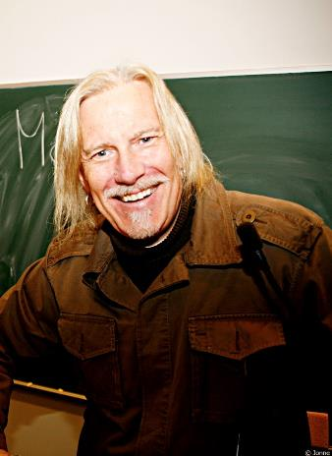
Critical Pedagogy
4
Peter McClaren (b. 1948) Educ. professor, Education as Class Warfare
Remove systems of oppression (McClaren).
Against all oppressive systems (like traditional schooling).
Influenced by (values of) Marxism, postmodernism, liberation theology.
Address multiculturalism, feminism, globalism.
Curriculum is cultural politics: social construction of knowledge.
Conflict theory: Schooling prepares students to be dominators or subjects.
Teach students to rise up to take the power and stop being enslaved.

Slide 20
Your Critical Pedagogy Qs
4
What is critical pedagogy? How is a critical pedagogy a theory separate and distinct than the rest? Or is it rather just a focus within other common theories?
How should schools approach world events and life after education? Should schools advocate for feminism, globalism, and multiculturalism or is that crossing a line into the political/social realm?
Peter McClaren (b. 1948) Educ. professor, Education as Class Warfare

Slide 21
Critical Pedagogy Table Talk Topics
4
Peter McClaren (b. 1948) Educ. professor, Education as Class Warfare
Pros
Cons
Compatibility with Christian worldview
Personal experience in a Critical Pedagogy learning situation
Implications for Curriculum design
Implications for Methods of instruction
Implications for Assessment
Implications for Classroom management
Important take-aways for parents & board members

Slide 22
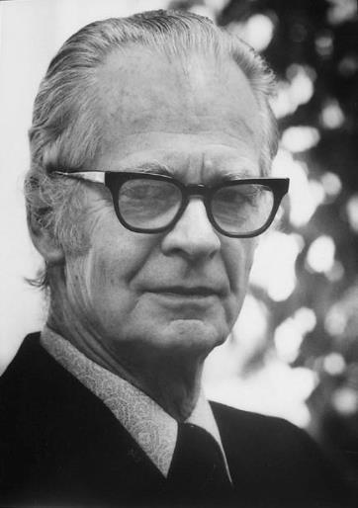
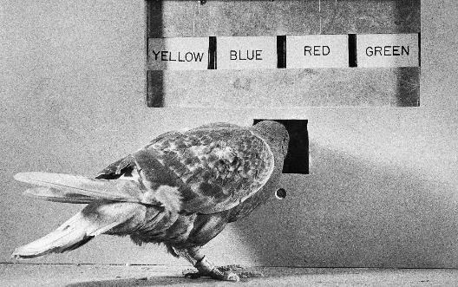
Behaviorism
See Skinner’s pigeons (2:00-4:45) https://www.youtube.com/watch?v=D-RS80DVvrg
3
Scientific behavior modification -- Skinner, Comte, Pavlov
Reacting against traditional education’s harshness
Influenced by scientific methods: laws of behavior
We’re being conditioned anyway, so let’s study and refine the conditioning
Behaviorism’s values influenced by the accountability movement
The student is a highly developed, conditioned animal. No concepts of special dignity or freedom are necessary.
The teacher’s role is to learn and harness the laws of behavior.
Curriculum: break up the subjects into small steps – reward each step. It’s all training. Use performance-based standards.
Schooling creates learning environments that lead to the desired behaviors.
B.F. Skinner (1904-1990) psychologist, social philosopher, Father of Behaviorism

Slide 23
Your Behaviorism Qs
3
What are the positive and negative aspects of behaviorism? Why do some teachers not want to use reinforcements in their classroom?
Are aspects of behaviorism still being used in classrooms? Or are they old and overlooked?
As a behaviorist, how do you explain the wide range of intellect compared to humans and animals?
Is there no religion associated with behaviorism?
If psychology starts focusing on what people do rather than what they think and feel would it really be psychology anymore?
B.F. Skinner, Father of Behaviorism

Slide 24
Behaviorism Table Talk Topics
3
Pros
Cons
Compatibility with Christian worldview
Personal experience in a Behaviorist learning situation
Implications for Curriculum design
Implications for Methods of instruction
Implications for Assessment
Implications for Classroom management
Important take-aways for parents & board members
B.F. Skinner, Father of Behaviorism

Slide 25
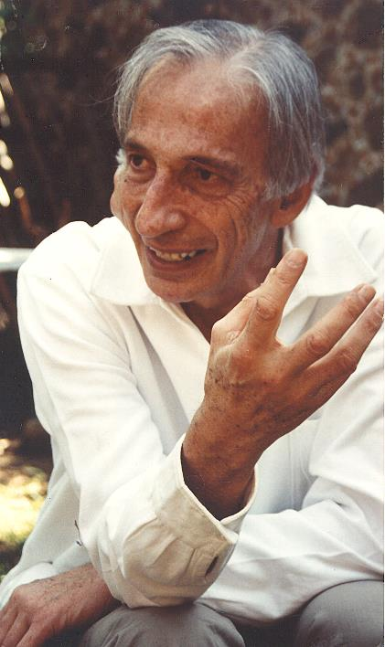
Deschooling
2
Repeal compulsory education.
Ivan Illich.
The good life is hampered by compulsory schooling.
Values: the good life
Teacher: available if needed in an “educational network”
Some homeschooling networks provide content experts for science, art, or vocational training
Curriculum:
Skill exchanges
Take a course or get a tutorial as needed
(Bill Gates: “Merit Badges”)
Provide resources to all who want to learn at any age
Ivan Illich (1926-2002)
Austrian philosopher, Roman Catholic priest, social critic

Slide 26
Your Deschooling Qs
2
If deschooling provides children with more choices than the current public school system we have and is still funded by the government, why were people not interested in the system especially if homeschooling was so popular?
Do you think there are any pros to the deschooling method? If yes, what are they?
What would happen if vouchers were introduced as a part of the American education system? What would be different about education if we had more networks such as skill exchanges, peer-matching, reference services to educators at large?
Ivan Illich (1926-2002)
Austrian philosopher, Roman Catholic priest, social critic

Slide 27
Deschooling Table Talk Topics
2
Pros
Cons
Compatibility with Christian worldview
Personal experience in a Deschooling learning situation
Implications for Curriculum design
Implications for Methods of instruction
Implications for Assessment
Implications for Classroom management
Important take-aways for parents & board members
Ivan Illich (1926-2002)
Austrian philosopher, Roman Catholic priest, social critic

Slide 28
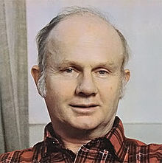
Homeschooling (and Unschooling)
1
More family control of education
Holt (progressive side of homeschooling)
Totally different views and influencers among homeschoolers:
Progressivism, critical pedagogy – free the learner, free society
Student needs more choice, freedom – be anything you want
Parents provide resources, field trips, contact with similar families
Perennialism, essentialism – reclaim solid curriculum and values
Student needs more focus, discipline, coverage of material, like the classics or universal truths
Parents provide solid, often Christian curriculum, homework, standardized tests
Both sides against: traditional schooling (too stifling or too whimpy & Godless)
John Holt (1923-1985) educator,
Growing without Schooling

Slide 29
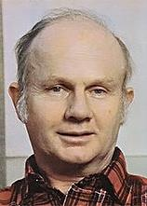
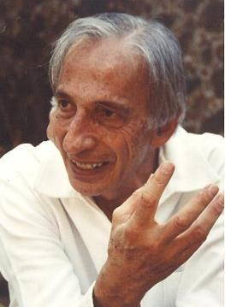
Your Homeschooling Qs
1
Do you think students who are homeschooled growing up face a bigger challenge when peer influence is no longer monitored (in high school, college, or after)?
Would you ever consider homeschooling your child, and if yes, why?

Slide 30
Homeschooling (and Unschooling) Table Talk Topics
1
Pros
Cons
Compatibility with Christian worldview
Personal experience in a Homeschooling learning situation
Implications for Curriculum design
Implications for Methods of instruction
Implications for Assessment
Implications for Classroom management
Important take-aways for parents & board members
John Holt (1923-1985) educator,
Growing without Schooling

Slide 31
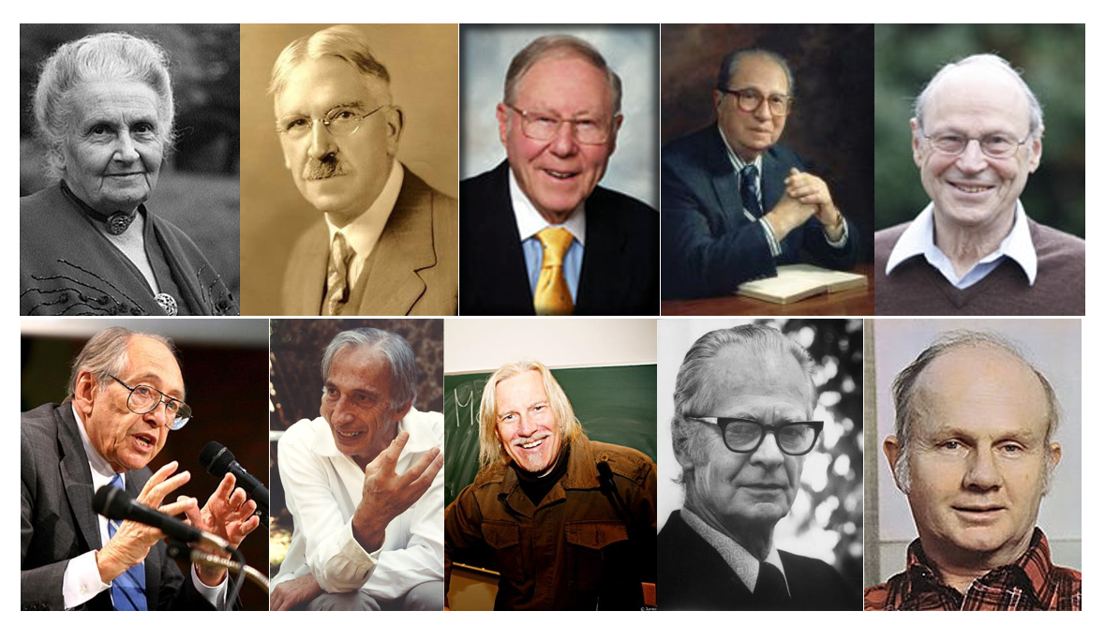
Your Qs on all the –isms
0
How should we attempt to apply each positive aspect of all of these philosophies in our classroom someday? If each philosophy is partially true, how can people adhere to just one? can people adhere to just one philosophy?
Can you implement multiple educational theories into one lesson?
Is it wise to pick and choose ideas from different philosophies that we like in order to enforce our own?

Slide 32
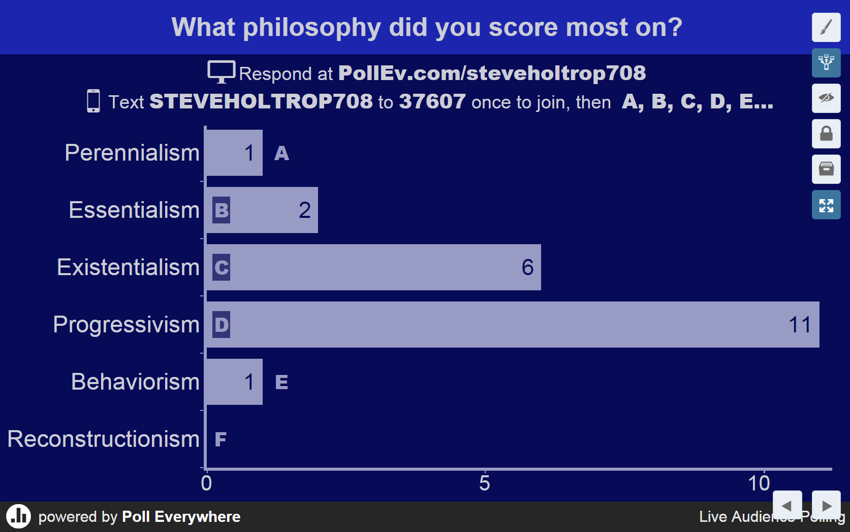

Slide 33
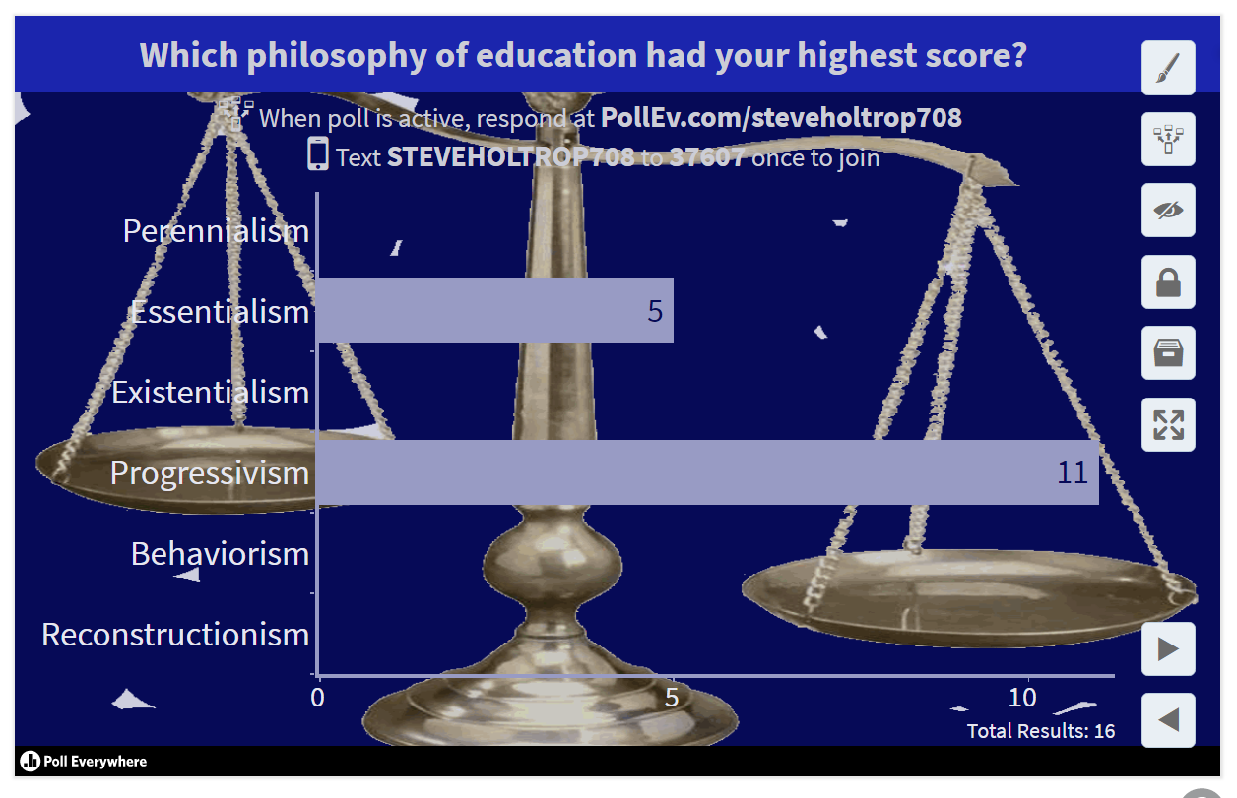

Slide 34
What’s Your Philosophy of Education?
On-line Questionnaire
http://www.authenticeducating.com/education-philosophy-inventory/
Also, check out the philosophies behind these movies about education:
Perennialism Essentialism Progressivism Existentialism Social Reconstruction
Kevin Kline
2002
Edward James Olmos
1988
Robin Williams
1989
Michelle Pfeiffer
1995
Jack Black
2003
7:18

Slide 35
Midterm Test ~ General Information
Due: October 24 at 9:45 pm. Covers court cases, historical eras, and Knight chapters 1-9.
Format: This test is open-book, open-notes. Number your answers to correspond to the questions. I also would appreciate headings in each essay to show transitions to new court cases, historical eras, or new philosophical components. Do not worry about term-paper-perfect spelling, punctuation, and grammar, but make sure your sentences make sense. Please save your three essays in a single Word or PDF document and submit on the Canvas course site by 9:45pm on October 24.
Content: Essays will deal with court cases, history of education, and philosophies from all three categories studied: traditional, modern and postmodern, and contemporary (which includes Chap. 7, Analytic Philosophy). The essay questions will ask you to compare and contrast specifics among philosophies, bring in personal examples at times, and evaluate the philosophies through a Christian lens.
See Study Guide (Word doc) on Canvas – in Modules, under Week 7.

Slide 36
Debate Topic: View of the Teacher (Week 5: Knight Chapter 6)
How would two –isms in Chapter 6 view the teacher?
List the different views of the teacher that you see in this chapter.
Groups pick one of the views of the teacher (listed below).
Views of the teacher: shepherd, cop, facilitator, coach, fellow traveler, experienced guide, trainer, seed planter
Brainstorm and write a sentence expressing this view of the teacher.
Pick two of this week’s –isms that could back up this view of the teacher.
Evaluate the pros and cons of this view from a biblical stance.
Write a sentence that describes your group’s consensus for now on your view of the teacher.
What implications does this view of the teacher have for one’s view of classroom management?
What implications does this view of the teacher have for one’s view of the student, curriculum and purpose of education?

