Slide 1
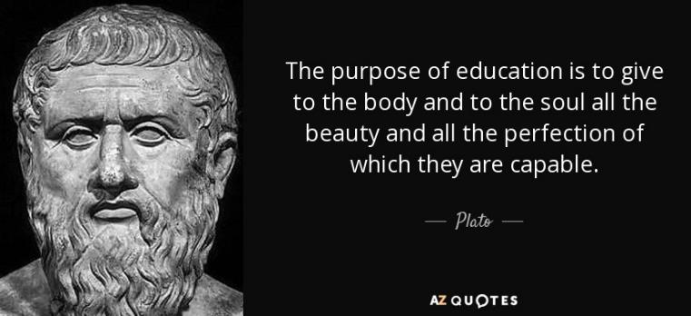
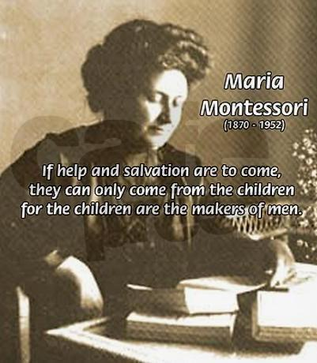
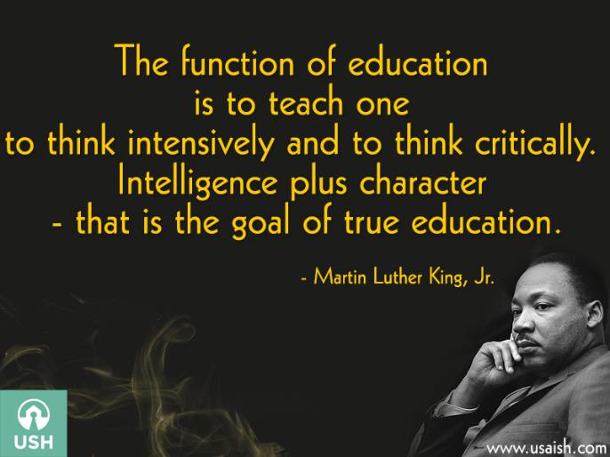
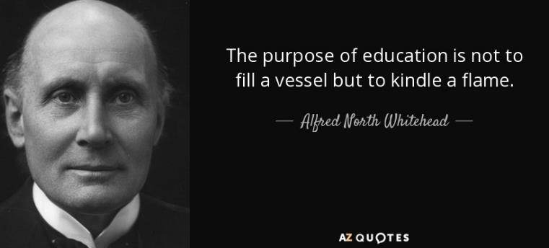
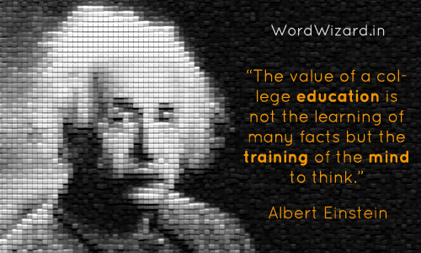
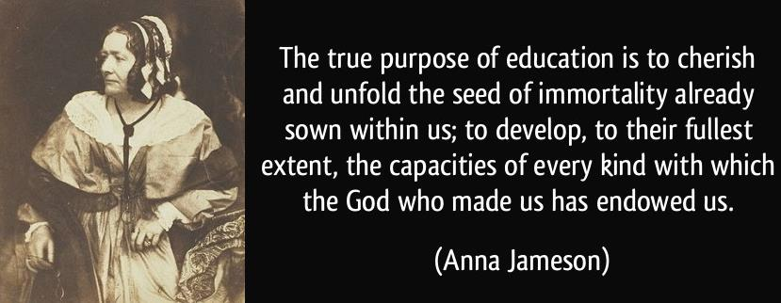
Various views of the purpose of education

Slide 2
Various stakeholders on the purpose of education ➔ in our culture
The state
The federal government
Employers
The local community
The church
The family
The student
The teacher
The education industry
Biggest profession (ever)
Publishers, scholars, unions

Slide 3
Christian perspectives on the purpose of education ➔ Christianity against culture
Curriculum-centered
Teaching discernment between good and evil
Identifying biases against Christians in the curriculum and culture
Identifying “Christian” standards, not necessarily state standards
E.g., young-earth science books
Protecting kids from godless elements of education
A rationale for Christian school enrollment or homeschooling
Influenced by essentialism, perennialism, neo-scholasticism
Back to the basics
Even a return to the Puritan Horn Book, 1960s basil readers, and Great Books
Coverage approach, inculcating values
Values education

Slide 4
Christian perspectives on the purpose of education ➔ Christianity embracing culture
More modern
Influenced by humanistic, progressive trends, even possibly reconstructionism, existentialism, postmodernism
Formation of the student more important than the actual curriculum used
E.g.: recognizing and preparing to eradicate social injustices
Opportunities in co-curriculars and sports, the arts, A.P. courses
Interest-initiated homeschooling
Biblical concepts about the image of God, having unique strengths and gifts seem compatible with modern theories of learning.
Individualized/differentiated instruction, project-based or cooperative learning, mastery learning, self-actualization
Critical thinking but less being on-guard against evil influences
Emphasis on excellence

Slide 5
Christian perspectives on the purpose of education ➔ Christ transforming culture
Acknowledges…
Sin and evil in the world (and schools)
Beauty and potential of young minds exploring gifts and opportunities from God.
Students preparing to be agents of change used by God to transform culture for good.
Identify evil forces
Education must train the heart, mind, and strength.
Prepare to be anti-evil agents of change—wherever called to serve.
School is a major part of the formation process God is using to prepare students for transforming culture.

Slide 6
Summary: Different Christian Perspectives on Making Disciples in the Educational Environment Christianity Against, X-ity Embracing, or X Transforming Culture
Rejecting Culture
“Baptizing”
Faith over Reason
Student as sinner
Teacher as controller
Curriculum centered
Head knowledge?
Called to duty
Truth: theology over science
Assimilating Culture
“With you always”
Reason not affected by faith
Student as explorer
Teacher as accommodator
Student centered
Heart knowledge?
Called to freedom
Truth: science locates the Biblical truths
Transforming, Kingdom building
“Teaching”
Faith-Reason mutually infused
Student as responsible agent
Teacher as collaborator
Teacher, curriculum & student in creative balance
Called to action, to respond, to discern (head, heart, and hands)
Truth: best understood in faithful, relational service to “the way, the truth, and the life.”

