Slide 1
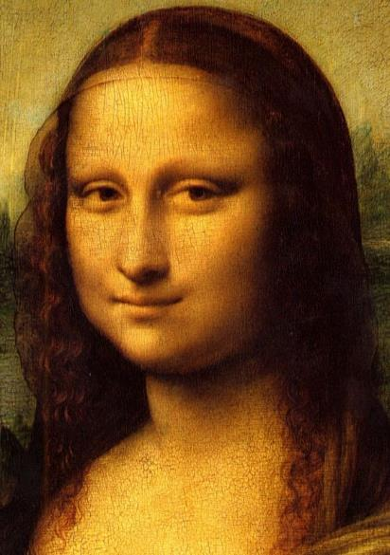
Week 7 Knight Chapters 8 & 9
Dr. Steve Holtrop
EDUC 300
Fall 2017

Slide 2
How the course grades are being figured | Points | Percent of final course grade
Discussion Forums 1-5 | 10 points each | 10%
Group presentation on historic era in education (turn in peer form) | 25 | 5%
Test on the philosophies of education | 100 | 20%
Discussion Forums 6-10 | 10 points each | 10%
Personal philosophy of education paper (written first in separate sections) | 200 | 40%
Group presentation on philosophical background of contemporary teaching methods | 25 | 5%

Slide 3
Discussion Forum Grades
 | 1 | 2 | 3 | 4 | 5
Average Score | 9.89 | 9.94 | 9.82 | 9.81 | 9.86
Number Completed | 18 | 16 | 17 | 16 | 14

Slide 4
Average Course Grade: 97% A
 | 100% A | Other A | A-
# | 13 | 3 | 1

Slide 5
Week | Read | Assignments Due
Week 8 Oct. 24 |  | Mid-term Test
Week 9 Oct. 31 | Read Graham, Part 1&2 (Chapters 1-6) (69 pp.). Read article & PPT on purpose of education. Read articles & PPT on curriculum & assessment. | Section 1 of paper due: purpose of education. Do Discussion Forum 7.
Week 10 Nov. 7 | Read Knight, Chapter 10 (45 pp.). Read articles & PPT on calling. | Section 2 of paper due: view of curriculum Do Discussion Forum 8 (see new options).
Week 11 Nov. 14 | Read Graham, Part 3 (35 pp.). Read Knight, Chapter 11 (15 pp.). Read articles & PPT on views of the teacher and classroom management. | Section 3 of paper due: View of calling/work. Do Discussion Forum 9.
Nov. 21 | No class. Thanksgiving week. Read articles & PPT on views of the student and diversity. | Section 4 due: View of the teacher. No discussion forum.

Slide 6
Week | Read | Assignments Due
Week 12 Nov. 28 | Read Graham, Part 4 (39 pp.). Read articles & PPT on views of truth. | Section 5 due: View of the student. Do Discussion Forum 10.
Week 13 Dec. 5 | Read Graham, Part 5 & 6 (46 pp.). | Section 6 due: Worldview. Do Discussion Forum 11.
Week 14 Dec. 12 | No readings. | Group presentations on teaching methods. Paper Primo due for peer reviews Dec. 12. Peer reviews due Dec 15. See Canvas.
Exam Week Dec. 19 | No exam. | Finish group presentations? Revised paper due on Dec. 19 (Tue) at midnight.

Slide 7
Building a Christian philosophy of education
What is your biblically-based view of…
What is real (metaphysics)
Truth, what is knowable (epistemology)
Values - ethical and aesthetic (axiology)
The student (image of God, calling)
The teacher (calling, image of God)
The curriculum (truth or exploration?)
Purpose of education
Work (calling, incl. avocations)
What methods and curriculum choices can support this view? E.g.:
Content knowledge
Critical thinking skills & practice
Communication skills & practice
Problem solving skills & practice
Cooperative learning skills & practice
Citizenship/kingdom service skills & practice
Stewardship skills & practice
“Glorifier of God” skills & practice
Westminster Shorter Catechism
(What is the chief end of man?)
Belonging body & soul to Jesus Christ
Heidelberg Catechism
(What is your only comfort in life and death?)
Prophet, priest, and king
1 Peter 2:9
Is it OK that Christian education focused on Christian curriculum when the culture focused on curriculum and shifted more toward Christian student outcomes when the culture focused on student outcomes?

Slide 8
“Through-Lines” (used in some CSI schools) Is the emphasis here on knowing or doing? Curriculum or student? How does the teacher factor in?
1. God-Worshipper: | Students will understand that worshipping God is about celebrating who God is, what God has done and is doing, and what God has created.
2. Idolatry-Discerner: | Students need to learn to 'read' a worldview by asking questions about what is being portrayed in regard to culture, values, and belief systems.
3. Earth-Keeper: | Students will respond to God's call to be stewards of all of creation.
4. Beauty-Creator: | Students will create beauty that praises God and enriches our world. Creation shouts that our God is a God who loves diversity, complexity, and creativity.
5. Justice-Seeker: | Students will act as agents of restoration.
6. Creation-Enjoyer: | Students will celebrate God's beautiful creation and give testimony to the presence of God in creation.
7. Servant-Worker: | Students will work actively to heal brokenness and bring joy to individuals and to culture.
8. Community-Builder: | Students will be active pursuers and builders of community in their classrooms, their neighborhoods, and in the global village they are a part of.
9. Image-Reflector: | Students bear the image of God in their daily lives. Being an image-bearer isn't something we DO. It is deeper than that. Image-bearer is something we ARE. We reflect God's image and we learn to see God's image in others.
10. Order-Discoverer: | Students see God's fingerprints all over creation.
See also: http://www.christian.fmpsdschools.ca/Teaching%20For%20Transformation.php (Fort McMurray Christian School, Fort McMurray, Alberta)

Slide 9
Different Christian Approaches
 | Christianity Against Culture | Christianity Sold Out to Culture | Kingdom Building Here & in the Future
View of the Student | Sinner, needs firm guidance and discipline | Potentially perfect human, inherently curious “image of God” that resembles humanistic blank slate | Responsible agent, can become a positive agent of change in God’s creation
View of Knowledge & the Curriculum | Stick to the classics – less risk of being tainted by the world, “integrated” curriculum | Embrace modern curriculum & methods, Christianize them, focus on acting out faith in social justice projects | Learning how to live out a biblical worldview in all areas of life—real issues. Don’t shun culture or try to Christianize it.
View of the Teacher | Authoritarian, knowledge expert | More permissive, fellow traveler, “guide on the side” | More experienced, expertly trained coach with divine calling—authoritative, situational management
View of Calling: Work & Avocations | Training for a job – maybe a “good” job to be able to support family & church obligations. Avocation is often evangelistic. | Do everything to the glory of God, focus on excellence, enjoy the blessings you’ve earned | Different opportunities to transform/redeem culture instead of shunning it or just accepting it.

Slide 10
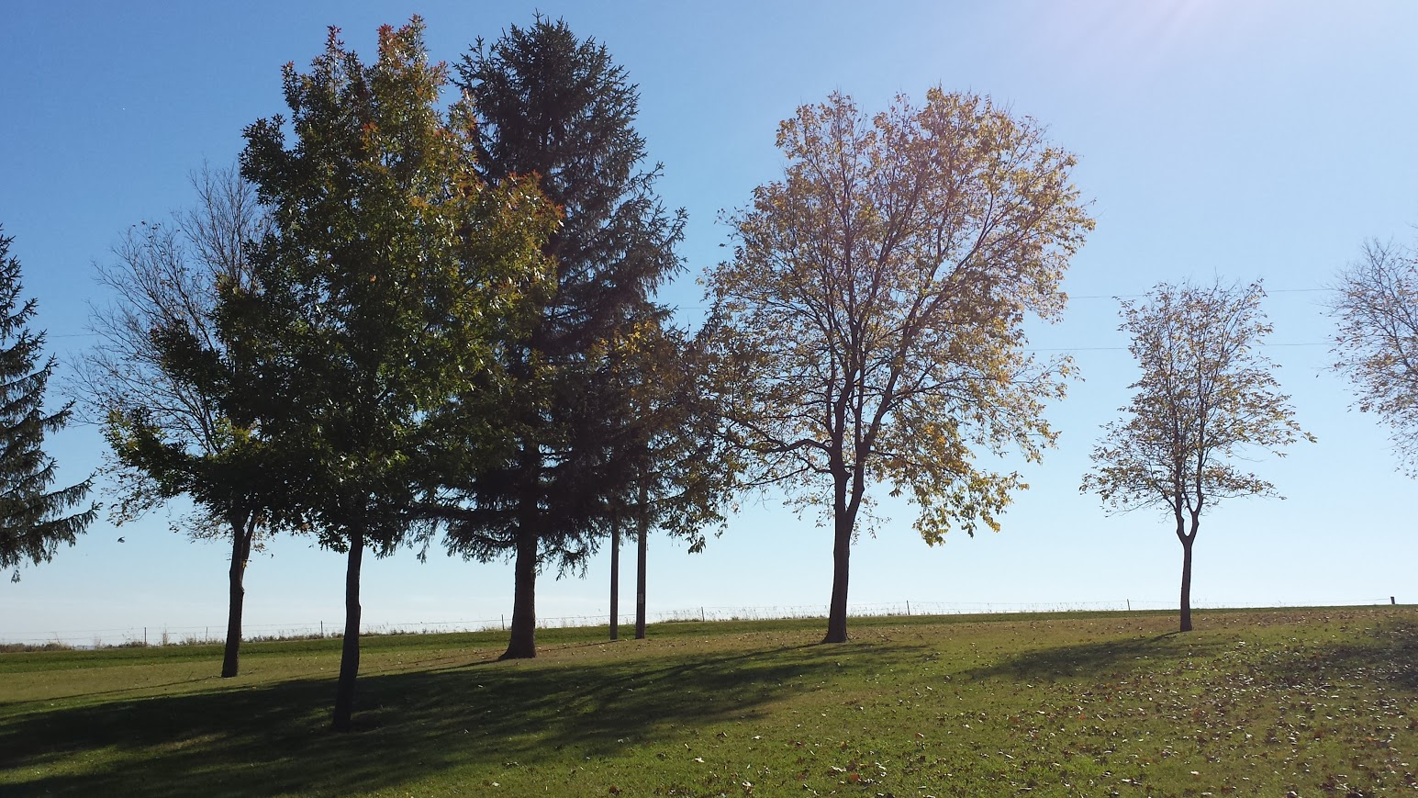
Christian metaphysics (a Christian approach to what is)
Jean-Paul Sarte (atheistic existentialist) “noted that the basic philosophic problem is that something is there, rather than that nothing is there” (p. 170).
Francis Schaeffer (Christian): “nothing that is worth calling a philosophy can sidestep the question of the fact that things do exist and that they exist in their present form and complexity” (p. 170).
Knight: The universe in its most basic nature is friendly to humans and other forms of life….People have found that the natural world appears to be made-to-order to meet such needs as food, water, temperature, light, and a host of other necessities” (p. 170).

Slide 11
Ecclecticism
The good
The bad
The ugly
Eclecticism is a conceptual approach that does not hold rigidly to a single paradigm or set of assumptions, but instead draws upon multiple theories, styles, or ideas to gain complementary insights into a subject, or applies different theories in particular cases.
--Wikipedia

Slide 12
Teaching Christianly in Christian & Public Schools
I believe in…
God the Father
Maker of heaven and earth [creation]
Jesus Christ
Our Lord [salvation]
Holy Spirit [sanctification & restoration]
Church
Communion of saints
Forgiveness of sins
Resurrection of the body
Life everlasting
Star forming pillars in the Eagle Nebula, as seen by the Hubble Space Telescope's WFPC2. The picture is composed of 32 different images from four separate cameras in this instrument. The photograph was made with light emitted by different elements in the cloud and appears as a different colour in the composite image: green for hydrogen, red for singly-ionized Sulphur, and blue for double-ionized oxygen atoms. --Wikimedia Commons

Slide 13
Christian metaphysics (a Christian approach to what is)
Search for Meaning (p. 172)
Existentialists: no external meaning
Postmodernists: knowledge is a social construction
But do we accept evasive, meaningless answers?
An infinite universe seems to imply an infinite Creator
An intelligent universe seems to imply an Ultimate Intelligence.
A basically friendly universe points to a benevolent Being.
Problem of Pain (p. 173)
First: noticing pain (loss, suffering, injustice, etc.) means that it’s not the norm.
Second: there is obviously a cosmic struggle between the friendly and hospitable aspects of the universe and the constant threats to peace, orderliness, and life
Ergo→ Existence of good and evil in a cosmic conflict (“controversy”)

Slide 14
Christian metaphysics (a Christian approach to what is)
The uniqueness of Christianity
Other religions are self-redemptive and self- justifying (p. 176)
“They fail adequately to account for individual human nature—its greatness and its wretchedness, its reaching out toward the highest and its satanic devilishness, its place half-way between angel and ape.”
“Only Christianity provides a sufficient framework in which to view the predicament of human existence.”
We can’t focus just on a quest for goodness without accounting for badness.
Jesus cannot be viewed as just a “great teacher” along with other religions’ prophets.
C.S. Lewis: Jesus is either what he claims to be (God) or a lunatic or the world’s greatest deceiver.
Do we want to follow a liar or a lunatic?

Slide 15
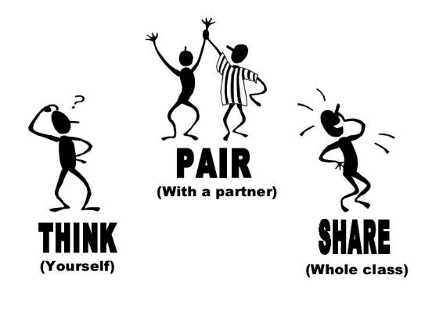
Christian metaphysics (a Christian approach to what is)
How can we be confident as Christians that the concepts we teach really exist?
How can we have that same confidence if teaching in a public school?

Slide 16
Christian epistemology (a Christian approach to what is true)
That leads us to the Bible.
God’s specific revelation to go along with this observable stuff in Creation
See Biblical Framework of Reality (p. 177)
Does this look kind of like some of our Creeds? (Which attempt to encapsulate the key points of Salvation History from the Bible)
Epistemology is about knowledge.
“All truth is God’s truth” (p. 182).
The Bible is our foremost source of knowledge of salvation.
The Bible is not concerned with abstract truth (p. 183).
But “the Bible is not an exhaustive source of knowledge and never was intended to be a ‘divine encyclopedia’” (p. 179).
“It provides a perspective and a metaphysical framework.”

Slide 17
Christian epistemology (a Christian approach to what is true)
Role of Reason
Reason isn’t opposed to faith (e.g., Creation vs. the Bible, scientific facts about global warming or evolution vs. faith)
God made human reason (after his own Reason)
God is the single/same author of
General Revelation (“insufficient source of knowledge concerning God and ultimate reality” p. 181)
Special Revelation (“part of God’s disclosure of truth in His common grace”)
Humans are discoverers, not originators of truth
Theology is our attempt to organize and understand the Bible.
Science is our attempt to organize and understand Creation.
Humans have a “confidence that nature is orderly and intelligible and open to human investigation” –scientists hold to this even in the face of existential and post-modern philosophies that say everything is utterly meaningless.
God wants to reason together with us (Isaiah 1:18).
“Unaided human reason can be deceitful and lead away from truth.”
All truth is God’s truth (p. 182)

Slide 18
Christian epistemology (a Christian approach to what is true)
Think-Pair-Share (Pick 2)
How do we know the following concepts are “true”? (We affirm most of them in the Apostle’s Creed.)
Love
Eternity
Sin or Evil
The Divine
Forgiveness
Holy Spirit
Resurrection
The Church
Life Everlasting

Slide 19
Your questions: building a truly Christian philosophy of education
How long has eclecticism been practiced? Is this method still used in education today?
How do you develop a truly Christian philosophy of education?
On page 169 Right talks about how a Christian philosophy should be constructed on the bible as the main source of truth, but how would you do this when teaching in a non-Christian school?
What in the eyes of many is the most serious problem of Christian education?
“All too often, Christian education has not been deliberately built upon a distinctive Christian philosophy” (page 164). Do many parents realize that there is this underlying issue? Wouldn’t there be a major uproar if they felt their kids were not receiving a proper Christian education?
How do we start this approach to redesigning the education system to fit the Christian philosophy? How do we know if we are truly basing our education system on this philosophy vs just sugar coating the secular system?
Do you think that our Christian schools will ever get to a point where they stop referring to Christian education as the same as a public school, just with chapel and religious classes?

Slide 20
Your questions: being set apart
Why don't you think God lets us know in full capacity the mysteries of this world?
As Christians, are we separating ourselves from the secular world and trying to live in our own little Christian only world? What are the pros and cons of living separate from the secular world or being a part of it?
What are the main values in the world that we are to be countercultural towards? What does countercultural look like in a place like Dordt?
Knight writes that “individuals often, (and perhaps most often) live on a level less than fully human.” What would it be like and what does it mean to be fully human?
Chapter 9 stated, “Teaching is not learning a formula for relating to people or following a blue-print for the development of Christian character.” – How do we try to develop Christian character? How does that look from the teaching standpoint?
Can we categorize art as Christian and non-Christian?

Slide 21
Christian axiology (a Christian approach to values)
Ethics in Christianity is “not a bettering of the self through a secular model of self-improvement” (p. 185).
Holy Spirit
It’s about love
Agape not Eros (p. 186)
Relationships, restoration
Not merely the Ten Commandments (p. 187)
Legalism vs. relativism (antinomianism) (p. 188)

Slide 22
Pick 1: Christian axiology -- ethics
What is one way that the Christian ethics of an educator can impact the classroom?
Lack of respect in a classroom can be devastating to a classroom from either side (children disrespect instructor or vice versa). What does respect look like in a classroom from the teacher’s perspective in respecting the students as able thinkers who have good ideas?
How will these concepts come into play in your classroom as a teacher or in how you view the classroom as a parent, school board member, or member of the community?
How can God’s ethical ideals be central in the educational process?

Slide 23
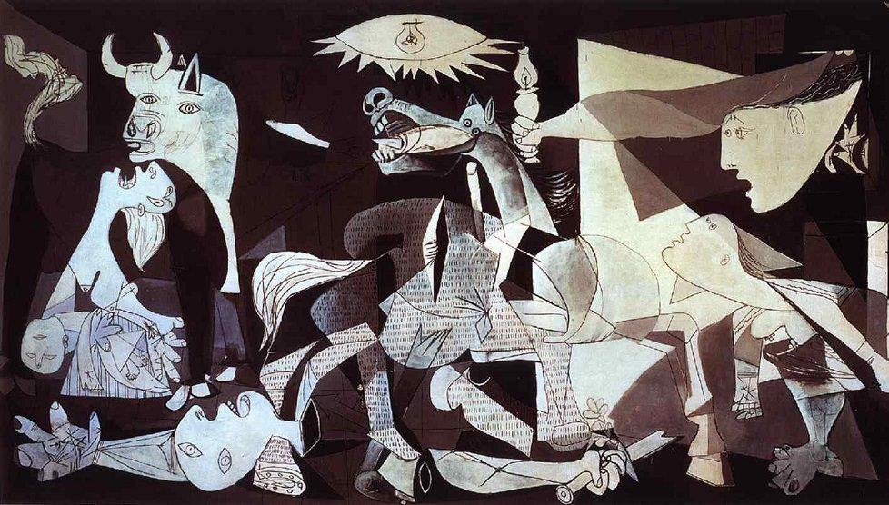
Beauty? - The Forest Chapel by Thomas Kinkade - Guernica by Pablo Picasso

Slide 24
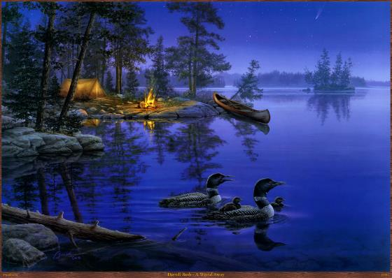
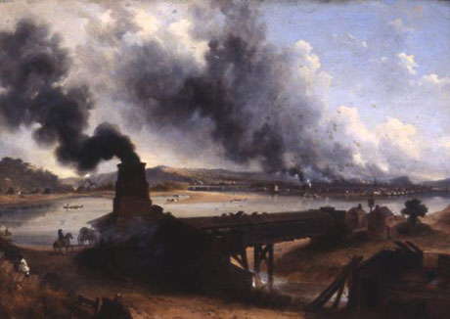
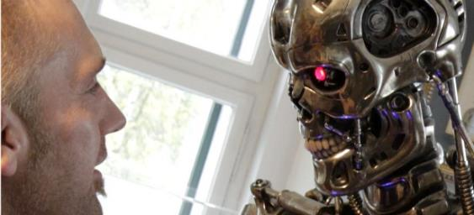
Christian aesthetics (a Christian approach to beauty)
Humans are “lovers of beauty” (p. 192)
Why? Image of God.
Is there a place for non-beauty in art?
Pointing out humanity’s need for a savior, need for God’s grace
By showing ugliness, sin, evil, the unnatural, the erroneous, and the perverted? (p. 193)
The basis of aesthetics is Christian love (p. 195)
Just like the basis of ethics is Christian love
8:20

Slide 25
Christian aesthetics (a Christian approach to beauty)
The Bible does not imply a dichotomy between “high art” and more “primitive” expressions (p. 196).
Implications for aesthetics in school:
Architecture of the school
Classroom decor
Student dress (teacher’s dress?)
Attractiveness of learning materials & presentations
Neatness of homework!

Slide 26
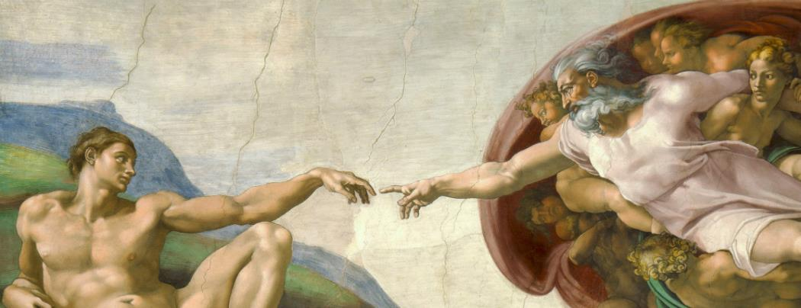
Christian aesthetics
Who determines the aesthetics of a classroom?
The teacher? The student(s)? The curriculum? Administration?
What would different –isms say about aesthetics in education?
Traditional Philosophies
Idealism
Realism
Neo-scholasticism
Modern and Postmodern Philosophies
Pragmatism
Existentialism
Postmodernism
Contemporary Theories
Progressivism
Humanism
Perennialism
Essentialism
Reconstructionism
Futurism
Critical Pedagogy
Behaviorism
Deschooling
Home Schooling
Analytic Philosophy

Slide 27
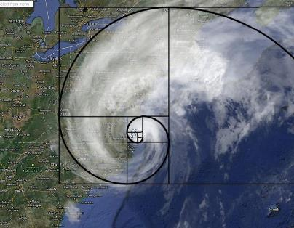
Pick 1: Christian axiology--aesthetics
“Aesthetics lives at the very center of Christian life. This aesthetic impact is central, because the ultimate work and end of Christian art is the fully developed Christian life in all of its beauty and symmetry” (Knight, 194). How does this look in our lives? How important is it really to our philosophical views?
Why are there so many controversies regarding aesthetics?
So, is aesthetics more about looking at the intentions of an artist or the end result of an artist’s work?
How will these concepts come into play in your classroom as a teacher or in how you view the classroom as a parent, school board member, or member of the community?
How can our understanding of God’s aesthetic ideals be more central in the educational process?

