Slide 1
Building a Christian Philosophy of Education
EDUC 300 / CORE 310 Philosophy of Education
Dr. S. Holtrop
Fall 2017

Slide 2
Building a Christian Philosophy of Education
Tonight’s class:
Course schedule reminders
Graham Parts 1 & 2 Christian Grace and …
Broken realities in the classroom
Teachers called as image bearers, new creations to bring grace to the classroom
Class Discussions on sections of the final paper

Slide 3
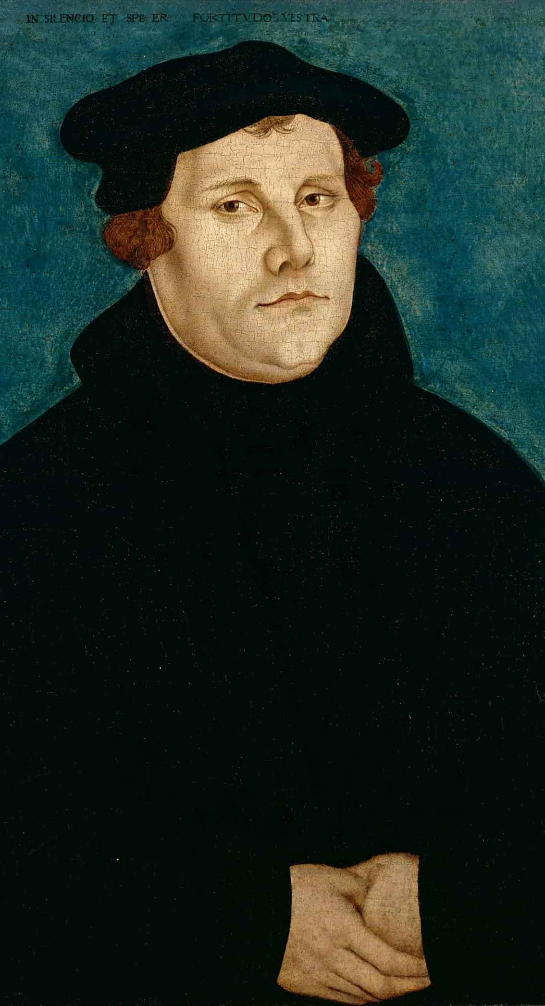
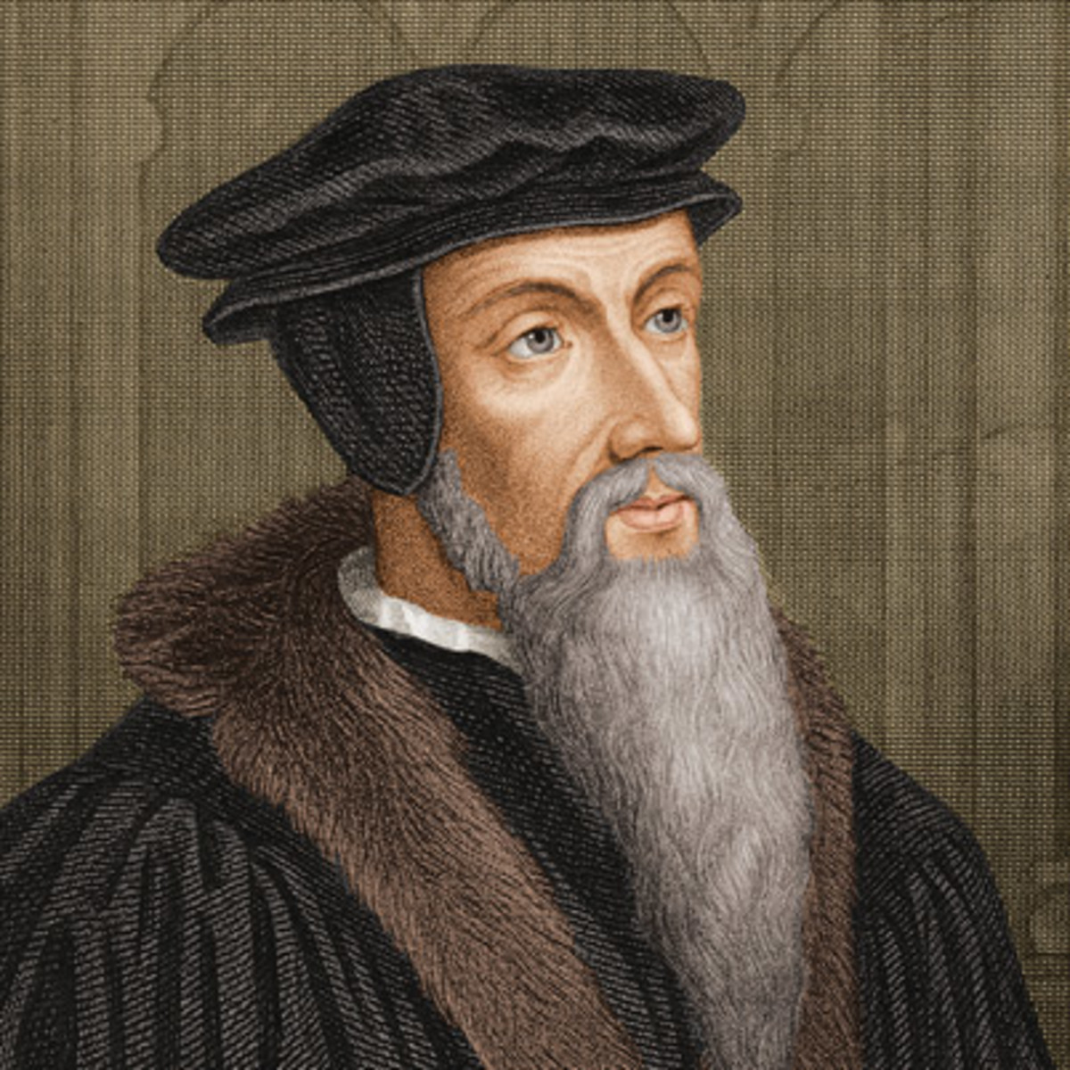
Happy Reformation Day!

Slide 4
Week | Read | Assignments Due
Week 9 Oct. 31 | Read Graham, Part 1&2 (Chapters 1-6) (69 pp.). Read article & PPT on purpose of education. Read articles & PPT on curriculum & assessment. | Section 1 of paper due: Purpose of education. Do Discussion Forum 7.
Week 10 Nov. 7 | Read Knight, Chapter 10 (45 pp.). Read articles & PPT on calling. | Section 2 of paper due: View of curriculum Do Discussion Forum 8 (see new options).
Week 11 Nov. 14 | Read Graham, Part 3 (35 pp.). Read Knight, Chapter 11 (15 pp.). Read articles & PPT on views of the teacher and classroom management. | Section 3 of paper due: View of calling/work. Do Discussion Forum 9.
Nov. 21 | No class. Thanksgiving week. Read articles & PPT on views of the student and diversity. | Section 4 due: View of the teacher. No discussion forum.

Slide 5
Week | Read | Assignments Due
Week 12 Nov. 28 | Read Graham, Part 4 (39 pp.). Read articles & PPT on views of truth. | Section 5 due: View of the student. Do Discussion Forum 10.
Week 13 Dec. 5 | Read Graham, Part 5 & 6 (46 pp.). | Section 6 due: Worldview. Do Discussion Forum 11.
Week 14 Dec. 12 | No readings. | Group presentations on teaching methods. Paper Primo due for peer reviews Dec. 12. Peer reviews due Dec 15. See Canvas.
Exam Week Dec. 19 | No exam. | Finish group presentations? Revised paper due on Dec. 19 (Tue) at midnight.

Slide 6
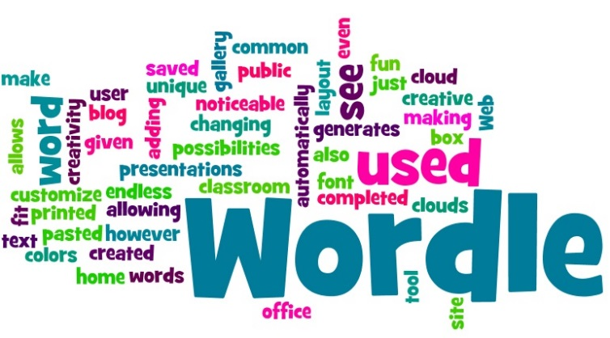
Prevailing metaphors in your purpose of Education papers
Groups of 3-6 students
Combine all your papers into one document.
Paste that document into Wordle.com.
Display your Wordle for the class to see.
Send me a screenshot
Or bring your computer up front

Slide 7
Building a Christian Philosophy of Education Graham Part 1
Realities Our Students Face
Realities Teachers Face
Broken Realities and Grace

Slide 8
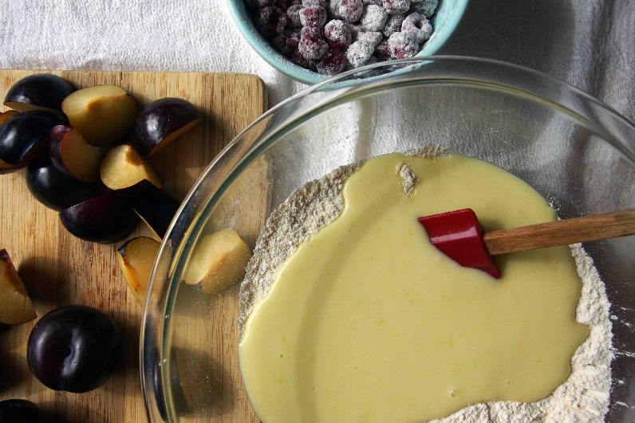
Grace and Justice Balancing vs. combining
Is it Grace vs. Justice or Grace AND Justice?
We don’t “balance” Jesus’ nature: “somewhat” God and “somewhat” human
We don’t “balance” some faith with some works
A comparison:
We often think of a one-dimensional spectrum: permissive vs. authoritarian.
(This can apply to teaching, parenting, management, chairing a board, governing, etc.)
But really it’s better not to reduce authority when increasing relationality.

Slide 9
Grace and Justice
Sergiovanni & Blanchard leadership quadrants (be strong on tasks AND relationships):
High Grace, High Relationship | Accommodating --more grace than justice | Collaborating --both justice and grace
Low Grace, Low Relationship | Avoiding --neither grace nor justice | Controlling --more justice than grace
 | Low Justice Low Task Orientation | High Justice High Task Orientation
Think-Pair-Share →

Slide 10
Grace and Justice
Sergiovanni leadership quadrants (be strong on tasks AND relationships):
High Grace, High Relationship | Accommodating --more grace than justice | Collaborating --both justice and grace
Low Grace, Low Relationship | Avoiding --neither grace nor justice | Controlling --more justice than grace
 | Low justice Low task orientation | High justice High task orientation
Think-Pair-Share: Pick two quandrants and identify teacher behaviors you’ve experienced in each quadrant

Slide 11
Grace (& Justice) with fallen students (or employees, clients, voters, or suspects)
Questions from Discussion Forum
How can we teach students that the spirit lives within them?
What do you do with a student like Acacia (chapter 1, p. 14) who knows what buttons to push and then get angry and doesn’t listen when disciplined?
What’s more important, reconciliation or justice?
Small groups (education majors get with someone who’s not an ed. major):
How do these concepts apply to business employees, sports-team players, news room employees, or voters?

Slide 12
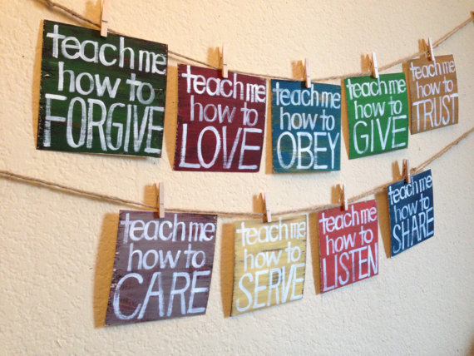
Grace in a fallen environment
Questions from Discussion Forum
Why does the concept of grace make so much sense but is so hard to live out?
From what I have read and seen in my practicum, how do we get parents to participate in their child’s life and help them do good in school?
What would be an example of giving a student grace when they really deserve to be disciplined? How do you balance grace and discipline? Does this look different in elementary schools and secondary schools?
- How do teachers avoid “creating an atmosphere where performance is the name of the game” while still achieving order and high test results?

Slide 13
Grace in a fallen environment
Questions from Discussion Forum
Applications outside of education?

Slide 14
Grace applied to the Christian & public environments Think-pair-share: Pairs pick one
In what ways can you see Graham’s ideas working well in a Christian school environment?
In what ways can you see Graham’s ideas working well in a public school environment?
In what ways can you see Graham’s ideas working well in a Christian work environment (other than school)?
In what ways can you see Graham’s ideas working well in a public work environment (other than school)?

Slide 15
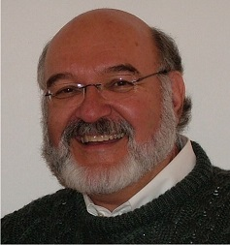
Graham Keynote speeches Heartland convention 2015 Think-pair-share coming up
Are we treating students as full image bearers? OR are the (4) things we hold highest (worshipping?) getting in the way of seeing students for who they are and not just what they do?
Do we practice reductionism?
“Majoring in the minors”
Do we lose sight of the big questions:
Who am I?
Will I be OK?
What am I to be about in life?
If so, what do we end up focusing on instead?

Slide 16
Graham Keynote speeches Heartland convention 2015
Do we put too much faith in grades?
Does our grading promote legalism? Do we end up worshipping legalism?
Seduces students into thinking they are what they do?
Do we put too much emphasis on moralism?
Does this over-emphasize “correct” behaviors?
Again? Seduces students into thinking they are what they do?
Do we worship excellence? Especially in our school websites and marketing?
Is this getting in the way of redemptive witnessing for reconciliation?
Again – putting the emphasis wrongly on what we do?

Slide 17
Think-pair-share:
Which, in your experience, do we worship the most at the expense of receiving and passing on God’s grace in the classroom?
Reductionism (losing sight of the big, important questions for students)
Grades
Excellence
Moralism
Any other idols?

Slide 18
Helpful truths & Assurances
Psalm 19:1 (NIV)
The heavens declare the glory of God; the skies proclaim the work of his hands.
Philippians 4:8 (NIV)
Finally, brothers and sisters, whatever is true, whatever is noble, whatever is right, whatever is pure, whatever is lovely, whatever is admirable—if anything is excellent or praiseworthy—think about such things.
Galatians 6:14 (NIV)
May I never boast except in the cross of our Lord Jesus Christ, through which the world has been crucified to me, and I to the world.
2 Corinthians 13:14 (NIV)
May the grace of the Lord Jesus Christ, and the love of God, and the fellowship of the Holy Spirit be with you all.

Slide 19
Groups of 3-4:
What does Image of God mean for Graham? (e.g., p. 3, etc.)
What does grace mean for our view of (pick 2)…
truth, values, aesthetics, the student, the teacher, the curriculum, the purpose of education, work/calling
Which of our –isms (find 2-3) help shed light in a general revelation way (God’s Word in Creation) on Graham’s 3 questions that students and teachers ask:
Who am I?
Will I be OK?
What am I to be about?
Think of a specific recipe or other set of how-to instructions that you find analogous to the philosophy-building process. How has that recipe or set of instructions undergone change over time?

Slide 20
Building a Christian Philosophy of Education Graham Part 2
4. Teachers as Image Bearers
5. Teachers as New Creations
6. The Calling of a Teacher

Slide 21
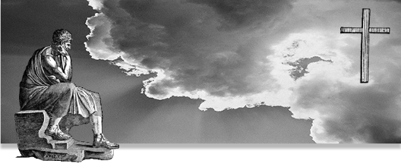
Chapter 4 Teachers as image bearers Think-pair-share: Pairs pick one
How do teachers show that they are image bearers of God?
How do they help students experience being image bearers of God?
Does image bearing have implications for curriculum choices, classroom management approaches, teacher authority, view of calling and work, and overall view of the student?

Slide 22
Questions from the forum--Image
How can teachers infuse education with their individuality as well as foster each students individual specialties when the curriculum is "standardized" to a national average? Is there any room for individuality in public schools?
How does diversity in the classroom affect your future as an educator?
When we have students who are being raised to believe they are not important or not smart, how much can we actually say that goes against that? Couldn't we get into trouble if we are going against how the parents want their child(ren) to be raised?

Slide 23
Chapter 5 Teachers as a New Creation Think-pair-share: Pairs pick one
How do teachers show that they are a new creation (a recipient of God’s grace)?
How do they help students experience being a new creation (and having the new freedom that that entails)?
Does new creation have implications for curriculum choices, classroom management approaches, teacher authority, view of calling and work, and overall view of the student?

Slide 24
Chapter 6 Teacher’s calling Think-pair-share: Pairs pick one
How do different views of the teacher’s calling have different effects in the classroom?
How does the teacher’s sense of calling affect the students’ sense of their own calling?
Does the concept of calling have implications for curriculum choices, classroom management approaches, teacher authority, view of work, and overall view of the student?

Slide 25
Questions from the Forum--Teacher
Is it easier for a teacher to talk too much about his/her sinful nature or not talk about it enough? Is it healthy to talk about your flaws with people that haven’t had the same life experience as yourself?
What is the best way to discipline student through grace?
How do we keep patient with students and not judge them or give up on them, especially when there is zero progress being made?
Why do Christian educators in pubic schools seem to know so little about what they can say and what they cant say or do? is this lack of knowledge of their rights contributing to a thought that they cannot teach Christianly in a public school?

Slide 26
Questions from the Forum--Teacher
Small groups (education majors get with someone who’s not an ed. major):
5. Personally, how would you answer the questions:
Who am I?
Will I be OK?
What am I to be about?

Slide 27
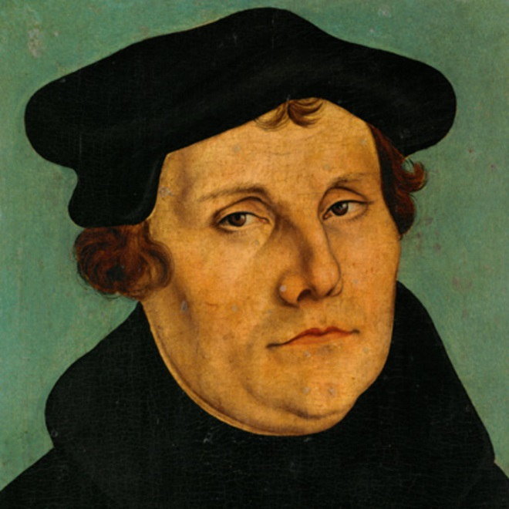
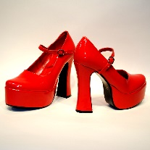
Martin Luther
“The Christian shoemaker does his duty not by putting little crosses on the shoes, but by making good shoes, because God is interested in good craftsmanship.”
~ Think-Pair-Share:
How can you apply this statement to Christian teaching?

Slide 28
Christian views of the curriculum
In groups, discuss these two question regarding the article: Christian Views of the Curriculum
Do either A or B:
Pick 2 of the 4 cases at the end of the handout, identifying examples of each of the 2 cases in your own schooling.
Pick 1 of the 4 cases and give a detailed description of what this would look like in a real school – give both pros and cons.
How do the views of curriculum that you discussed imply different purposes of education and different views of the student, of the teacher, and of the sense of calling and future vocations?

