Slide 1
Week 10 Knight Chapter 10 Personal PoE & Christian Approach
Dr. S. Holtrop
Fall 2017

Slide 2
Assignments | Points | Progress
Weekly discussion forums on the readings | 10 | 9 10 11
Group presentations | 25 | 2
Midterm Test | 100
Sections of Philosophy Paper | 10 | 3 4 5 6
Drafts of Philosophy Paper | 25, 105 | 1 2
Peer responses on Philosophy Paper | 5 | 1 2

Slide 3
Week | Read | Assignments Due
Week 10 Nov. 7 | Read Knight, Chapter 10 (45 pp.). Read articles & PPT on calling. | Section 2 of paper due: View of curriculum Do Discussion Forum 8 (see new options).
Week 11 Nov. 14 | Read Graham, Part 3 (35 pp.). Read Knight, Chapter 11 (15 pp.). Read articles & PPT on views of the teacher and classroom management. | Section 3 of paper due: View of calling/work. Do Discussion Forum 9.
Nov. 21 | No class. Thanksgiving week. Read articles & PPT on views of the student and diversity. | Section 4 due: View of the teacher. No discussion forum.

Slide 4
Week | Read | Assignments Due
Week 12 Nov. 28 | Read Graham, Part 4 (39 pp.). Read articles & PPT on views of truth. | Section 5 due: View of the student. Do Discussion Forum 10.
Week 13 Dec. 5 | Read Graham, Part 5 & 6 (46 pp.). | Section 6 due: Worldview. Do Discussion Forum 11.
Week 14 Dec. 12 | No readings. | Group presentations on teaching methods. Paper Primo due for peer reviews Dec. 12. Peer reviews due Dec 15. See Canvas.
Exam Week Dec. 19 | No exam. | Finish group presentations? Revised paper due on Dec. 19 (Tue) at midnight.

Slide 5
Prevailing metaphors in your view of curriculum papers
Groups of 3-6 students
Combine all your papers into one document.
Paste that document into WordItOut.com.
Display your Word Map for the class to see.
Send me a screenshot

Slide 6
Building a Christian philosophy of education
What is your biblically-based view of…
What is real (metaphysics)
Truth, what is knowable (epistemology)
Values - ethical and aesthetic (axiology)
The student (image of God, calling)
The teacher (calling, image of God)
The curriculum (truth or exploration?)
Purpose of education
Work (calling, incl. avocations)
What methods and curriculum choices can support this view? E.g.:
Content knowledge
Critical thinking skills & practice
Communication skills & practice
Problem solving skills & practice
Cooperative learning skills & practice
Citizenship/kingdom service skills & practice
Stewardship skills & practice
Glorifier of God skills & practice
Westminster Shorter Catechism
(What is the chief end of man?)
Belonging body & soul to Jesus Christ
Heidelberg Catechism
(What is your only comfort in life and death?)
Prophet, priest, and king
1 Peter 2:9
Is it OK that Christian education focused on Christian curriculum when the culture focused on curriculum and shifted more toward Christian student outcomes when the culture focused on student outcomes?

Slide 7
“Through-Lines” (used in some schools) Is the emphasis here on knowing or doing? Curriculum or student?
1. God-Worshipper: | Students will understand that worshipping God is about celebrating who God is, what God has done and is doing, and what God has created.
2. Idolatry-Discerner: | Students need to learn to 'read' a worldview by asking questions about what is being portrayed in regard to culture, values, and belief systems.
3. Earth-Keeper: | Students will respond to God's call to be stewards of all of creation.
4. Beauty-Creator: | Students will create beauty that praises God and enriches our world. Creation shouts that our God is a God who loves diversity, complexity, and creativity.
5. Justice-Seeker: | Students will act as agents of restoration.
6. Creation-Enjoyer: | Students will celebrate God's beautiful creation and give testimony to the presence of God in creation.
7. Servant-Worker: | Students will work actively to heal brokenness and bring joy to individuals and to culture.
8. Community-Builder: | Students will be active pursuers and builders of community in their classrooms, their neighborhoods, and in the global village they are a part of.
9. Image-Reflector: | Students bear the image of God in their daily lives. Being an image-bearer isn't something we DO. It is deeper than that. Image-bearer is something we ARE. We reflect God's image and we learn to see God's image in others.
10. Order-Discoverer: | Students see God's fingerprints all over creation.
See also: http://www.christian.fmpsdschools.ca/Teaching%20For%20Transformation.php (Fort McMurray Christian School, Fort McMurray, Alberta)

Slide 8
Different Christian Approaches
 | Christianity Against Culture | Christianity Embracing Culture | Christ Transforming Culture
View of the Student | Sinner, needs firm guidance and discipline | Potentially perfect human, inherently curious “image of God” that resembles humanistic blank slate | Responsible agent, can become a positive agent of change in God’s creation
View of Knowledge & the Curriculum | Stick to the classics – less risk of being tainted by the world, “integrated” curriculum | Embrace modern curriculum & methods, Christianize them, focus on acting out faith in social justice projects | Learning how to live out a biblical worldview in all areas of life—real issues. Don’t shun culture or try to Christianize it.
View of the Teacher | Authoritarian, knowledge expert | More permissive, fellow traveler, “guide on the side” | More experienced, expertly trained coach with divine calling—authoritative, situational management
View of Work & Avocations | Training for a job – maybe a “good” job to be able to support family & church obligations. Avocation is often evangelistic. | Do everything to the glory of God, focus on excellence, enjoy the blessings you’ve earned | Different opportunities to transform/redeem culture instead of shunning it or just accepting it.

Slide 9
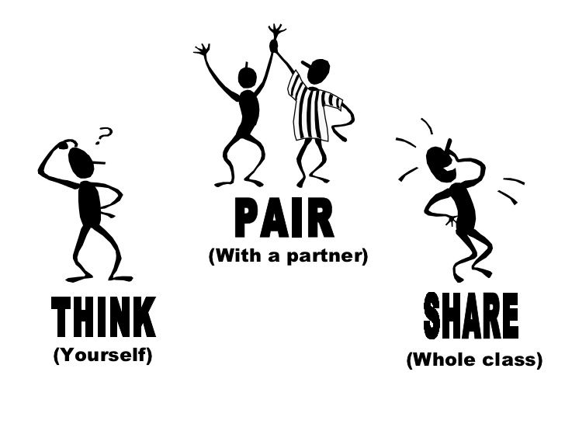
Student Questions ~ Teaching as Ministry ~ do 1 Q this slide + 1 Q next 2 slides
What are some ways a teacher can try to build a relationship with students? Students come from all aspects of life, like we talked about last class, how can a teacher that can’t really relate to some of the students home life, what should the teacher do then?
What time is the right time to stop being conservative and do more of the revolutionary aspect?
How can teachers get students to recognize they are fallen in subjects such as mathematics?
Is their more to teaching Christianly than just “loving God’s children”?
If you had Christian education, do you think that it helped during your formative years direct you to God?

Slide 10
Student Questions ~ Teaching as Ministry ~ do 1 Q this slide + 1 Q next 2 slides
Do you feel that your school prepared you more in one way than the other (for a career role and a ministry role)?
What type of school needs the most ministry?
What was the best way that a teacher implemented Christian values into the classroom?
Is it really okay to go as far as to say that pastors and teachers have the same jobs, just to different audiences? Knight is trying to say that they are the same.
If Christian teachers are supposed to be like pastors, should we take more theological classes?

Slide 11
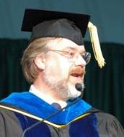
Prof’s Questions ~ Teaching as Ministry
Why is the view of the student so crucial for all of this? Is the student good or bad?
How is the following statement different from what is typically meant by “mission”?
“The entire process entails a restoration of the image of God in individuals through the agency of the Holy Spirit. Education is one arm of God’s restorative and reconciling effort. It may therefore be seen as a redemptive activity.” (p. 207)
Look at the primary and secondary purposes of education on p. 213. How do these work together?
Are students better equipped to be reconcilers if we have addressed their character development, knowledge acquisition, job preparation, and their social, emotional, and physical health? Do these things make them more spiritually healthy and able to work toward reconciliation in God’s kingdom?

Slide 12
Student Questions ~ Christian view of Curriculum~ do 1 Q this slide + 1 Q next 2 slides
How then do we balance this, teaching curriculum, and helping students be the best they can be?
Which ‘isms’ best fits the Christian view of education? Or do multiple views fit with the Christian view?
- In a Christian school, should faith be emphasized on its own or through the use of subjects? If through subjects, should it be all subjects?
In teaching, are you supposed to base everything off of the bible- like use scripture?
Infusing the bible into all subjects seems to be easier said than done, what would be a real life example of a teacher infusing a subject/lesson with the bible without sprinkling a little Christian perspective at the end? Did anyone have a teacher that did a good job of this?

Slide 13
Prof’s Questions ~ Christian view of Curriculum
Explain these quotations:
“Nuclear physics is not explained in the Bible. That, however, does not mean that nuclear physics is not connected with God’s natural laws and that it does not have moral and ethical implications…” (p. 225).
“Much truth exists outside of the Bible, but it is important to note that no truth exists outside the metaphysical framework of the Bible.” (p. 226)
Special and general revelation – “both shed light on each other, since all truth has its origin in God.” (p. 228)

Slide 14
Prof’s Questions ~ Christian view of Curriculum
What insights can you gain from Knight’s methods section (pp. 245-253) for teaching strategies in your content area?
What’s the “informal” (or “hidden”) curriculum (p. 240)? The “null” curriculum (p. 242)?
Explain this quotation: “Christian education and the Christian school must therefore be seen in terms of both the conservative and revolutionary roles of Christianity.” (p. 254)

Slide 15
Knight’s approach to teaching literature ~ replicate in content area groups (PE, Business/Math, Biology, Social Studies/Hist/PoliSci, The Arts)
Decide which parts of the content area to include in the curriculum (p. 229). In literature, this means deciding which short stories, poems, novels, and plays to study. What does this mean in your group’s assigned/chosen content area? Give some specific examples of age-appropriate and restoration-appropriate content and how you decided to include this content.
Knight implies that reading literature just for escape, enjoyment, or to be “educated” is misguided and is not the main point (p. 231). What aspects of learning your content area are analogous to these misguided aspects of studying literature? What *is* the main point of studying your content area?
Knight says, “The study of literature in a Christian institution can be richer than similar study in non-Christian institutions” (p. 232). Can you say the same about your content area? Why?

Slide 16
Knight’s approach to teaching literature ~ replicate in content area groups (PE, Business/Math, Biology, Social Studies/Hist/PoliSci, The Arts)
Knight says, “The essential thing in literary study is not the passing on of a body of knowledge, but the development of a skill—the ability to think critically and to interpret literary insights from the perspective of the biblical worldview” (p. 233). What would be the essential thing in your content area?
Knight says worldviews are often subliminal and accepted without challenge (p. 234). Some examples: The purpose of studying literature can be assumed to be (a) finding a moral lesson in the literature, (b) identifying the values and styles of the period in which something was written, or (c) allowing each reader to have an individual, unique experience with the literature and its effect on the individual reader’s life. What are some widely accepted “biases and assumptions” (p. 238) in your content area? How can a biblical framework (p. 237) help avoid hidden biases and assumptions in your content area?

Slide 17
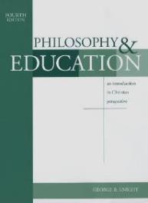
Final Knight quotations
“Even the search for correct doctrine and a unified theology can become a game that shuts us away from God. The only integration point for the Christian individual and the Christian school is Jesus Christ.” (p. 244)
“Life is meaningless outside of Christ…. People profit nothing if they gain the whole world and lose their souls. From this perspective, Christian educational goals are broader than those of secularized education, since Christian education seeks to prepare the young for both the present world and the world to come.” (p. 259)
The incarnate Word is with us, is still speaking, is present always, yet leaves no sign but everything that is.
--Wendell Berry

