Slide 1
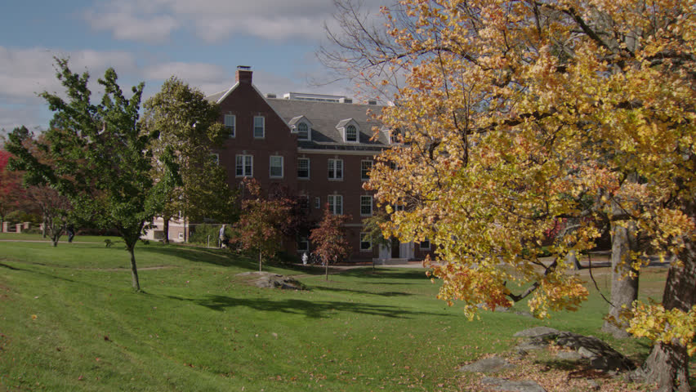
Various views on calling and work ➔ in our culture
Maximize income & minimize effort
Learn to avoid life’s pitfalls
Be all you can be
Collect the most toys
Live for the present
Be a well-rounded person
Be clever
Life is the journey not the destination
Learn to be rather than do
Use your gifts for God’s kingdom
Be a child of God

Slide 2
Christian perspectives on calling ➔ Christianity against culture
Rejects culture’s emphases on living for the moment, just having fun, finding yourself
Not always concerned about what the political-consumer-industrial complex wants
But very concerned about what the family and/or church wants
Emphasizes:
Duty, life is tough
Don’t be idle
Work hard as an act of worship (or necessity or penance)
Provide for one’s family
Contribute financially to the church (and perhaps the community)
Manual laborers are the “salt of the earth”—good, honest people
Sweat and toil are necessary
Still influenced by secular pragmatism (and somewhat by essentialism, perennialism):
Preparing for a “good job” may be worth the time and cost
Do a cost-benefit analysis to make sure the job is worth the educational sacrifice
Parable of the Talents taken quite literally

Slide 3
Christian perspectives on calling ➔ Christianity embracing culture
More progressivist, student-centered
Emphasizes freedom over responsibility
Work is more communal, social, holistic (less purely pragmatic)
More than just earning a living
Contributes to the betterment of the human condition
E.g., artists help to beautify God’s world,
social workers help to right injustices
Earning money not only pays the bills but can allow enjoyment of other cultures and generous giving
Education is key in self-actualization
Be all you can be (with the unique gifts and personality God gives you).

Slide 4
Christian perspectives on calling ➔ Christ transforming culture
Emphasizes both:
Responsibility
Freedom (true freedom includes response)
Wolterstorff: Educating for Responsible Action (1980)
responsible action toward society, to right injustices, and to use the gifts that God has given us in some kind of service (calling) for God
Teachers model this

Slide 5
Christian perspectives on calling ➔ Christ transforming culture
Education helps students identify what role (what part of the body of Christ) they are called to have.
Preparing head, heart, and hands (Beversluis)
All Christians are working in “full-time Christian service.”
Learn to see injustices and unmask rationalizations (Wolterstorff)
More than just working diligently to support our families
More than just narcissistically nurturing our God-given talents
Calling is more than paid work –it’s the whole package that God invites us into

Slide 6
Summary: Different Christian Perspectives on Making Disciples in the Educational Environment Christianity Against, X-ity Embracing, or X Transforming Culture
Rejecting Culture
“Baptizing”
Faith over Reason
Student as sinner
Teacher as controller
Curriculum centered
Head knowledge?
Called to duty
Truth: theology over science
Assimilating Culture
“With you always”
Reason not affected by faith
Student as explorer
Teacher as accommodator
Student centered
Heart knowledge?
Called to freedom
Truth: science locates the Biblical truths
Transforming, Kingdom building
“Teaching”
Faith-Reason mutually infused
Student as responsible agent
Teacher as collaborator
Teacher, curriculum & student in creative balance
Called to action, to respond, to discern (head, heart, and hands)
Truth: best understood in faithful, relational service to “the way, the truth, and the life.”

Slide 7
Group Topic: View of Calling and Work
List a few views of calling and work that you can think of.
Groups pick one of the views of calling and work: Maximize income & minimize effort, learn to avoid life’s pitfalls, be all you can be, live for the present, be a well-rounded person, be clever, life is the journey not the destination, learn to be rather than do, use your gifts for God’s kingdom, be a child of God
Brainstorm and write a sentence expressing this view of calling/work.
Find articles or educational resources online that illustrate this view of calling/work.
Evaluate the pros and cons of this view from a biblical stance.
Write a sentence that describes your group’s consensus for now on your view of calling/work.
What implications does this view of calling/work have for your view of the student, teacher, curriculum and purpose of education?

