Slide 1
Various views of the teacher ➔ in our culture
Shepherd
Cop
Content expert (sage of the stage)
Facilitator (guide on the side)
Babysitter
Coach
“Those who can, do; those who can’t, teach.”
Fellow traveler
Experienced guide
Someone whose 3 best parts of the job are June, July, & August
Trainer
Seed planter

Slide 2
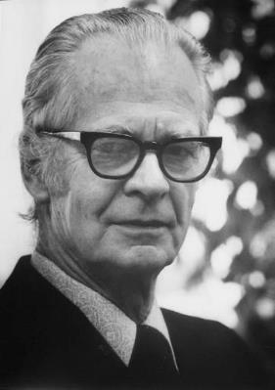
Christian perspectives on the teacher ➔ Christianity against culture
The culture is sinful, the student is sinful, theories about innate goodness of children are sinful.
Teacher must control sinful, often spoiled students
Learn strategies for controlling students: classroom management plan
Discipline is strict to maximize producing solid citizens, hard workers, decent bosses, and faithful family and church members if at all possible.
Teaching is “controlling” (management theory) and converting.
Curriculum-centered: curriculum is to be “covered.”
Teaching as “tent making,” being “salt and light” in the “moral wasteland” of the public schools.
Undercover evangelists in the public schools.
Christian education may eliminate a lot of bad influences from peers and godless curriculum materials, but it doesn’t eliminate the basic fallenness of students.
B.F. Skinner (1904-1990) psychologist, social philosopher, Father of Behaviorism
Notes:
Teacher must control sinful, often spoiled students
Learn strategies for controlling: classroom management plan, reward system, eyes in the back of your head, don’t smile till Christmas, etc.
Skinner
Teaching as “tent making,” being “salt and light” in the moral wasteland of the public schools. Undercover evangelists in the public schools.
Teaching is controlling and converting. Curriculum is to be “covered.”
Students are just part of a creeping evil in our educational system and culture.
Discipline is strict to maximize producing solid citizens, hard workers, decent bosses, and faithful family and church members if at all possible. In this view, Christian teachers are stricter than others.
Christian education may eliminate a lot of bad influences from peers and godless curriculum materials, but it doesn’t eliminate the basic fallenness of students.

Slide 3
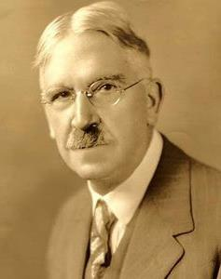
Christian perspectives on the teacher ➔ Christianity embracing culture
Embracing of many foci in humanistic and progressivist philosophies.
More student-centered than curriculum-centered.
Focus on biblical freedom more than on sinful nature.
Classroom guidelines and principles rather than a long list of rules and consequences.
More choice and creativity built into the daily lesson plans.
Teacher is more of a facilitator or guide than a traditional authority figure.
More on “accommodating” (management theory) student interests and differences, less on controlling them.
Say: Well, what do you think? Instead of: No, that’s wrong.
More two-way, less judgmental role:
Writing conferences, process approach, flipping the classroom, cooperative learning, whole language.
Focus on students’ unique potential, despite their limitations and challenging home lives.
Heavily influenced by humanism and progressivism.
Locke, Rousseau, Montessori, Dewey, Glasser, Illich, Holt.
John Dewey (1859-1952) Educator, University of Chicago
Notes:
Embrace of many foci in humanistic and progressivist philosophies.
More student-centered than curriculum-centered.
More on accommodating student interests and differences, less on controlling them.
Focus on biblical freedom more than on sinful nature.
Classroom guidelines and principles rather than a long list of rules and consequences.
More choice and creativity built into the daily lesson plans.
Teacher is more of a facilitator or guide than a traditional authority figure.
Say: Well, what do you think? Instead of: No, that’s wrong.
More accommodating, less judgmental role: writing conferences, process approach, flipping the classroom, cooperative learning, whole language.
Focus on students’ unique potential, despite their limitations and challenging home lives.
Heavily influenced by humanism and progressivism.
Locke, Rousseau, Montessori, Dewey, Glasser, Illich, Holt.

Slide 4
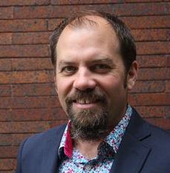
Christian perspectives on the teacher ➔ Christ transforming culture
Acknowledges students’ sinful nature and boundless God-given potential.
Teacher chooses curriculum and methods to maximize growth
(Vygotsky, constructivism, scaffolding)
Intimate knowledge of and relationship with the students: Understand learning styles, developmental stages, personality types, home environments.
Repertoire of strategies, breadth of content knowledge –brings curriculum and psychology together to maximize growth.
Holy Spirit guides, individualized approaches if necessary.
Collaborating (management style) with each student. Not controlling, not accommodating.
Disciplining is proactive, discipling.
Life coaching: Jamie Smith (2009) says, we’re not just informing students, we’re helping to form them.
Intellectually, morally, affectively, spiritually, creatively, holistically
Teachers have a profound influence on young lives and can profoundly help coach young people toward God’s calling in their lives and toward God’s team building and toward God’s transformation of culture.
James K.A. Smith
Calvin College
b. 1970
Notes:
Acknowledges both the sinful nature and boundless God-given potential of the student.
Teacher chooses curriculum and methods to maximize growth (Vygotsky, constructivism, scaffolding)
Understand learning styles, developmental stages, personality types, home environments.
Repertoire of strategies, breadth of content knowledge –brings curriculum and psychology together to maximize growth.
Holy Spirit guides, individualized approaches if necessary.
Collaborating with each student. Not controlling, not accommodating.
Disciplining is proactive, discipling.
Life coaching: Jamie Smith (2009) says, we’re not just informing students, we’re helping to form them.
Intellectually, morally, affectively, spiritually, creatively, holistically
Teachers have a profound influence on young lives and can profoundly help coach young people toward God’s calling in their lives and toward God’s team building and toward God’s transformation of culture.

Slide 5
Summary: Different Christian Perspectives on Making Disciples in the Educational Environment Christianity Against, X-ity Embracing, or X Transforming Culture
Rejecting Culture
“Baptizing”
Faith over Reason
Student as sinner
Teacher as controller
Curriculum centered
Head knowledge?
Called to duty
Truth: theology over science
Assimilating Culture
“With you always”
Reason not affected by faith
Student as explorer
Teacher as accommodator
Student centered
Heart knowledge?
Called to freedom
Truth: science locates the Biblical truths
Transforming, Kingdom building
“Teaching”
Faith-Reason mutually infused
Student as responsible agent
Teacher as collaborator
Teacher, curriculum & student in creative balance
Called to action, to respond, to discern (head, heart, and hands)
Truth: best understood in faithful, relational service to “the way, the truth, and the life.”

Slide 6
Various views of the teacher ➔ What’s your metaphor for the teacher and why?
Shepherd
Cop
Content expert (sage of the stage)
Facilitator (guide on the side)
Babysitter
Coach
“Those who can, do; those who can’t, teach.”
Fellow traveler
Experienced guide
Someone whose 3 best parts of the job are June, July, & August
Trainer
Seed planter

