Slide 1
Graham Parts 5 & 6 + finishing Part 4
EDUC 300 / CORE 310
Philosophy of Education
Fall 2017 Dr. S. Holtrop

Slide 2
Classroom Behavior and Discipline (pp. 129-137)
Group Discussion
Topic 1
Task-focused vs. relationship-focused (p. 129)
Classroom management (“systems of rewards and punishments” p. 129) vs. Graham’s “a better approach” (p. 130)?
Compliance vs. True Community
Ensuring student “compliance” can include both “nice” teaching and “mean” teaching—enticing rewards and entertaining distractions keeping students from acting out or dire consequences guaranteed for acting out.
But Graham advocates “moving beyond compliance” (p. 130) to “true community” (pp. 131-133).
Role of the learner vs. role of teacher in a true community classroom (pp. 133-135)
“Teaching redemptively” (pp. 135-137 – example of the “cast” sheep)

Slide 3
Classroom Behavior and Discipline (pp. 129-137)
Group Discussion
Topic 1
Would you say Graham is more task-focused or relationship-focused in his philosophy of classroom management? (p. 129)
What does he seem to think of “systems of rewards and punishments”? (p. 129) Why does he think this way?
Recall a teacher you had that seemed to focus more on the fallen nature of the students (p. 130). What was that classroom like?
Did you ever have a teacher who seemed to focus most on the “created potential” of students instead of their fallenness (p. 130)? What was that classroom like?
Have you had teachers who seem successful with what Graham calls “a better approach” (p. 130)? What were those classrooms like?
What do you see as the role of the learner and the role of teacher in a true community classroom (pp. 133-135)?
How does a compliance approach “undermine the Gospel” (p. 135)?
What does “teaching redemptively” mean for you? (pp. 135-137)

Slide 4
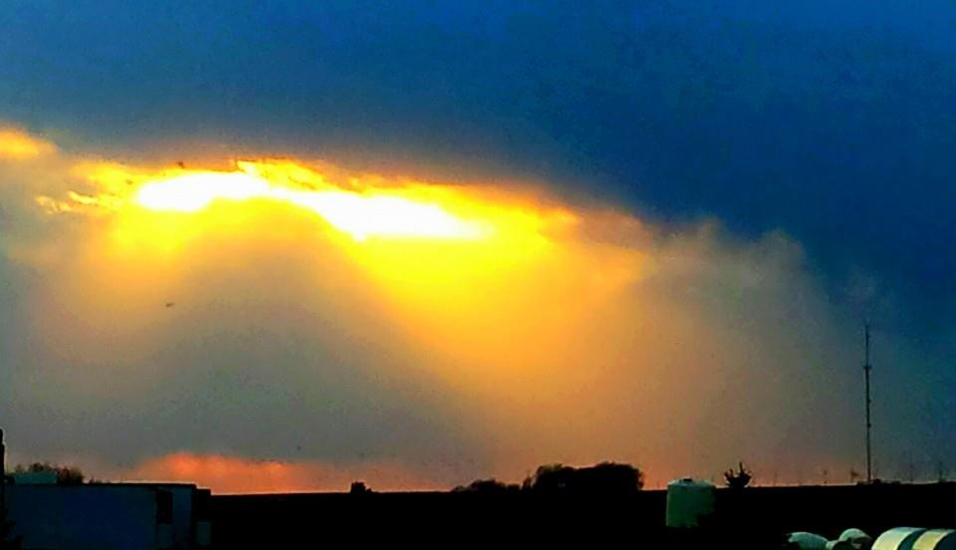
Advice from Graham
Avoid the teacher’s lounge
Be in conversation with God (vs. be right with God)
Rest in Jesus.
Be in partnership with the Spirit to avoid “performance” and “productivity” problems (p. 149).
Be in the moment (like Graham at his monastery experience, p. 152).
Don’t ignore the Sabbath.
Find a safe place.
Find soul friend(s).
Get a small group.
Examine your life.
It’s never too late to change things. [But it’s best to start off with good habits.] (Teachers under stress revert to how they were taught.)
Start small – one unit/ subject/class period at a time.

Slide 5
Part 5: Being a friend with God—Chap. 15 John 15: 12-17
"My command is this: Love each other as I have loved you. Greater love has no one than this: to lay down one’s life for one’s friends. You are my friends if you do what I command. I no longer call you servants, because a servant does not know his master’s business.
Instead, I have called you friends, for everything that I learned from my Father I have made known to you. You did not choose me, but I chose you and appointed you so that you might go and bear fruit—fruit that will last—and so that whatever you ask in my name the Father will give you.
This is my command: Love each other."

Slide 6
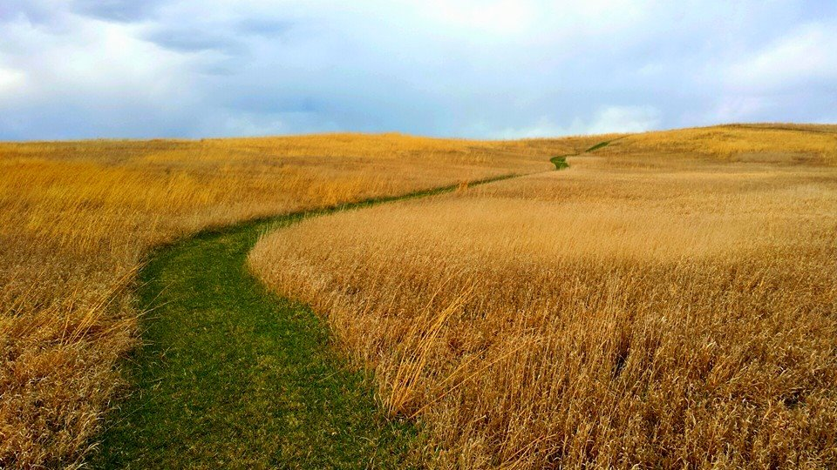
Part 5: Being a friend with God—Chap. 15
What are some standard ways we picture (think of) God? Why?
How does being a friend with God help someone be an effective teacher?
Do the biblical precedents (p. 142) seem to support the idea of being a friend with God? How do you feel about this idea?
The KJV uses the phrase “fearing” God. But Graham says he’s no longer afraid of God after becoming friends with God (p. 144). Is there anything to puzzle out about this?
What does Gary Moon mean when he says, “We settle for brief encounters instead of intimate dialogue and become content with the contract instead of enjoying communion.” (p. 145)?
Is your prayer time mostly about petitions or actual conversations? (p. 146)
Do you feel like you work for God or with God? (p 147)
Does it seem that God likes to engage your mind in helping to solve problems? (p. 148)
Do you tend to value productivity over rest? (p. 148). Do you have any really positive memories of “resting in Jesus”?
What aspects of this seem most relevant to teaching for you?

Slide 7
Part 5: Looking ahead ~ Faith development in adulthood (pp. 141-149)
Group Discussion
Topic 2
What is your view of God?
What picture would you pick to represent who God is to you?
Can you picture being a friend of God? (See John 15: 12-17 – next slide)
Why is your own relationship to God so important for a teacher?
What would Graham say?
What would your spiritual mentors say?
How does this prepare you to be a more effective teacher?

Slide 8
Intimacy with God
Group Discussion
Topic 2
What does it mean to you to be a friend of God?
What does this look like?
Is it a state or process? What does the state or process look like?
Work aspects?
Rest aspects?
Other thoughts?

Slide 9
Living in a Rhythm (pp 151-158)
Group Discussion
Topic 3
1. What’s the beauty of the rhythm?
2. What about the Sabbath?
3. What are some examples of ways to establish a personal and beneficial rhythm?
4. How will you get support for this?

Slide 10
You can’t go it alone (pp 159-165)
Group Discussion
Topic 4
What are the hazards of loneliness?
What’s the value of a safe place? Examples?
How can brokenness lead to community?
How can community come out of adversity and diversity?
How can you be open to a “soul friend”?
How can you see God in others on the job and in your personal life?
How can you be part of fostering hope for yourself and others?

Slide 11
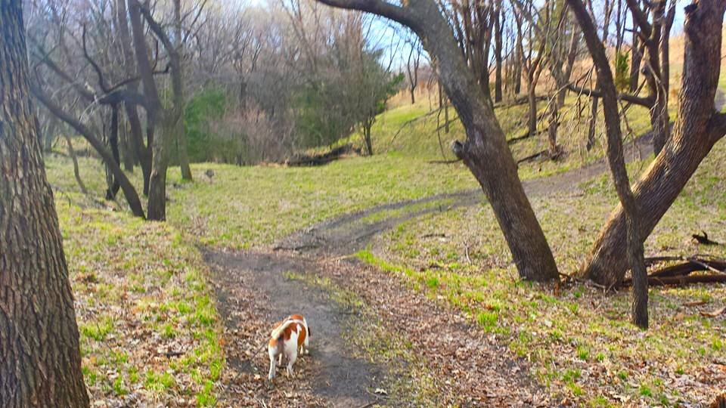
Examining your personal life (p. 170)
How would I characterize my “walk” with God? Truly intimate?
How did I get to where I am right now? Who and what influenced me?
How large is the gap between my head and my heart?
What are the peaks and valleys in my walk with God?
Is my prayer experience mostly asking and thanking or also conversations and listening?
How is grace “radical” in my life?
Do I rest easily and completely in the love of the Father? Truly intimate? Is there still fear in my life? How has my earthly father shaped my experience of my heavenly father?
Do I have a partnership with the Holy Spirit? Is it like a dance?
Do I view myself and others (e.g., students) as image bearers of God? Do I view myself and others being on a spiritual journey? What difference has this made?

Slide 12
Implementing change (pp. 169-184)
Group Discussion
Topic 5
What will you examine in your personal life?
people,
practices,
your classroom
What changes will you seek for your classroom?
resources,
barriers,
policies,
procedures,
planning, etc.
What are some ways to “start small”?

